Slide 1
Topic 13 Inheritance
R. Johansen 2021

Slide 3
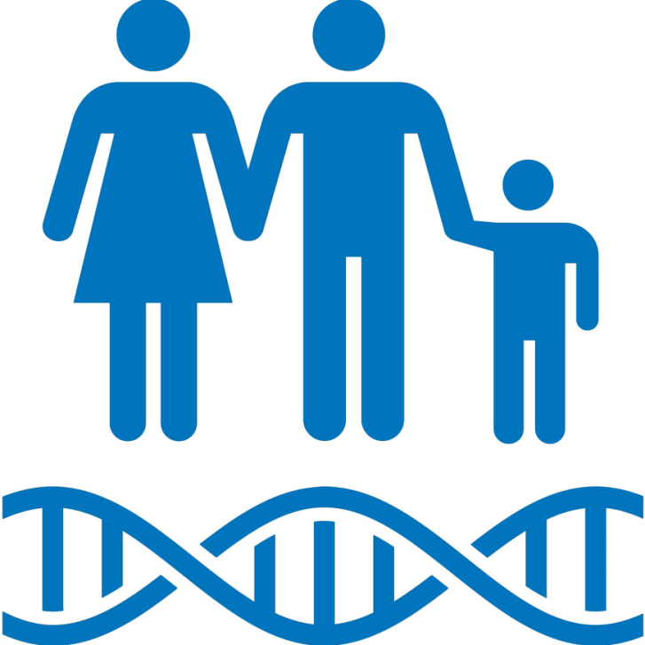
What is inheritance?
Genetic characteristics (traits) that are transmitted from parent to offspring.

Slide 4
Gregor Mendel
Prior to 1865 patterns of inheritance were identified but not clearly explained.
Gregor Mendel was the first scientist to provide a clear explanation of patterns of inheritance after studying traits in pea plants.
He proposed two principles:
Various hereditary characteristics are controlled by factors (genes) and these occur in pairs (alleles).
For example people with brown eyes may have the genotype BB or Bb
During the formation of gametes the pairs of factors (genes) separate. When gametes unite at fertilization the pairs of genes come back together. (The Principle of Segregation)
For example sperm and eggs with either carry a single ‘B’ or a ‘b’ allele for eye colour.

Slide 5
Watch
https://www.youtube.com/watch?v=Mehz7tCxjSE

Slide 6
Key terms
Some key terms when looking at Mendel’s genetics include:
Pure-breeding
Organisms that produce the same characteristic in each succeeding generation when bred amongst themselves (homozygous)
Hybrid
An offspring that results from mating two individuals with different genetic constitutions (heterozygous)
Dominant trait
The characteristic of shown by a hybrid
Recessive trait
The characteristic masked by the dominant trait

Slide 7
Monohybrid crosses

Slide 8
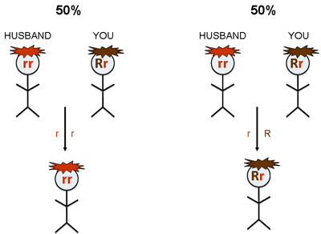
Monohybrid crosses
Cross = the mating of two organisms
Monohybrid cross = one pair of contrasting characteristics is studied at a given time.
For example: We may study patterns of inheritance for eye colour or hair colour (note: we do not study these together)

Slide 9
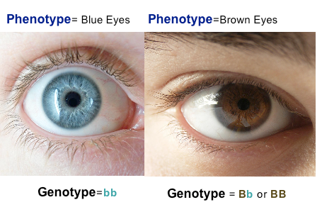
Genotype and phenotype
A persons genotype is the set of genes (represented by letters - alleles) that a person possesses.
An allele = the alternate form of the gene
A persons phenotype is the physical characteristic expressed by the person based on their genotype.

Slide 10
Dominant recessive inheritance

Slide 11
Genotype and alleles
Alleles = the alternate form of a gene
A person will receive one allele from their mother and another allele from their father for a particular gene. This makes up their genotype.
Alleles are represented by UPPERCASE and lowercase letters:
UPPERCASE LETTERS = DOMINANT ALLELE
lowercase letters = recessive allele
Inheritance that follows this pattern is know as dominant recessive inheritance

Slide 12
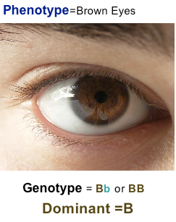
Genotypes - HOMOZYGOUS AND HETEROZYGOUS
Homozygous= A person has the same alleles for a particular characteristic (Pure-bred).
For example: A homozygous person with brown eyes has the genotype BB
Heterozygous = A person has different alleles for a particular characteristic. The characteristic expressed is the dominant allele (hybrid).
For example: A heterozygous person with brown eyes has the genotype Bb

Slide 13
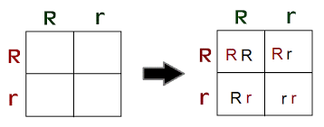
Punnett squares
Punnett squares can be used to determine patterns of inheritance
Note: whenever using punnet squares or identifying genotypes, you must ALWAYS identify what trait each letter represents!

Slide 14
Important rules when using punnett squares
When using punnett square for dominant/recessive inheritance you must:
Use the same letter. E.g. B or b
Use UPPERCASE and lowercase letters
Indicate what each letter represents. Eg. B = Brown eyes and b = blue eyes. This can be done next to the punnet square
When predicting genotypes, indicate whether homozygous or heterozygous
Remember that punnet squares only indicate the likelihood (ratio) of inheritance

Slide 15
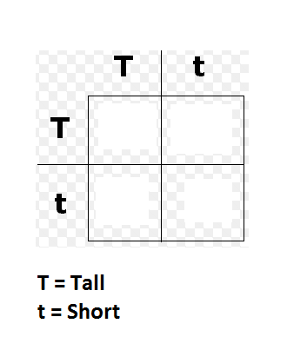
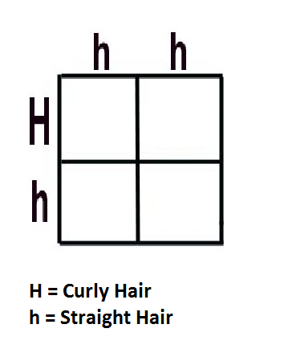
Your Turn…
For the following punnett squares:
Predict the possible genotype and phenotype of offspring
Predict the genotype and phenotype ratios/percentages for the offspring

Slide 16
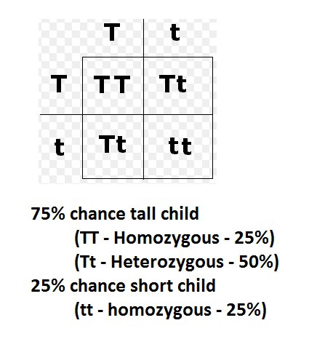
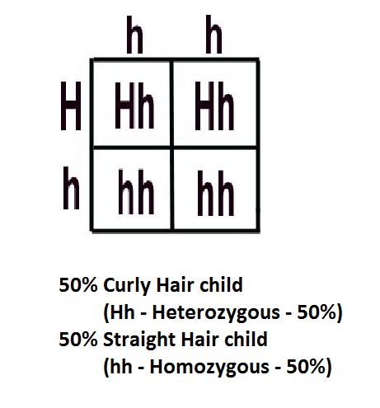
Check your answers…

Slide 17
Inherited traits
In your text book on page 391 is a list of dominant recessive inherited traits.
Copy this into your notes - you will need to be able to identify some of these!

Slide 18
Sex determination

Slide 19
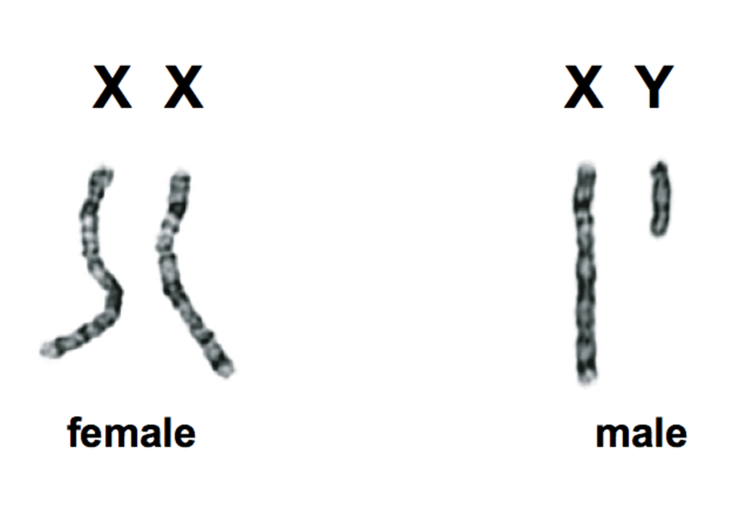
Sex Determination
The 23rd pair of chromosomes determine the sex of an individual
Males have an X and Y chromosome
Females have two X chromosomes
X chromosomes are larger than Y chromosomes

Slide 20
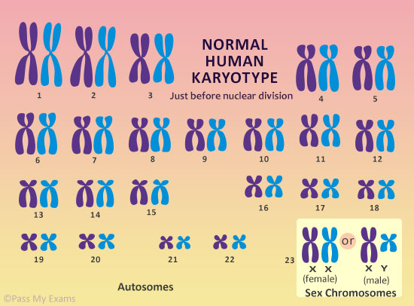

Slide 21
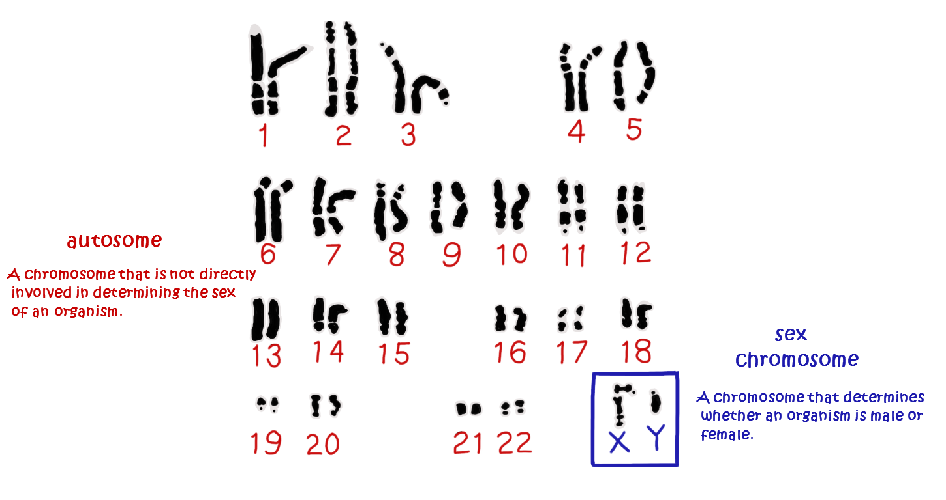
Sex chromosomes and autosomes
Sex chromosomes = the 23RD pair of chromosomes (XX OR XY). Determine the sex of an individual (male or female)
Autosomes (autosomal chromosomes) = The chromosomes that make up the first 22 pairs of chromosomes.

Slide 22
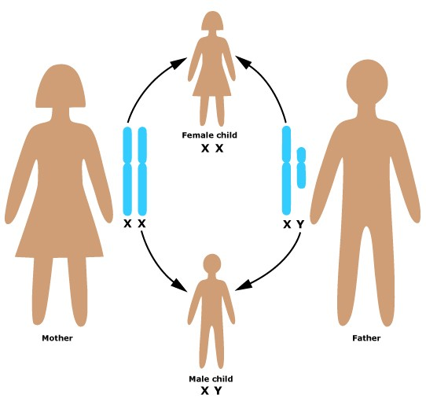
Thanks Dad!!
Males are responsible for determining the sex of their offspring….
Sperm can contain either an X or Y chromosome
Eggs can only contain an X chromosome

Slide 23
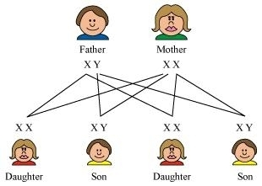

Slide 24
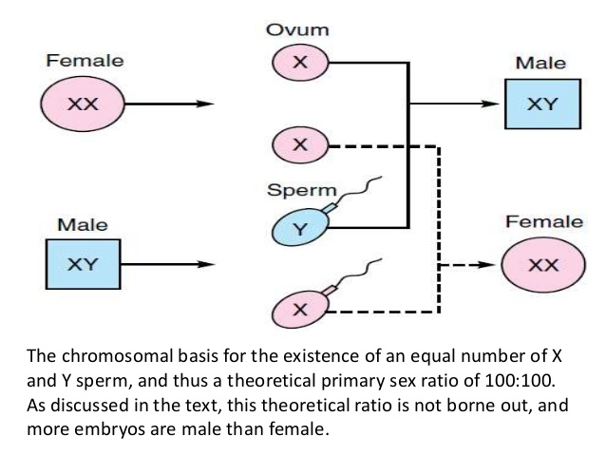

Slide 25
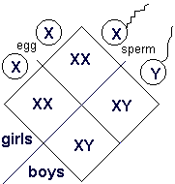
probability
The probability of a child being male or female is 50:50
Each time fertilization occurs there is a 50% chance the child will be male or female

Slide 26
Sex linked inheritance

Slide 27
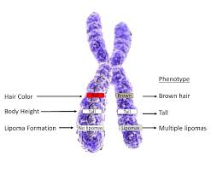
Sex linked characteristics
As the Y chromosome is smaller, it does not carry the same number of genes as the X chromosome
In females, normal pairing of alleles exists
In males, most genes on the X chromosome will lack a matching allele on the Y chromosome
The patterns of inheritance for characteristics carried on the X chromosome are different in males and females

Slide 28
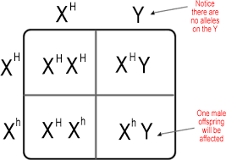
X linked punnett Squares
To determine the likelihood of offspring with an X linked disorder we use a punnett square
We use X’s and Y’s to represent gender (like a sex determination punnett)
Alleles are shown as superscripts on the X’s, no alleles are shown on the Y’s
UPPER CASE and lowercase letters are used to show dominant and recessive alleles

Slide 29
Genotypes
Females:
- Homozygous Dominant X^{T} X^{T}
- Homozygous Recessive X^{t} X^{t}
- Heterozygous (carrier) X^{T} X^{t}
Males:
- Hemizygous (dominant or recessive) X^{T} Y or X^{t} Y

Slide 30
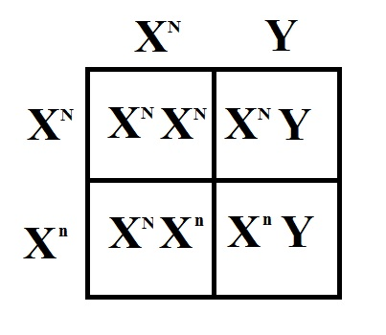

Slide 31
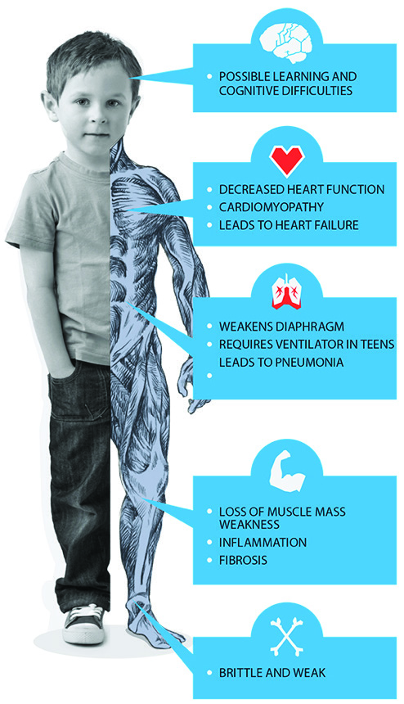
Common x linked disorders
Some common X linked disorders include:
Haemophilia
Red-Green colour blindness
Diabetes insipidus
Duchenne muscular dystrophy
See your text page 401 – 403 for more information on these.

Slide 32
Haemophilia
Relatively rare disease in which blood clots slowly or not at all
Defective allele to controlling normal blood clotting is recessive & carried on the X chromosome

Slide 33
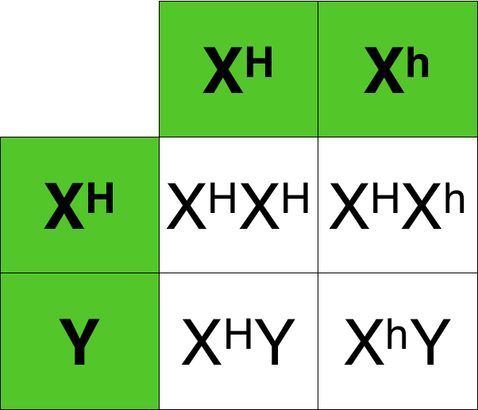
Haemophilia
Males: normal or haemophiliac, as they only have one ‘X’ chromosome
Females: Homozygous normal, heterozygous (carrier), or haemophiliac (homozygous)- this is very rare
Haemophiliac fathers pass this recessive gene to their daughters
Carrier mothers can pass defective gene to their sons (haemophiliac) or to daughters (carriers)
Example: Royal Family: Queen Victoria

Slide 34
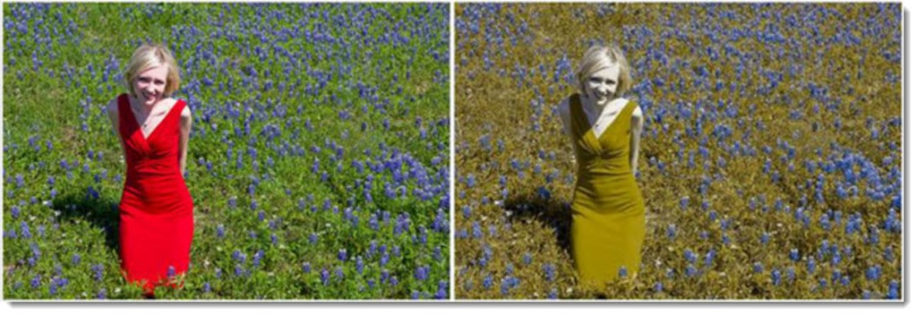
Red-green colour blindness
Ability to discriminate between red & green is controlled by a gene located in the X-chromosome
Individuals unable to distinguish between these colours possess the recessive allele of this gene
Gene is located on ‘X’ chromosome, therefore more frequently found in males than in females

Slide 35
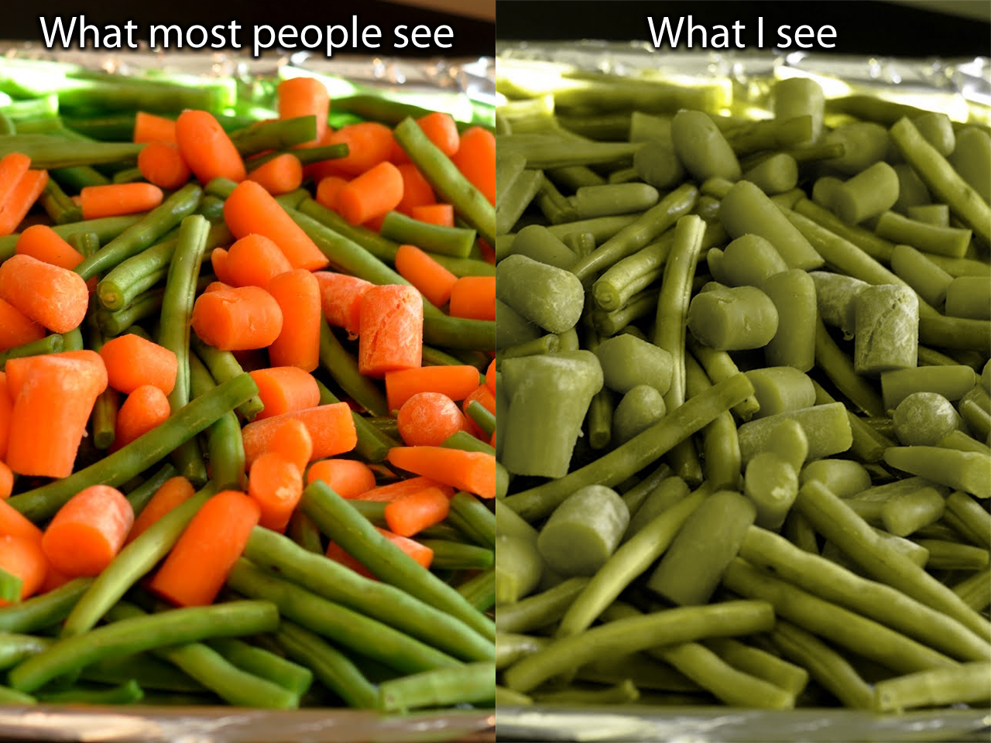

Slide 36
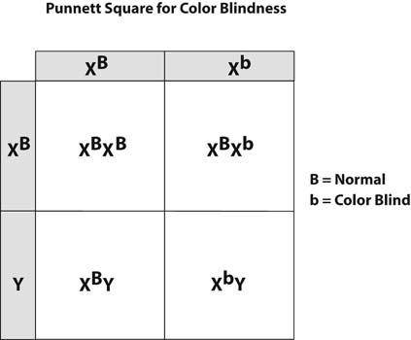

Slide 37
Duchenne muscular dystrophy
Wasting disease of leg muscles & later arms, shoulders & chest
At times may be due to a mutation- either in woman, making her a carrier, or in a boy, giving him the disease
Becomes apparent at around 3-5 years of age, when muscle weakness becomes evident
Muscle replaced by fatty substance as years pass
12-14 years: child confined to wheelchair & later bedridden
Have little chance of living beyond 20-25 years as respiratory failure eventually occurs

Slide 38
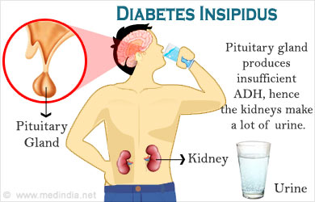
Diabetes insipidus
Individual passes very large quantities of urine, gradually becomes dehydrated
Death may result, unless water is available to replace that lost

Slide 39
Incomplete dominance

Slide 40
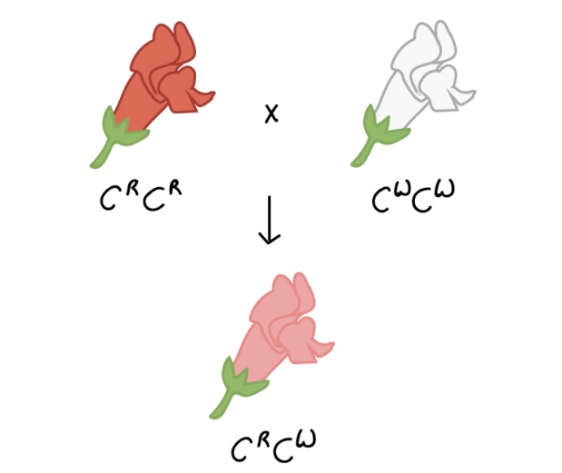
Incomplete dominance
There are some cases where the alleles of a particular gene are neither dominant or recessive….
This occurs when offspring show intermediate characteristics to those of their parents.
Can also be referred to as ‘blending’
When representing genotypes of incomplete dominant inheritance all UPPERCASE letters are used (as no allele is recessive)

Slide 41
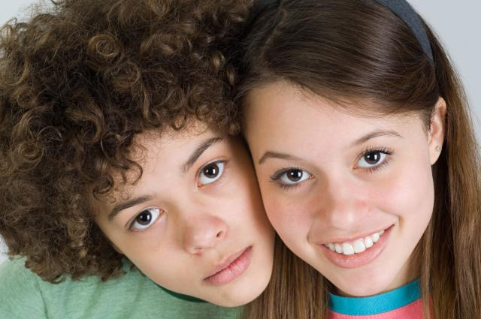
INCOMPLETE DOMINANCE
Hair type is an example of incomplete dominance:
Straight Hair = H^{S}H^{S}
Curly Hair = H^{C}H^{C}
Wavy Hair = H^{C}H^{S}

Slide 42
Co-dominance

Slide 43
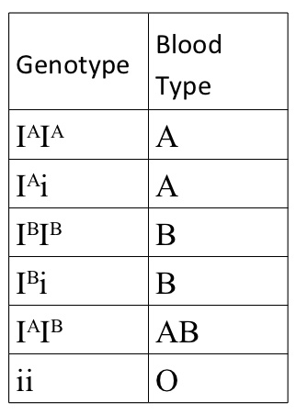
MULTIPLE ALLELES – blood groups
When there are more than two alleles for a particular characteristic.
Follow a co-dominant pattern of inheritance. Both traits are expressed.
Possible alleles for blood groups include:
Antigen A = I^{A}
Antigen B = I^{B}
No Antigen = i

Slide 44
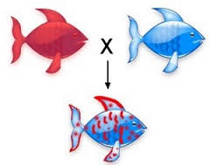
Co-dominance
Another example where the alleles of a particular gene are neither dominant or recessive….
Homozygous parents produce offspring that show characteristics of both parents

Slide 45
Mitochondrial dna

Slide 46
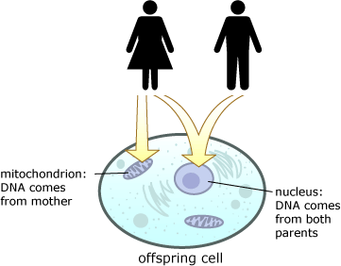
Mitochondrial dna
Mitochondria contain their own DNA (mtDNA)
Both eggs and sperm (gametes) contain mitochondria
Sperm have less mitochondria than eggs
After the sperm penetrates the egg, the mitochondria in the sperm are destroyed
Therefore mitochondrial DNA is only inherited from our mothers

Slide 47
Genetic diseases and populations

Slide 48
Genetic diseases and populations
Globally the population of people with recessive disorders that are not sex linked is usually low…
Geographically and culturally isolated communities are the exception
In these locations the population of people with rare recessive genetic disorders is higher

Slide 49
Genetic diseases around the world
Some genetic diseases that are common in certain geographical locations include:
Thalassemia
Defective formation of haemoglobin which leads to a build up of excess iron
Common in countries along the Mediterranean coast
Sickle-Cell Anaemia
Red blood cells are sickle shaped. Blood cells cannot carry as much oxygen as normal cells.
Advantage = degree of immunity to malaria
Common in Africa
Tay-Sachs Disease
Disorder of lipid metabolism. Lacking an enzyme which causes accumulation of fatty substances in the nervous system
Common in Eastern European Jewish populations

Slide 50
Pedigree charts

Slide 51
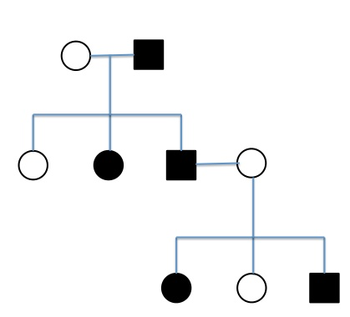
What is a pedigree?
A pedigree chart is also known as a family tree
Pedigrees show us phenotypes of individuals in a family
From the phenotypes, genotypes can be identified or predicted

Slide 52
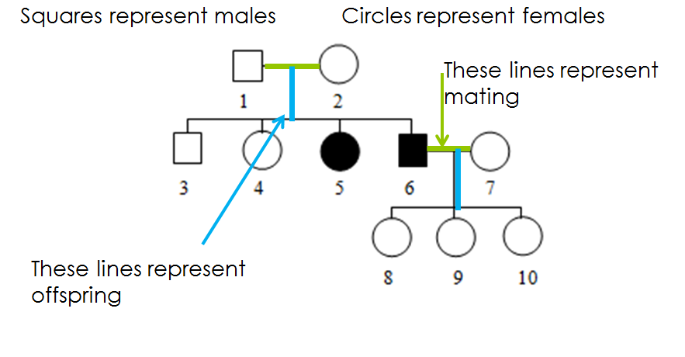
What do the symbols mean?

Slide 53
Watch!
http://www.youtube.com/watch?v=Wuk0W10EveU

Slide 54
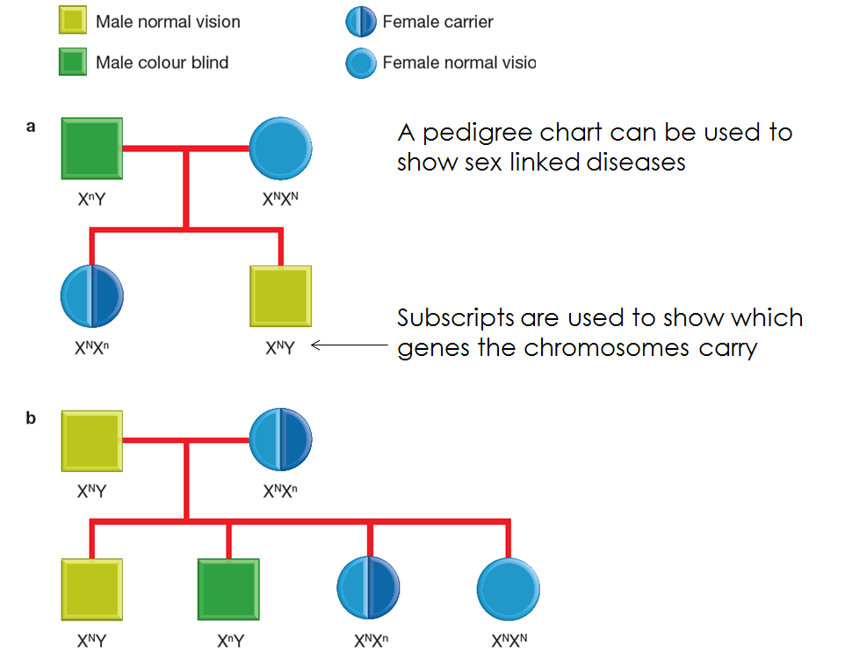
Note! Carrier females may not always be represented by a half shaded circles!

Slide 55
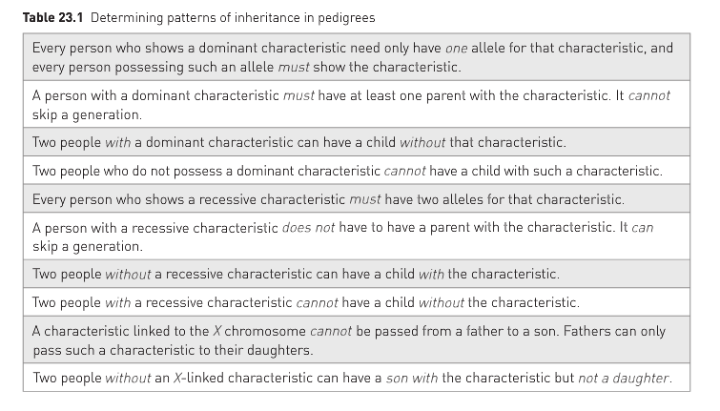
Rules for reading pedigrees..
Found on page 325 of text

Slide 56
Genetic profiling and counselling

Slide 57
What is genetic counselling??
Genetic Counselling is the advice given to couples planning to have children. Examine family tree and determining probabilities.

Slide 58
Reasons for genetic counselling…
Couples with a child with a birth defect will be naturally anxious at this prospect for any other children.
One partner may have a birth defect and concerned about passing that on to child.
Couples may have close relatives with inherited diseases.
If a genetic disorder were diagnosed, couple would have the option of terminating pregnancy.
Although genetic counselling and modern diagnostic techniques can alleviate much suffering, responsibility for decision making must still lie with the individuals concerned.

Slide 59
Obtaining a genetic profile
In the past we relied heavily on family pedigrees to determine likelihood of couple having a child with certain genetic disorder.
1960s scientists developed techniques using special enzymes to cut the DNA at specific sequences, leaving pieces of various lengths.
The length of the pieces varies distinctively from one person to another.
Electrophoresis

Slide 60
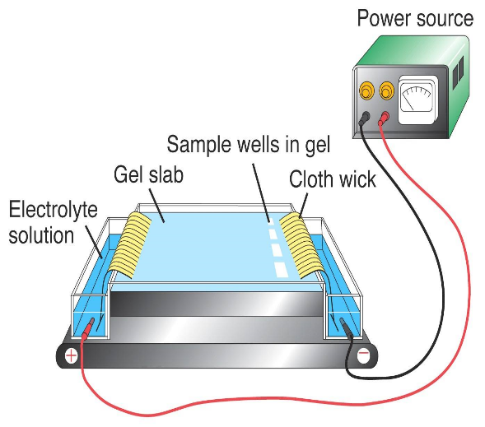
Electrophoresis
DNA pieces placed on a semi solid gel and an electric current was passed through the gel via electrodes located at each end.
DNA, which is negatively charged, moves through the gel toward the positive electrode.
Smaller DNA pieces move faster than the larger ones, resulting in a pattern of bands that looks similar to a barcode.
Banding pattern is an individual’s DNA fingerprint, or DNA profile.

Slide 62
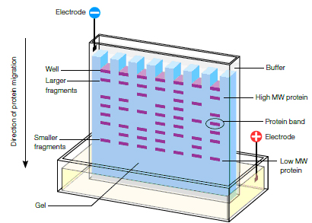

Slide 63
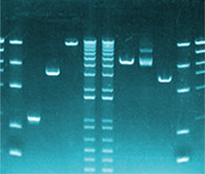

Slide 64
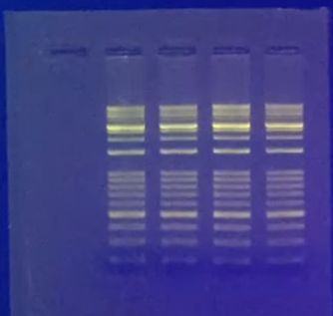
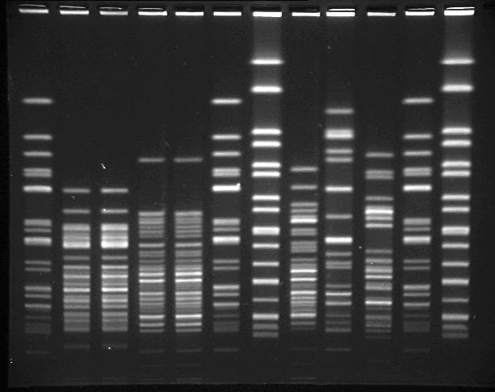

Slide 65
Why use DNA profiling (fingerprints)?
DNA fingerprints are frequently used in tracing ancestry and in forensic science.
Useful in identification of carriers of hereditary diseases.
Using gel electrophoresis, a person who carries an allele that may cause a hereditary disease, such as cystic fibrosis or Huntington’s disease, can be identified, as can a newborn baby who will develop the disease.
Allele does not mean they will automatically have disease or even develop it.
A recently discovered allele has been shown to increase an individual’s risk of colon cancer. DNA profiling enables this allele to be identified, so person can have regular medical examinations, but may never develop colon cancer.

Slide 66
Comparing DNA profiles (fingerprints)
Scientists use markers
Markers- a segment of DNA with known characteristics.
These segments of DNA do not code for a protein, but they contain short sequences where the same pattern is repeated a number of times.
The number of repeats in sequences is inherited, they make useful points of comparison in genetic testing.
DNA can be used to trace ancestry back through your family tree.
DNA passed down from one generation to the next, some parts remain almost unchanged, while other parts change greatly.
The unchanged parts of DNA provide link between generations and can be very useful in reconstructing family histories.

Slide 67
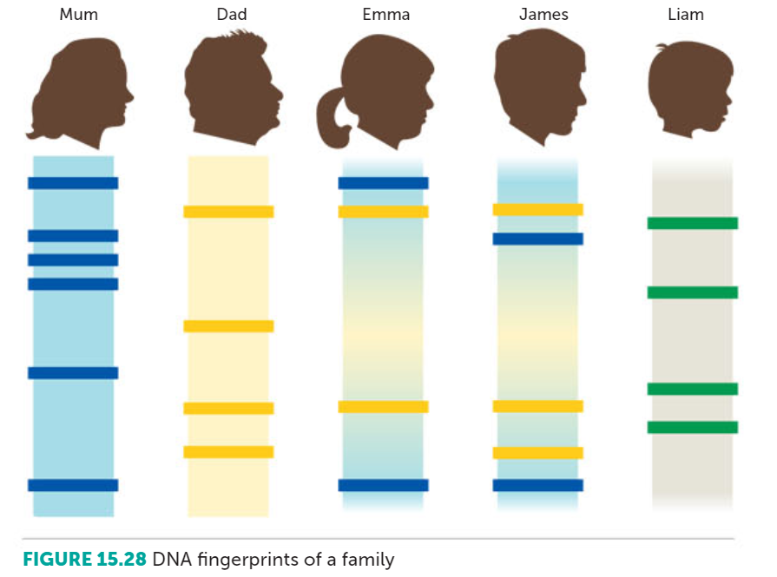

Slide 68
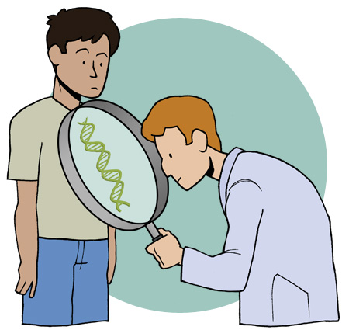
Ethical and Social Considerations
Many advantages and disadvantages can come from genetic profiling.
Profiling has potential to breach unwritten code of values. The way in which society uses profiling also present problems.
Genetic profiling provides a complete set of genetic information about a person- their genome.

Slide 69
Ethical and Social Considerations
Genome has the potential to provide great benefits for individuals and for providers of health care.
A person’s genome could be analysed during infancy and stored electronically to be used later if required
This raises many issues such as who this belongs to? Individual, laboratory or group. What if it was stolen? Who can access this information?
Future diseases could be predicted and early treatment could be possible.
May lead to unnecessary anxiety.
Could lead to discrimination with health care, insurance and even employment.

Slide 70
Complete chapter review questions!

