Slide 1
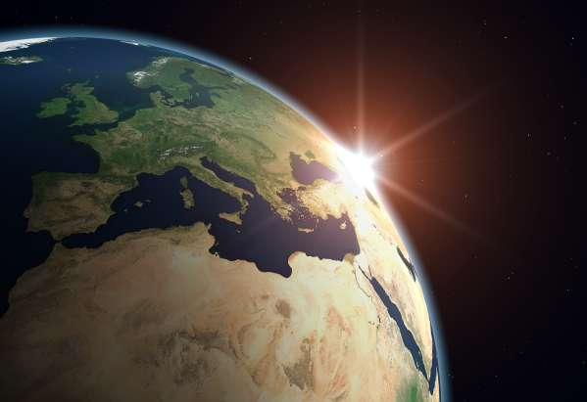
ENERGY FLOWS within biomes and ecosystems
Geography

Slide 2
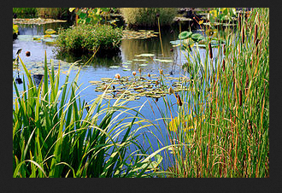
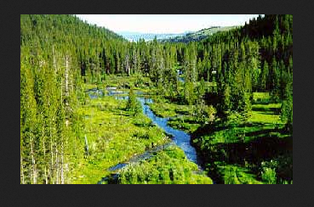
Energy Flows
Each ecosystem has its own community of plants and animals adapted to a particular environment
Ecosystems can be on a local scale – for example a small area of wet land
Or on a global scale –
for example a forest
community such as conifers

Slide 3
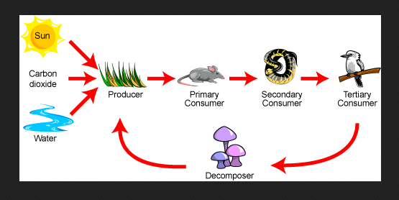
FOOD CHAINS
Within every ecosystem there are food chains made up of;
Producers
Consumers &
Decomposers

Slide 4
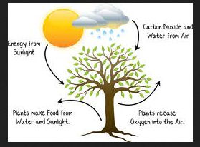
Producers
Plants are the producers in an ecosystem – because they produce their own food via photosynthesis
Plants use energy from the sun to convert CO2 and H2O into sugars, starches and carbohydrates
Oxygen is a by product of photosynthesis

Slide 5
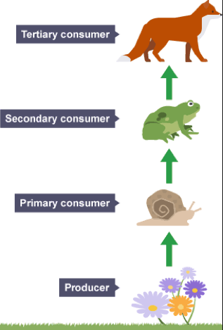
Consumers
Herbivores are primary consumers – they eat only plants
Herbivores are eaten by secondary consumers, carnivores (meat eaters)
Some carnivores eat only herbivores others only eat other carnivores
Carnivores that eat other carnivores are called tertiary consumers – they are at the top of the food chain
Some animals such as pigs cockroaches and humans eat both herbivores and carnivores – they are called omnivores

Slide 6
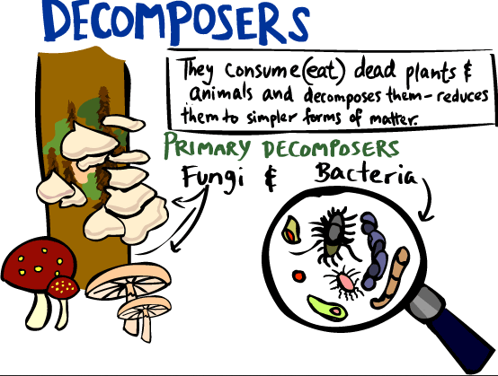
Decomposers
Decomposers include bacteria and fungi
Their purpose in the food chain is to breakdown (decompose) wood, leaves & dead bodies so that every living thing is recycled

Slide 7
Food Chains

Slide 8
Activities – remember & understand
Explain how ecosystems get their energy
Explain the difference between a producer and a consumer in a food chain
Outline how green plants manufacture their own food
What is the difference between a herbivore and a carnivore?
What is an omnivore?
Outline the role of decomposers in the food chain?

Slide 9
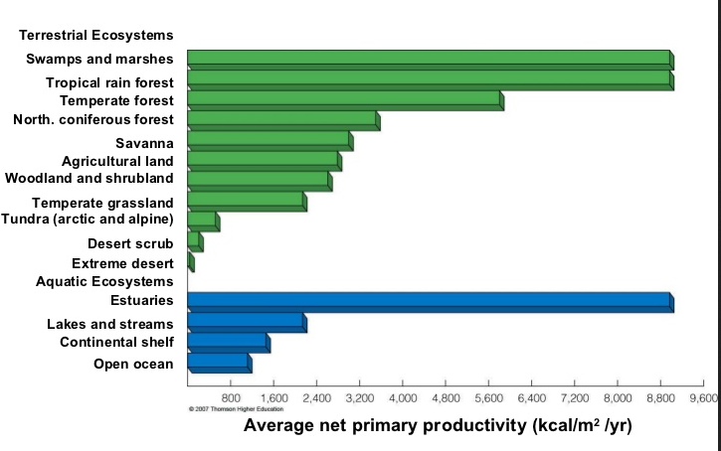
The productivity of biomes
The rate at which photosynthesis occurs in an ecosystem determines the primary productivity of that ecosystem
Rainforests are highly productive areas and deserts are the least productive

Slide 10
Primary Productivity & Humans
Primary producers are the source of all food available for every other organism in an ecosystem
It is the planets net primary productivity NPP that limits the number of species (including humans) that are able to survive on earth

Slide 11
Activities – remember and understand
Explain why primary producers of ecosystems are so important
Using the graph in slide 9 describe the differences in NPP/m2 of ecosystems from the Equator to the poles

Slide 12
Activities – apply and analyse
Using the graph in slide 9 working in pairs write a short response to the following statement;
“As swamps, marshes and estuaries are the most productive ecosystems, they should be protected before all other ecosystems”
2. Use your response to question 1 to evaluate the pros and cons of the proposed Roe Highway extension through Beeliar Wetlands
http://www.savebeeliarwetlands.com/wetlands/article/the_threats

