Slide 1
Topic 5: Digestive System
R.Johansen 2021

Slide 2
What is digestion?
Is the breaking down of the nutrients we eat into smaller simpler organic compounds that can be absorbed by the body and into the cells.
Proteins → amino acids
Carbohydrates → simple sugars (glucose)
Fats → fatty acid and glycerol
Digestive processes can be chemical (involving digestive enzymes), or mechanical

Slide 3
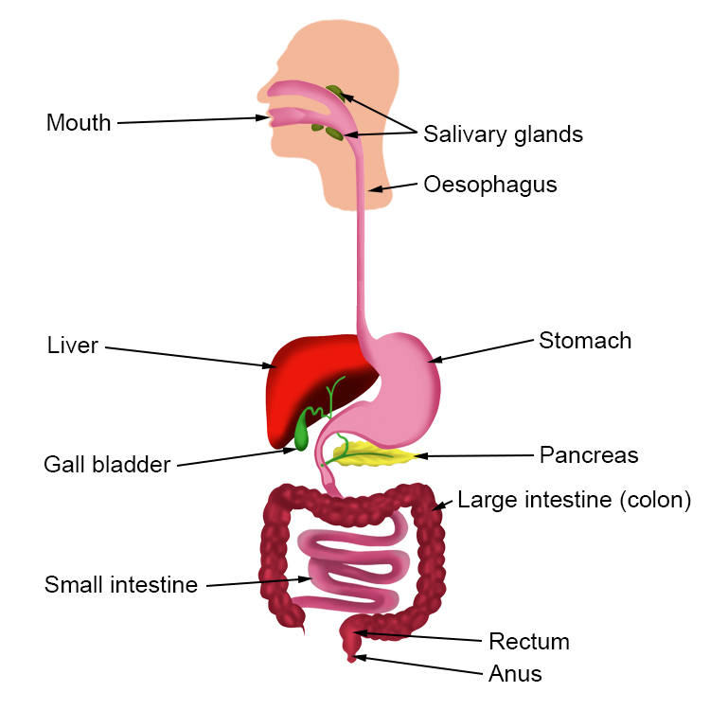
Organs of the digestive system
The alimentary canal is the continuous tube that runs from the mouth to the anus. Together with associated organs like the pancreas and gall bladder, the alimentary canal makes up the digestive system.
The lining of the alimentary canal is the surface through which the nutrients are absorbed.

Slide 4
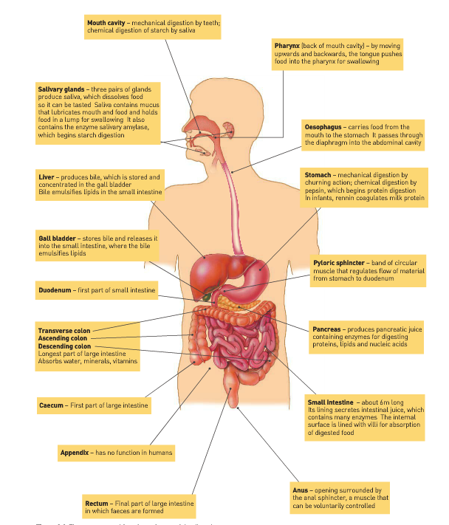
Organs of the digestive system (Structure and Function)

Slide 5
Role of the digestive system
The organs of the D.S. are structured and arranged to carry out 6 basic activities:
Ingestion of food and water
Mechanical digestion of food (physical breakdown)
Chemical digestion of food (using enzymes)
Movement of food along the alimentary canal (Swallowing and peristalsis)
Absorption of digested food and water into the blood and lymph
Elimination of material that is not absorbed

Slide 6
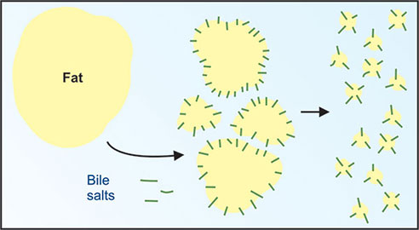
Mechanical and Chemical digestion
Mechanical and chemical digestion occur at various places during the digestion process.
Mechanical digestion of food (physical breakdown). Processes include chewing, churning and emulsifying.
Chemical digestion of food (using enzymes). Enzymes are substrate specific:
Enzyme Name | Substrate | Product
Amylase | Carbohydrates/Starch | Simple Sugars (Glucose)
Protease | Proteins | Amino Acids
Lipase | Lipids (fats) | Fatty Acids and glycerol

Slide 7
Mouth

Slide 8
Digestive processes
Three main digestive processes occur in the mouth:
Ingestion – Intake of food
Mechanical Digestion – Physical break down of food (large – small pieces) by the jaw and teeth
Chemical Digestion – Chemical break down of starch by salivary amylase found in saliva produced by the salivary glands

Slide 9
Chemical digestion in mouth
Chemical break down of starch by salivary amylase found in saliva produced by the salivary glands.
Location | Enzyme | Substrate | Products
Mouth | Salivary Amylase | Starch/ Carbohydrates (polysaccharides) | Shorter polysaccharides

Slide 10
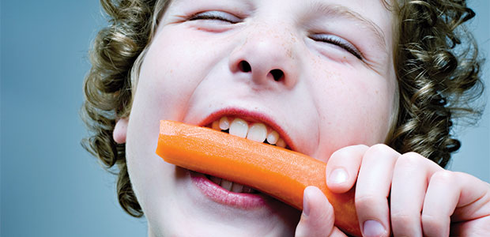
Mechanical digestion in mouth
Mechanical processes that occur in the mouth include:
Chewing (mastication)
Bolus formation

Slide 11
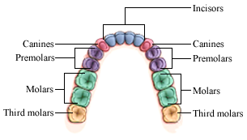
Structures assisting mechanical processes
The jaw, teeth and tongue facilitate the mastication and swallowing process in the mouth.
There are 4 types of teeth, each of which has a different function in mechanical digestion:
Incisors – Used for biting and cutting
Canines – Used for tearing
Premolars – Used for crushing and grinding
Molars – Used for crushing and grinding
Each type of tooth has a unique structure to account for it’s function

Slide 12
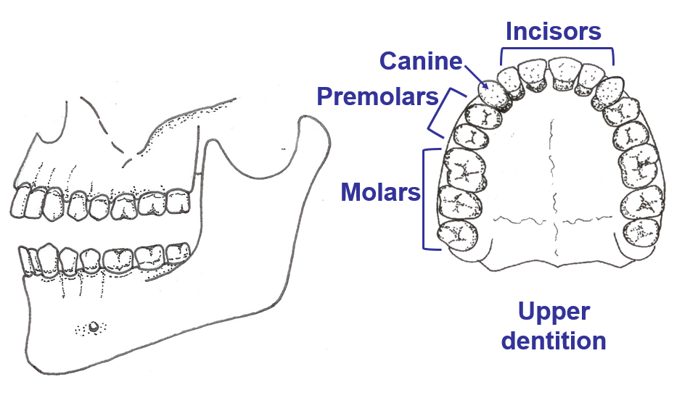
Dentition
Type of tooth | Structure
Incisor | Chisel-shaped teeth
Canine | In humans canines are the same length and other teeth. Pointed ends (not sharp like other animals)
Pre Molar | Broad crowns with 2 rounded cusps
Molar | Broad crowns with 4 rounded cusps

Slide 13
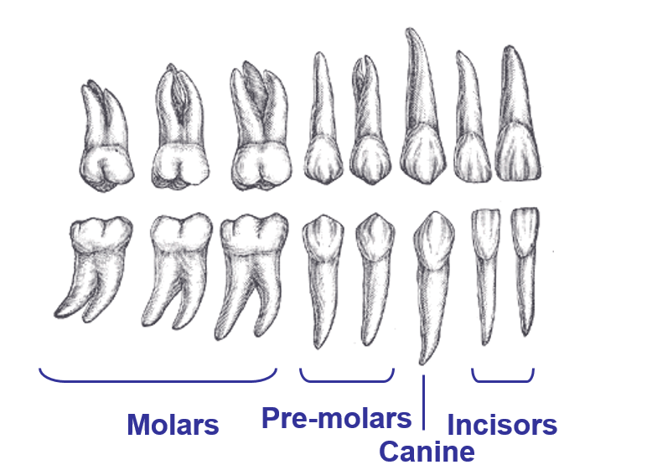
Dentition

Slide 14
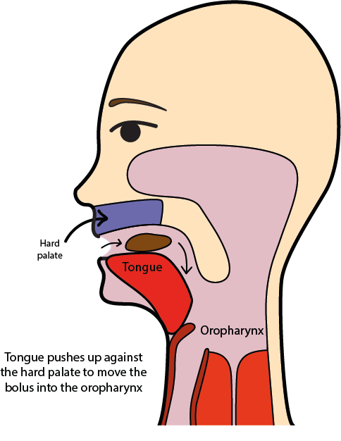
Swallowing
After chewing the food is formed by the tongue into a rounded lump called the bolus.
To swallow the tongue moves upwards and backwards, pushing the bolus into the back of the mouth, the pharynx.
The pharynx leads into the oesophagus.

Slide 15
Oesophagus

Slide 16
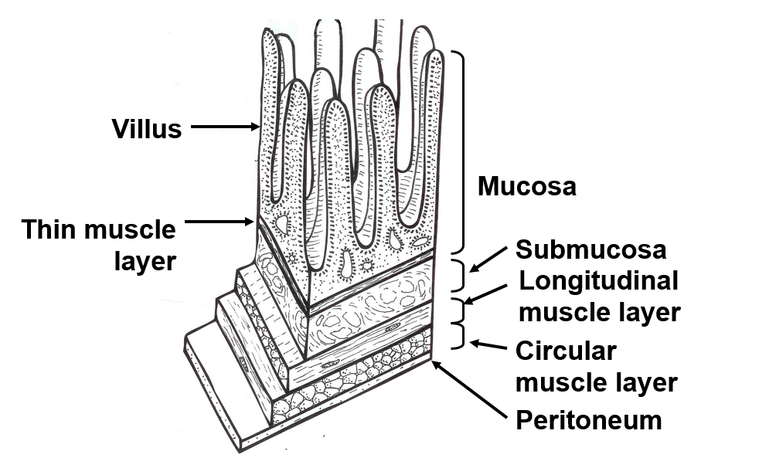
Structure of the lining of the alimentary canal

Slide 17
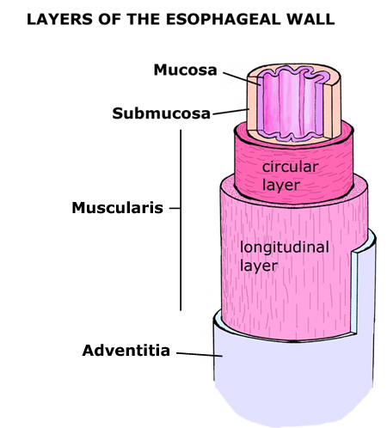
Structure of the oesophagus
The wall of the oesophagus, like the rest of the alimentary canal has a double layer of muscle:
Circular Muscle - Muscle fibres arranged in a circle around the alimentary canal
Longitudinal Muscle – Muscle fibres arranged along the length of the canal

Slide 18
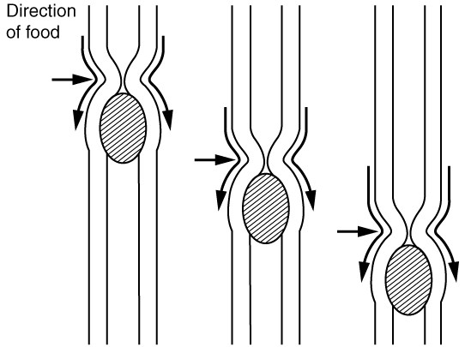
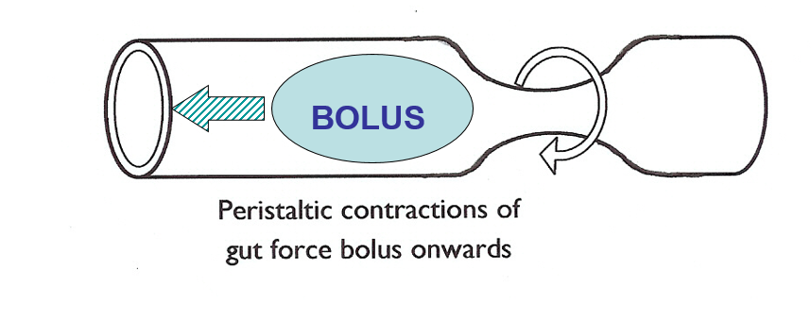
Peristalsis
Peristalsis is a process which occurs to move food (bolus) along the alimentary canal.
Behind the bolus the circular muscle contracts to form a constriction.
Circular muscle around and in front of the bolus relaxes.
By contraction of successive bands of circular muscle the constriction moves in a wave along the oesophagus, pushing the bolus in front of it.
Movement of the bolus is lubricated by mucus secreted by the lining of the oesophagus.

Slide 19
Stomach

Slide 20
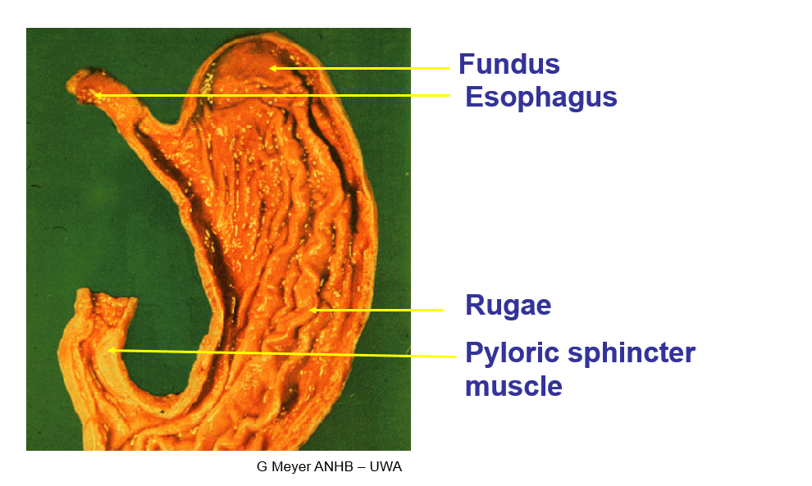
Structure of the stomach
Oesophagus

Slide 21
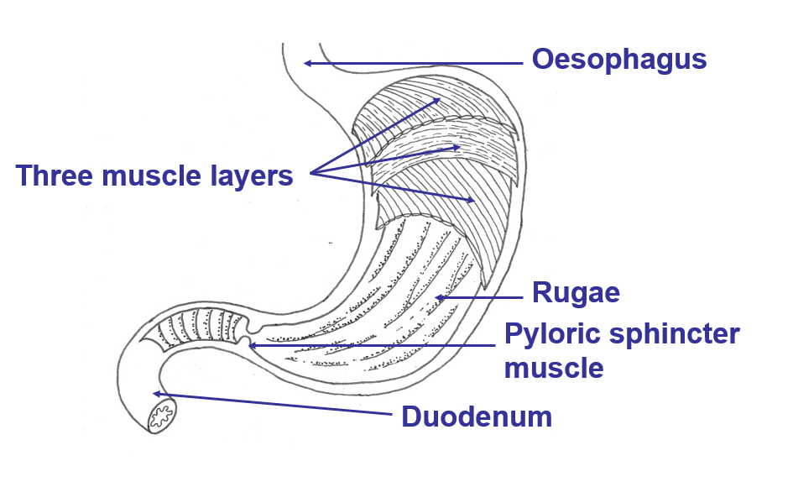
Structure of the stomach
The stomach is a roughly J-shaped enlarged section of the alimentary canal.
The gastric rugae are a series of folds in the stomach wall.
Unlike the rest of the alimentary canal, the stomach has an additional muscle layer known as the oblique layer.

Slide 22
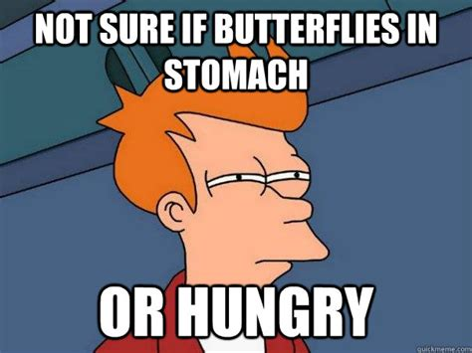
Structure of the stomach – Mechanical Digestion
Waves of muscular contractions move along the stomach walls causing a form of mechanical digestion known as churning.
Unlike the rest of the alimentary canal, the stomach has an additional muscle layer known as the oblique layer.
This oblique layer allows the stomach to contract in a variety of different ways to churn the food and mix it with stomach juices until the food is converted to a thick soupy liquid called chyme.
Rennin (in infants only) curdles milk

Slide 23
Structure of the stomach – Chemical Digestion
Chemical digestion occurs through enzymes found in the gastric juices which are secreted by the mucosa (lining of the stomach).
Gastric juice is secreted by gastric glands which are located in the narrow tube like structures called gastric pits.
Gastric juices contain hydrochloric acid, digestive enzymes and mucus (all secreted by specialised cells).
Hydrochloric acid in the stomach is essential in activating the enzyme gastric protease/pepsin, as it requires acidic conditions to function.
Location | Enzyme | Substrate | Product
Stomach | Gastric protease (Pepsin) | Proteins (long polypeptide chains) | Peptones/Polypeptides (shorter)

Slide 24
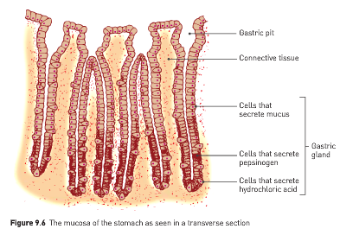
Mucosa of the stomach

Slide 25
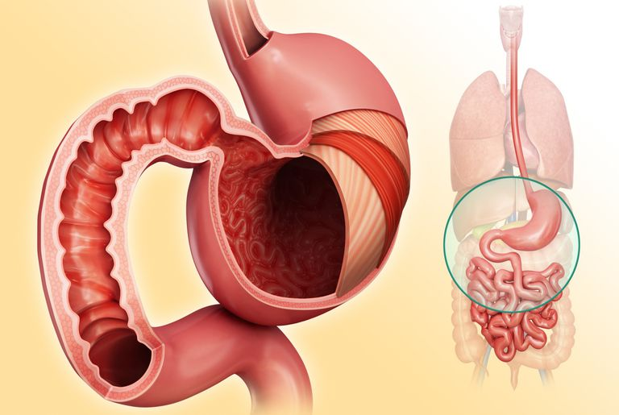
Absorption in the stomach
Nutrients are not absorbed into the blood through the stomach, because the internal surface is covered by a think layer of mucus.
However, limited absorption of water, glucose, alcohol and some drugs takes place in the stomach

Slide 26
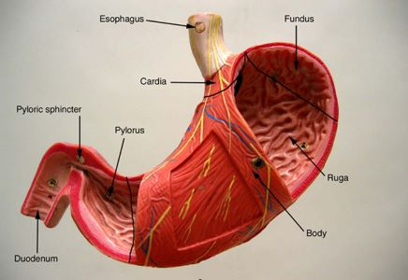
Regulating movement – Pyloric Sphincter
At the lower end of the stomach there is a thickening of the circular muscle, which results in a constriction called the pyloric sphincter.
This constriction is sufficient to prevent the stomach contents moving through unless pushed along by peristalsis.
Stomach contents will remain in the stomach for between 2-8 hours.

Slide 27
Duodenum
The first part of the small intestine

Slide 28
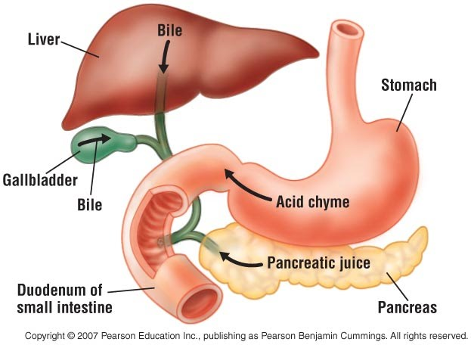
Duodenum structure
The duodenum is approx. 25cm long and extends from the bottom end of the stomach in a curve around the pancreas.
It receives material that has been pushed through the pyloric sphincter from the stomach.
The common bile duct allows the gall bladder and the pancreas to deliver useful digestive substances into the duodenum.
The pancreas and the gall bladder are not part of the alimentary canal, yet still play an important role in digestion.
https://sites.google.com/a/mtlstudents.net/the-digestive-system/home/the-small-intestine/duodenum?tmpl=%2Fsystem%2Fapp%2Ftemplates%2Fprint%2F&showPrintDialog=1

Slide 29
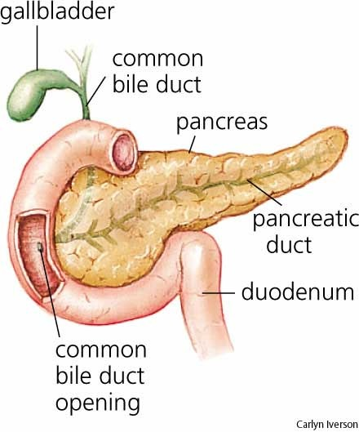
Pancreas, gall bladder and duodenum
Pancreatic juices containing enzymes (produced in the pancreas) are secreted into the duodenum via the common bile duct.
The pancreatic juices help to neutralise the acid that has come into the duodenum with the contents of the stomach.
Enzymes contained in the pancreatic juices include:
Pancreatic amylase
Pancreatic protease (Trypsin)
Pancreatic lipase
Ribonuclease and Deoxyribonuclease

Slide 30
Location Produced | Location performs activity | Enzyme | Substrate | Product
Pancreas | Duodenum | Pancreatic Amylase | Shortened polysaccharides | Disaccharides
Pancreas | Duodenum | Pancreatic Protease (Trypsin) | Previously Shortened polypeptides | Peptides
Pancreas | Duodenum | Pancreatic Lipase | Fats and Oils | Fatty acids and Glycerol
Pancreas | Duodenum | Ribonuclease and Deoxyribonuclease | RNA and DNA | Smaller components of RNA and DNA

Slide 31
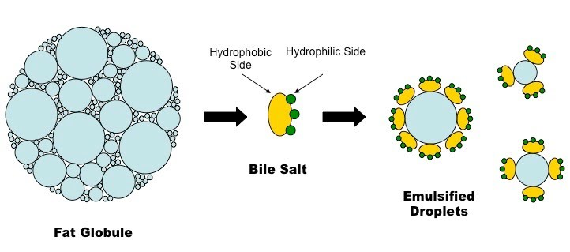
Mechanical digestion in the duodenum
Bile is produced in the liver and secreted into the pancreas from the gall bladder (where it is stored) via the common bile duct.
Bile contains bile salts which emulsify fats. This is a mechanical process.
Bile breaks the fat into tiny droplets which increases their surface area to improve digestion by chemical means.

Slide 32
Small Intestine

Slide 33
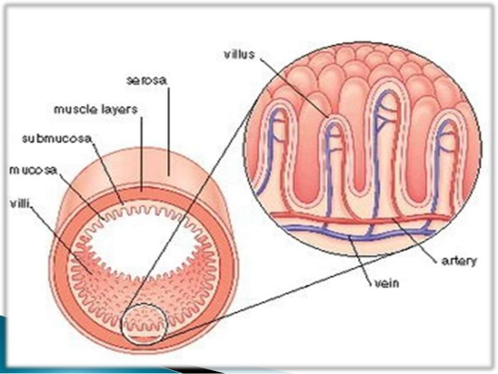
Structure of the small intestine
The duodenum is the first section of the small intestine (already discussed)
The small intestine is very long - about 6 metres in length (if stretched out).
The mucosa of the small intestine is folded and contain finger-like projections called villi. The villi also contain microscopic projections on their surfaces called microvilli.

Slide 34
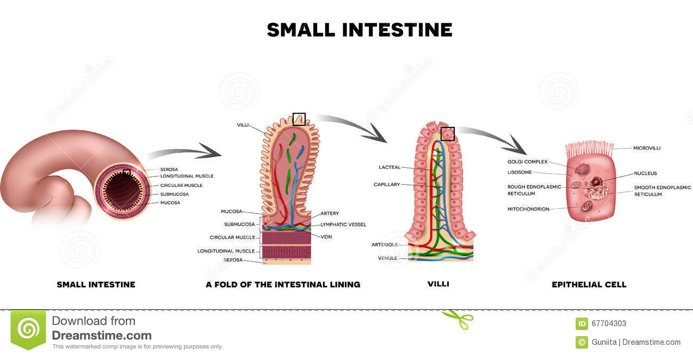

Slide 35
Segmentation
Main mixing movement in the small intestine.
Contents must be continually moved so they can mix in with digestive juices (containing intestinal enzymes).
Circular muscle fibres in the intestinal wall contract, dividing the intestines into segments.
The rhythmic effect is to ‘slosh’ the contents back and forth – mixing contents together.

Slide 36
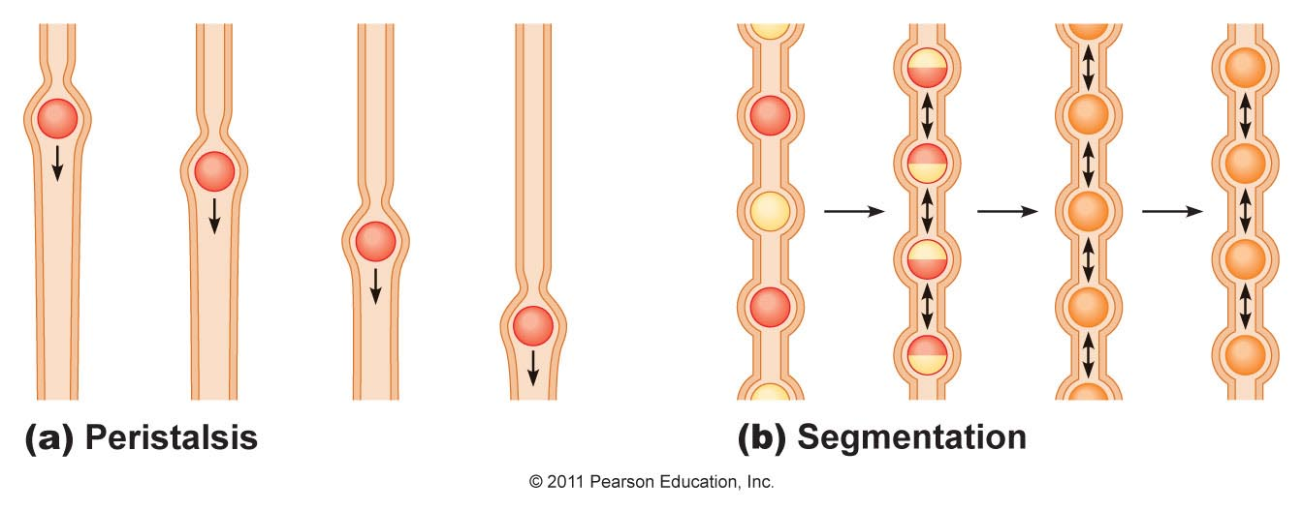

Slide 37
Chemical digestion in the small intestine
The cells in the mucosa of the small intestine secrete intestinal juices. These contain the following enzymes:
Intestinal amylase
Intestinal protease
Intestinal lipase
This is the last place where chemical digestion occurs.
Location | Enzyme | Substrate | Product
Small Intestine | Intestinal Amylase | Disaccharides | Glucose/simple sugar (monosaccharide)
Small Intestine | Intestinal Protease | Peptides | Amino Acids
Small Intestine | Intestinal Lipase | Fats and Oils | Fatty acids and Glycerol

Slide 38
Absorption
Now that all of the nutrients have been broken down into their most simple forms they must be absorbed into the bloodstream and lymph so they can be used by the body.
Glucose and amino acids are absorbed into the blood capillaries via active transport.
Water and water-soluble vitamins are absorbed into the blood capillaries by diffusion
Fatty acids and glycerol and fat-soluble vitamins are absorbed into the lacteals (forming chyle) by simple diffusion.
The structure of the small intestine makes it especially suited to this process.
The surface area of the small intestine maximised to allow for this process.

Slide 39
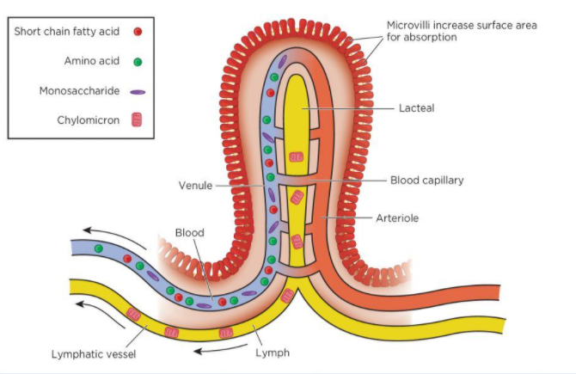
Structure of the small intestine to increase surface area for absorption
The surface area of the small intestine is maximised to increase absorption in the following ways:
The small intestine is 6 metres long
The mucosa of the small intestine is folded
The mucosa contains villi (small finger-like projections)
The villi contain microvilli (microscopic finger-like projections)
The small intestine is well supplied with blood
The epithelium is thin (one cell thick) to allow for easy diffusion

Slide 40
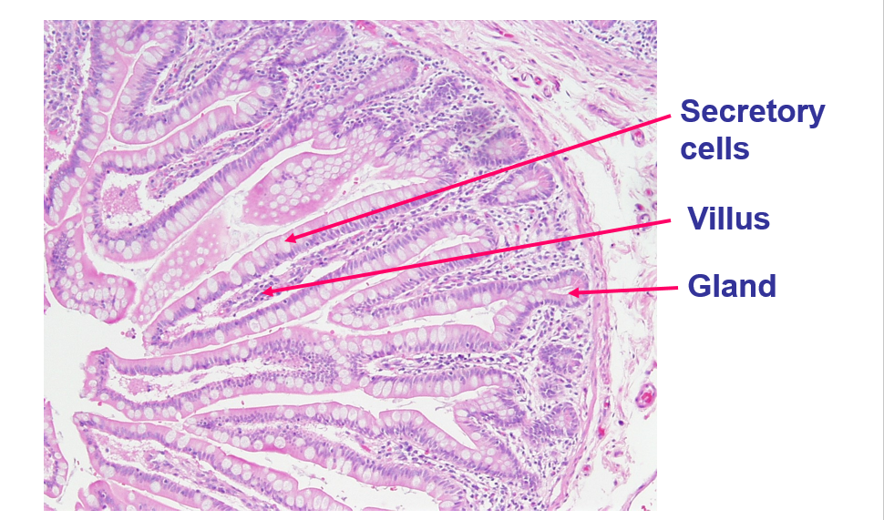
Structure of the villi

Slide 41
Structure of the villi
The villi is well suited to it’s function of absorption.
Each villi is about 1mm long and is covered by a single layer of cells.
Inside the villi is a lymph capillary called the lacteal which is surrounded by a network of blood capillaries.
Absorption is further enhanced by continual movement of the villi bought about by muscular movements of the intestinal walls, which brings the villi into contact with different parts of the intestinal contents.
The substances that are absorbed into the blood capillaries are carried to the hepatic portal vein to the liver. Here they may be removed for further processing, or they may remain in the blood to be carried to other body cells.
The substances that are absorbed into the lacteals are transported to the lymph system which eventually empties into the blood through the veins in the upper part of the chest.

Slide 42
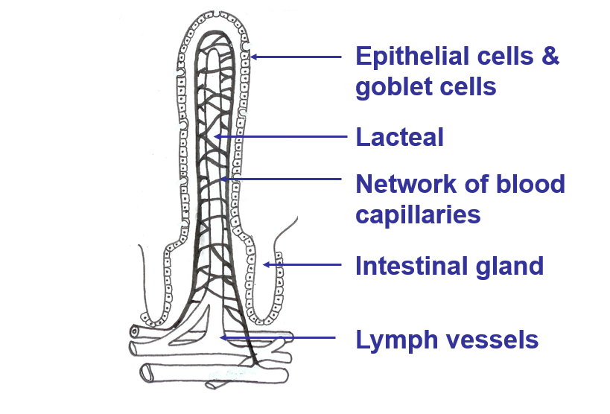
Structure of the villi - Lacteal

Slide 43
Large Intestine

Slide 44
Structure of the large intestine
The large intestine is about 1.5m long (shorter than the small intestine). The large intestine receives its name due to it’s large diameter.
There are no villi in the large intestine and no digestive juices (enzymes) are secreted here = no chemical digestion.
The lining of the large intestine does however secrete large amount of mucus.
The large intestine contains bacteria which is important in breaking down much of the remaining organic compounds such as cellulose.
Material is moved through the intestine relatively slowly. It may take 18-24 hours to pass.

Slide 45
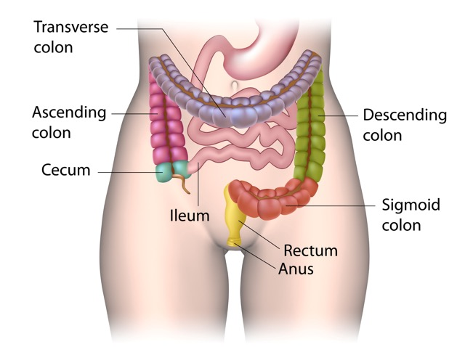

Slide 46
Function of the large intestine
The main process that occurs in the large intestine is the absorption of water via the process of osmosis. Some salts are also absorbed. This makes the contents become more solid.
Bacteria is important in breaking down much of the remaining organic compounds.
Some bacteria produce vitamins (folic acid) which are absorbed through the walls into the bloodstream along with other mineral nutrients.
The semi solid material that is remaining after water absorption and bacterial action is called faeces.
Faeces contain water, undigested food material (particularly cellulose), bacteria, bile pigments (contribute to the colour) and the remains of cells which have broken away from the internal lining of the alimentary canal.
With the exception of bile pigments, the content of faeces are not metabolic wastes, so the process of defecation is referred to as elimination.

Slide 47
Liver

Slide 48
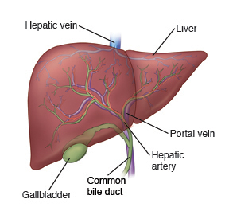
Function of the liver
Although the liver is not directly involved in digestion, it has some important roles in the body which involve the products of digestion:
Deaminates amino acids (will discuss next topic)
Converts glucose to glycogen
Produces bile
Stores iron, and vitamins A, B₁₂, D, E & K
Synthesises vitamin A and plasma proteins
Removes toxins (detoxicates drugs – alcohol)

Slide 49
Digestion Process Summary

Slide 50
Digestion Summary
Each organ of the digestive system is designed for specific breakdown of food molecules or absorption of substances.
Digestion aims to break food into smallest molecule so can be absorbed (and therefore cells able retrieve nutrients)
Carbohydrates (break into monosaccharides – simple sugars) | 1st - Mouth 2nd – Duodenum (Pancreatic Enzymes) 3rd – Small Intestines
Proteins (break down to amino acids) | 1st – Stomach 2nd – Duodenum (Pancreatic Enzymes) 3rd – Small Intestines
Fats/Lipids (break down to fatty aids + glycerol) | 1st – Duodenum (Pancreatic Enzymes) 2nd - Small Intestines

Slide 51
DO: Questions in the text
Complete a glossary using the key words from chapter 6 (Page 164-165)
Complete all relevant Chapter 6 Review Questions (Page 166-167)
Prepare your own notes

