Slide 1
How the Sharemarket Works

Slide 2
Share Trading
Share trade occurs when both a buyer and seller agree on a price per share.

Slide 3
Buyer | Bid Price | Seller | Ask Price
Buyer A | $1.00 | Seller D | $1.05
Buyer B | 99 cents | Seller E | $1.00
Buyer C | 98 cents | Seller F | $1.06
Trade
Buyer A has placed the highest “bid”. For a trade to take place there needs to be a seller wishing to sell the shares at $1 per share and that is Seller E.
The lowest price a seller is willing to accept for their stock is sometimes called the “Ask” price (because that is the price that the seller is “asking” for the stock).

Slide 4
When will a trade take place?
Buyer | Bid Price | Seller | Ask Price
Buyer A | 50 cents | Seller D | 51 cents
Buyer B | 40 cents | Seller E | 54 cents
Buyer C | 41 cents | Seller F | 50 cents
What will Seller D & E need to do?

Slide 5
Factors that can Influence Price
Company performance
Company management
Takeovers
Technological Innovation

Slide 6
Factors that Influence the Sharemarket Overall
Interest Rates
Exchange Rates
Government Policies
Commodity Prices
Other Financial Markets and Economies

Slide 7
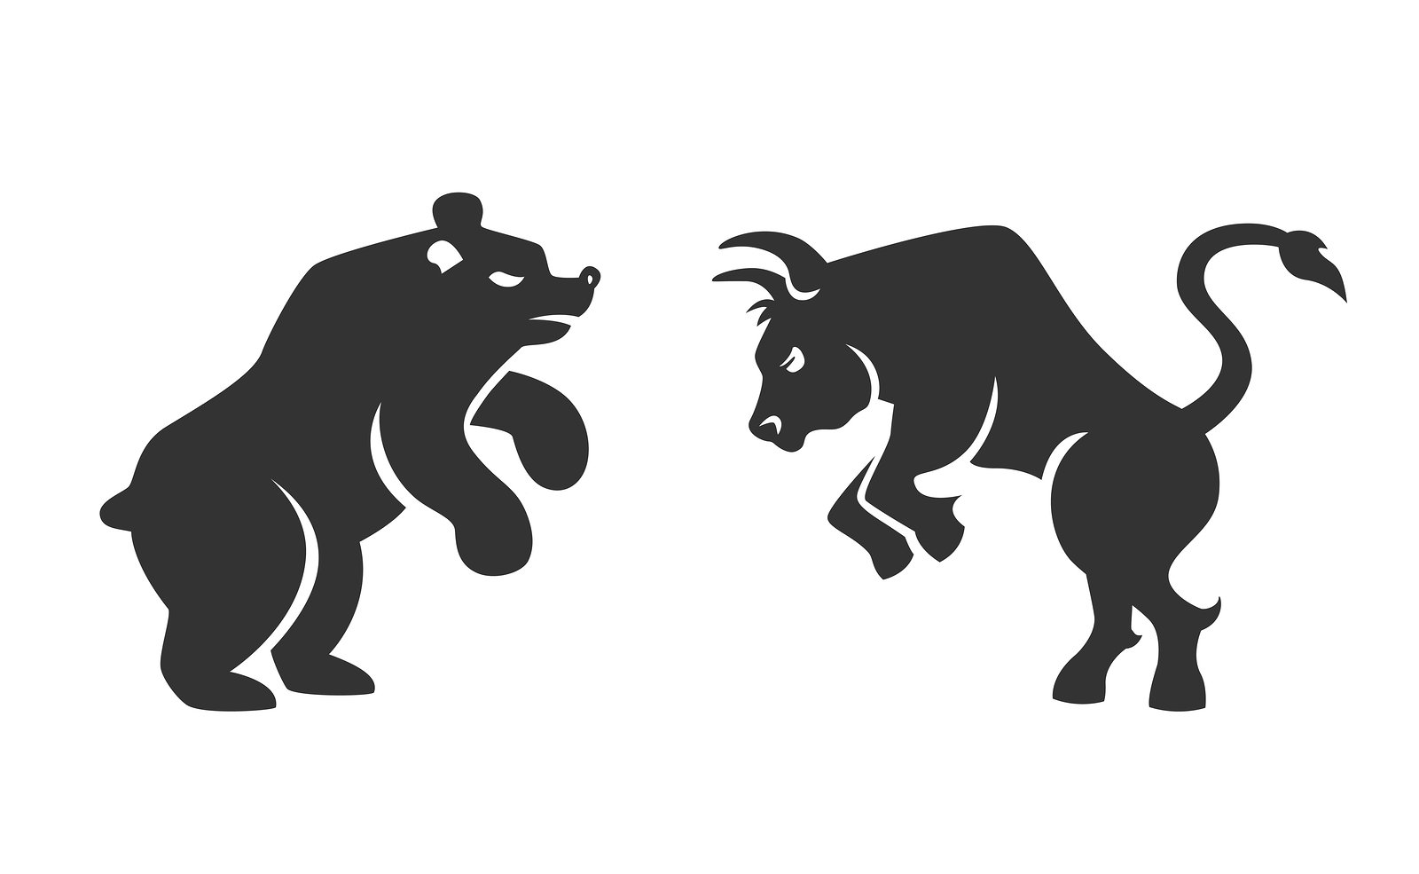
Bull vs Bear Market
A bull market is a rising sharemarket. A “bull” tosses market prices up.
A bear market is a falling market. A “bear” claws market prices down.

Slide 8
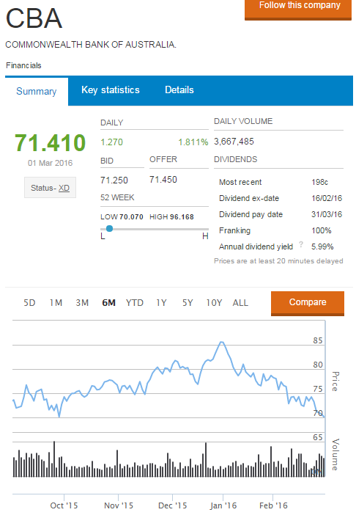

Slide 9
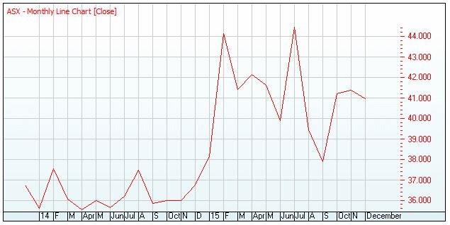
Date | Sep 14 | Oct 14 | Nov 14 | Dec 14 | Jan 15 | Feb 15 | Mar 15 | Apr 15 | May 15 | Jun 15 | Jul 15 | Aug 15 | Sep 15
Closing price $ | 35.86 | 35.99 | 36.00 | 36.74 | 38.14 | 44.14 | 41.41 | 42.15 | 41.63 | 39.90 | 44.45 | 39.44 | 37.88

