Slide 1
Unit 2 Topic 10: DNA & Protein synthesis
R. Johansen 2021

Slide 2
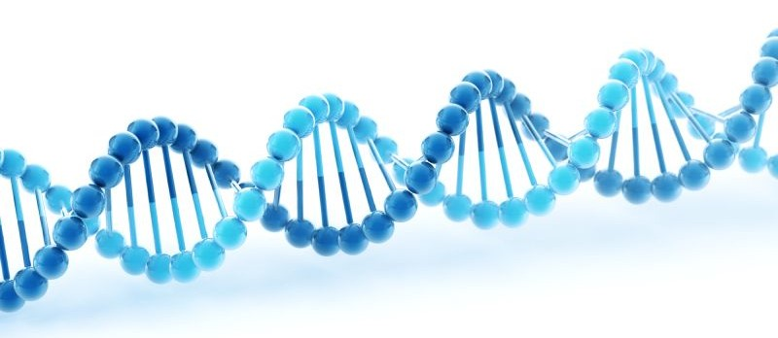
What is DNA?
Deoxyribonucleic acid
DNA is found in 2 locations in the cell:
Nucleus
Mitochondria (mtDNA)
DNA determines the structure of the cell and how it functions
DNA therefore determines all of the characteristics we have as an individual:
Hair colour
Eye colour
Allergic reactions
Height

Slide 3
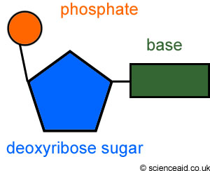
Structure of DNA
Two molecules arranged into a ladder – double helix
Estimated length is between 2-3 meters long
A DNA molecules is made up of tiny sub-units called nucleotides
Each nucleotide consists of:
Phosphate Group
Pentose Sugar
Nitrogenous Base
DNA strands are bound to proteins called histones (space saving)

Slide 4
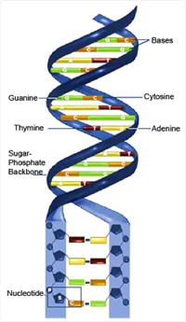
Nucleotides
The phosphate and sugar from a backbone
The nitrogenous bases form the rungs

Slide 5
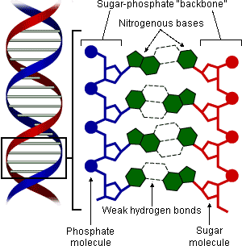

Slide 6
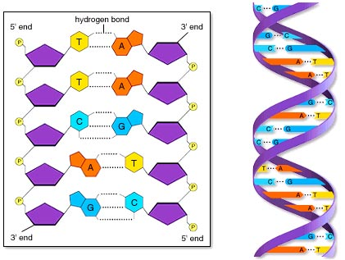
Nitrogenous Bases
There are 4 types of nitrogenous bases:
Adenine
Thymine
Cytosine
Guanine
When the 2 molecules of DNA come together the bases match up forming base pairs
A weak hydrogen bond connects the bases together
A always matches with T
C always matches with G

Slide 7
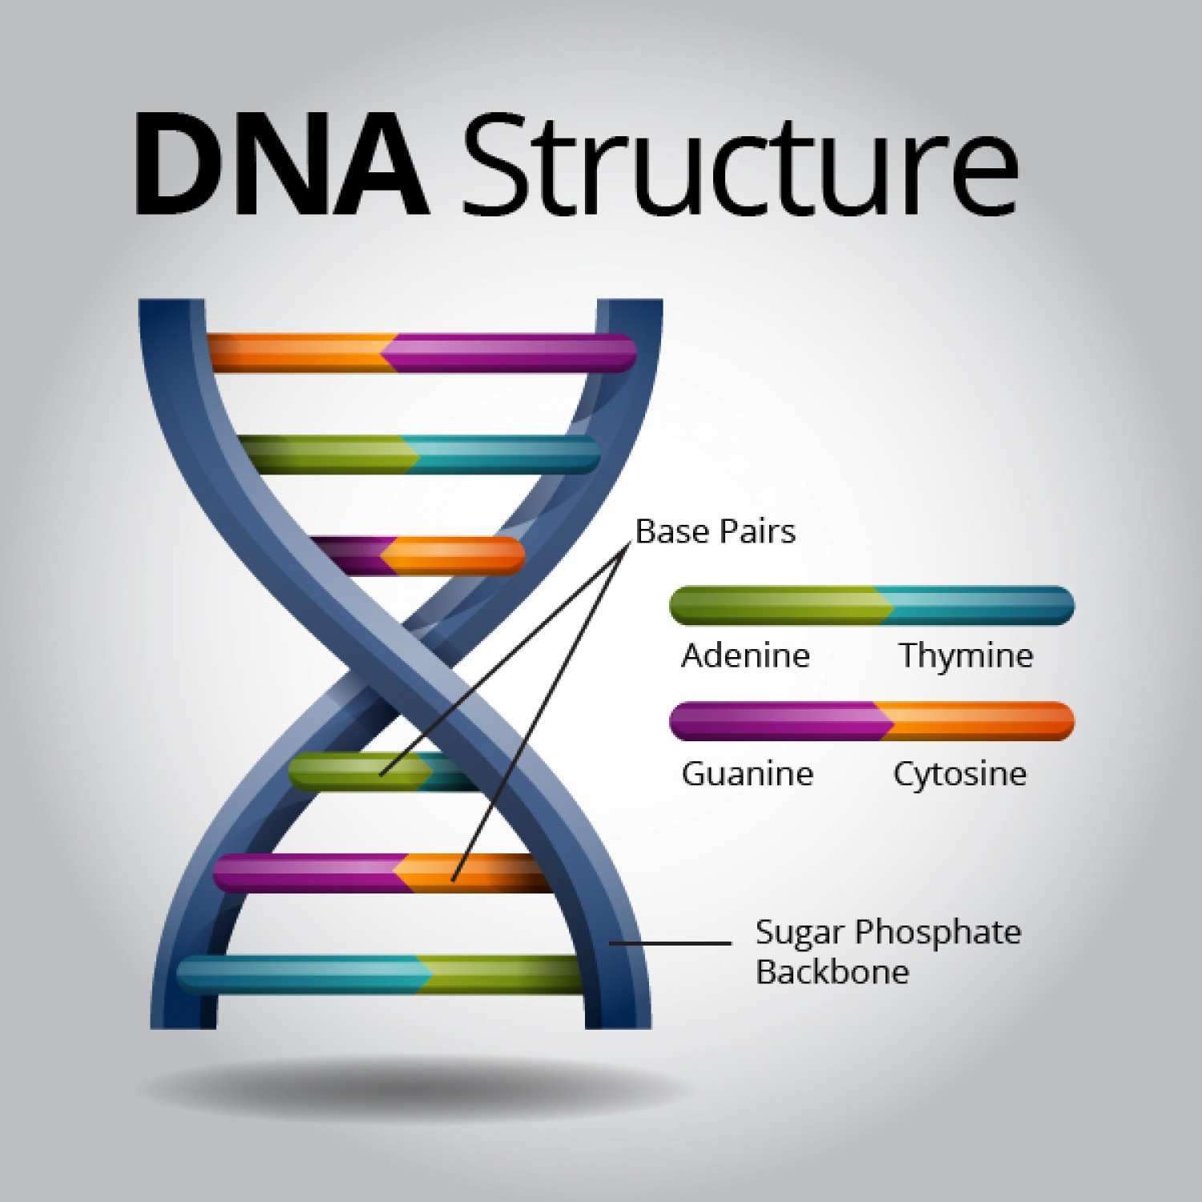

Slide 8
A
T
C
G
T
A
C
G
A
T
G
C
T
A

Slide 9
A
T
C
G
T
A
C
G
A
T
G
C
T
A

Slide 10
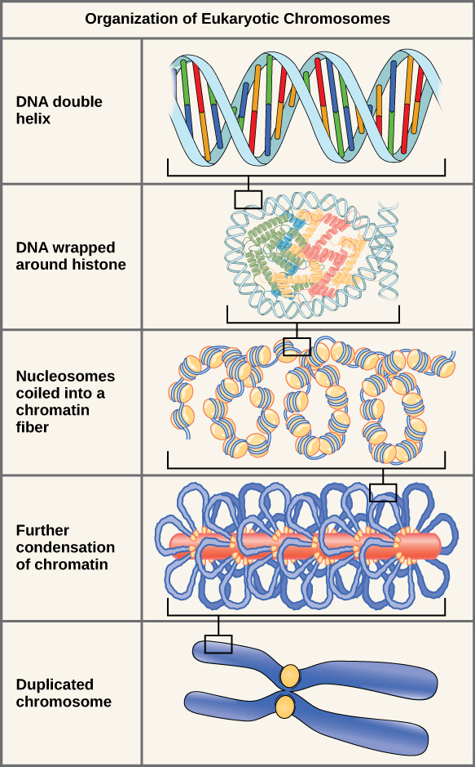
Chromatin and Chromosomes???
Chromatin exist in the nucleus of a cell that is not dividing. The coiled DNA (around histones) forms a tangled network.
Looks like spaghetti!!
Chromosomes exist during cell division as an exact copy of the DNA molecule must be provided to the two daughter cells.
Coiled chromatin become even more tightly coiled (condensed). These are now chromosomes.

Slide 11
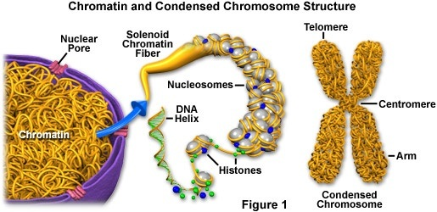
See diagram on page 232 of text!

Slide 12
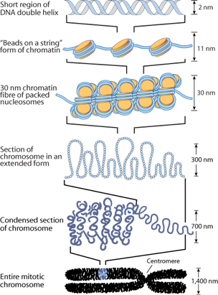
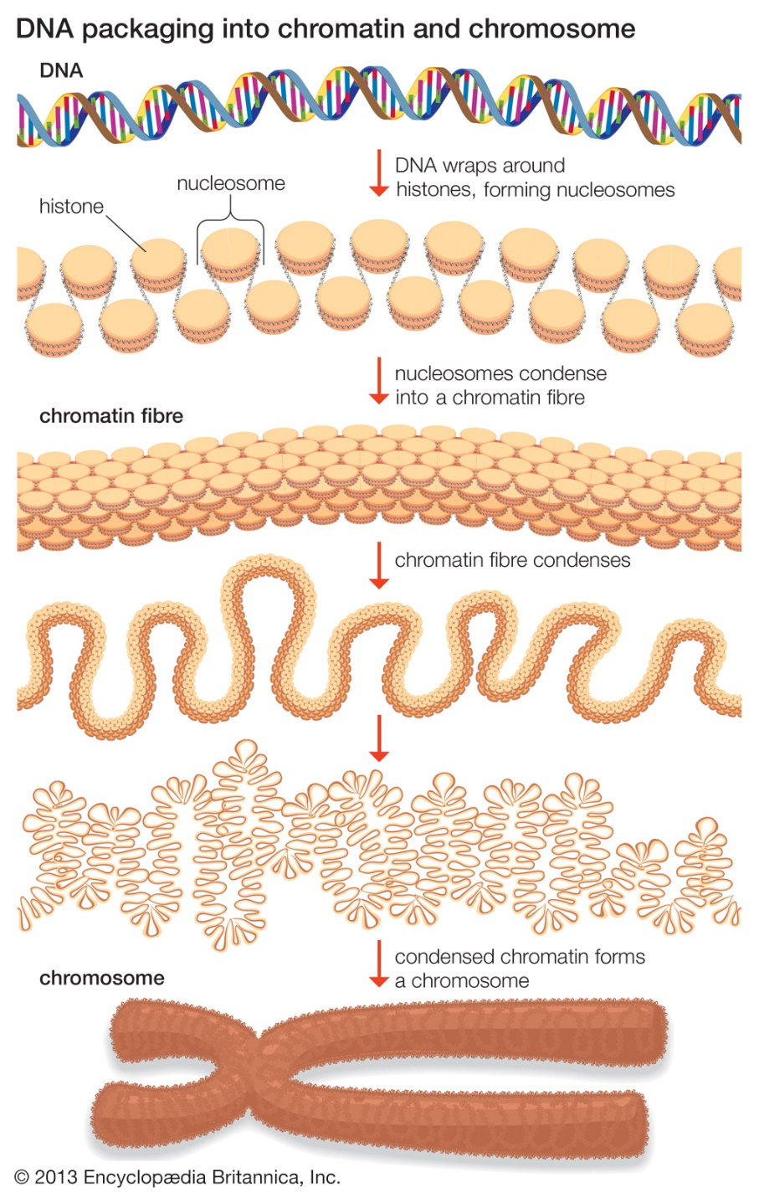

Slide 13
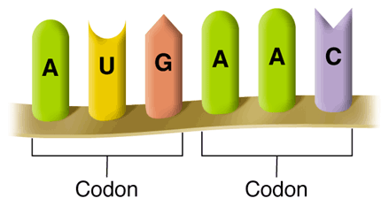
DNA Code
To solve the genetic code we look at the sequence of bases
The bases are read (arranged) into triplets known as codons
A G G - C T C - A AG - T C C - T A G
T C C - G A G - T TC - A G G - A T C

Slide 14
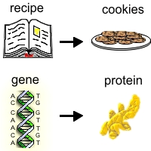
Genes
A gene is a section of DNA
Each gene contains a genetic code which determines the structure and activities of the cell (codes for proteins to be made)
Each gene has a unique sequence of bases
This sequence is the ‘code’ for the production of certain proteins… like a recipe!!

Slide 15
GENE
Protein
Trait

Slide 16
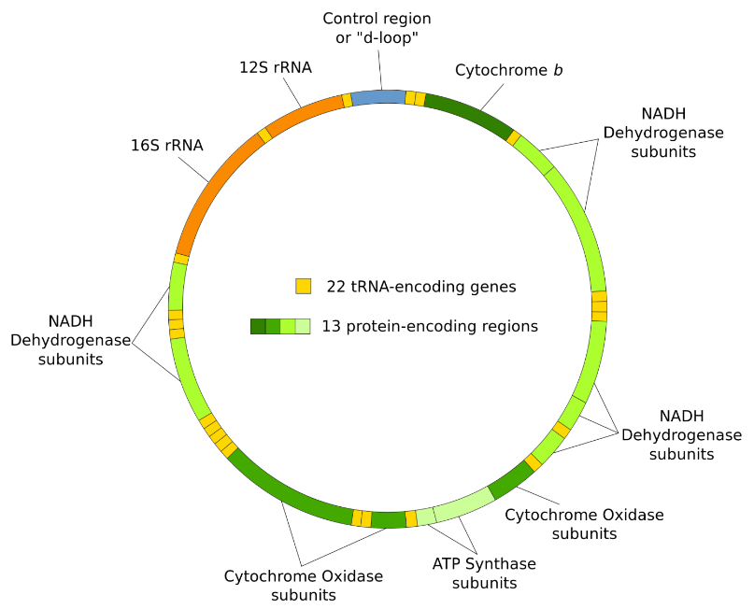
Mitochondrial DNA (mtDNA)
mtDNA is different to DNA because:
mtDNA is found in the mitochondria not the nucleus
mtDNA are small circular molecules that are not bound to histones
mtDNA has 37 genes which are responsible for normal function of the mitochondria
24 of the genes contain the code for making transfer RNA (tRNA) molecules, which are involved in protein synthesis.
The other 13 are responsible for the making enzymes necessary for cellular respiration to occur.
mtDNA is inherited from the mother alone, not both parents like nuclear DNA. This is due to the fact that mitochondria in the sperm are rapidly destroyed after fertilization with the egg. The egg’s mitochondria remain in tack.
Mutations in the mtDNA can cause genetic disorders

Slide 17
DNA REPLICATION

Slide 18
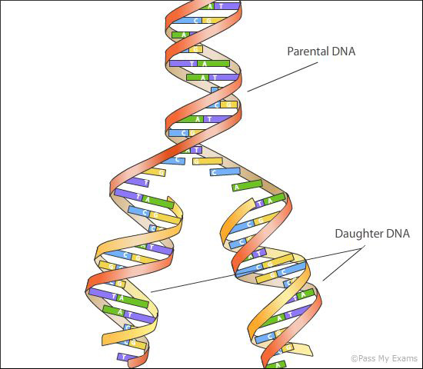
What is DNA replication?
DNA produces exact copies of itself (replication)
Occurs during interphase (period between cell divisions - mitosis)
This ensures inherited information is passed on unchanged when a cell reproduces (mitosis)
The 2 molecules of DNA separate (unzip) using the enzyme helicase. (Breaks the hydrogen bonds between base pairs)
Each separate strand now contains half the original genetic information
This now acts as a template for the nucleotides that will form the new half
Base pair rule applies to form a DNA molecule identical to the original
DNA polymerase adds new nucleotides to the new strand and DNA ligase joins the sections of DNA together.

Slide 19
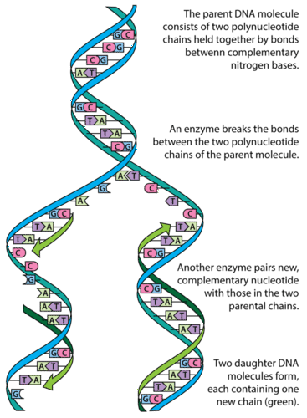
Watch: https://www.youtube.com/watch?v=Qqe4thU-os8
https://www.youtube.com/watch?v=TNKWgcFPHqw

Slide 20
PROTEIN SYNTHESIS

Slide 21
What is protein synthesis?
Synthesis means to ‘build up’ by combining products together. Combining small molecules to make larger molecules.
Protein Synthesis is the process of making proteins from amino acids
Requires matter (amino acids) and energy (chemical bonds)
The sequence of bases in DNA controls the order of amino acids, and therefore the type of protein that is produced.
Some important proteins synthesised by the body include:
Enzymes
Hormones
Antibodies
Structural components of cells
(See the list of proteins and their functions on page 234 in text)

Slide 22
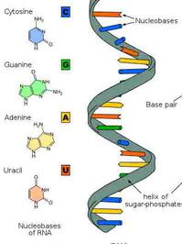
Ribonucleic acids (rna)
RNA is another type of nucleic acid.
RNA is used in the process of protein synthesis.
As ribosomes are responsible for making proteins, the ‘code’ for how to make particular proteins needs to be delivered to the ribosome in the cytoplasm.
DNA is too large to leave the nucleus through the nuclear pore. So an RNA molecule is make and is small enough to exit the nucleus.
Like DNA, RNA is composed of nucleotides.

Slide 23
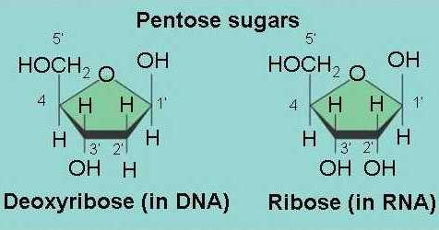
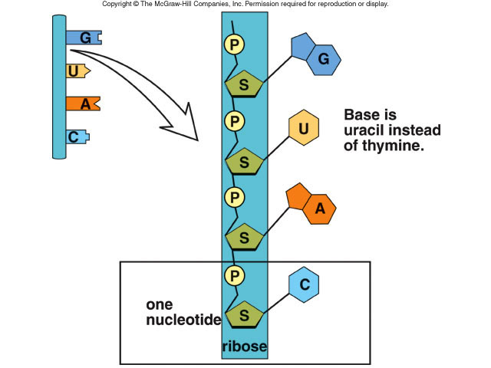
DNA vs RNA
DNA = MASTER PLAN
RNA = BLUE PRINT (of the master plan)
https://www.youtube.com/watch?v=JQByjprj_mA
Comparison | DNA | RNA
Type of sugar in backbone Number of strands Base pair complimentary to Adenine Types | Deoxyribose sugar Double Stranded Thymine nDNA mtDNA | Ribose sugar Single Stranded Uracil mRNA rRNA tRNA

Slide 24
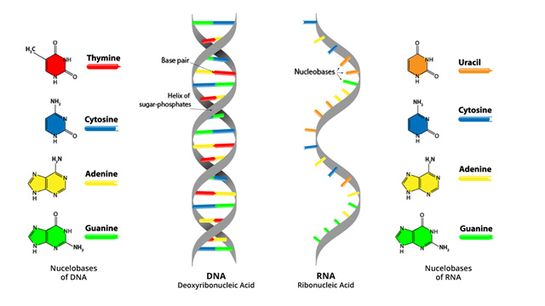

Slide 25
Types of rna
Messenger RNA (mRNA) copies DNA’s code & carries the genetic information to the ribosomes.
Located in the nucleus and travels into the cytosol
Contains codons
Ribosomal RNA (rRNA) makes up to 60% of the mass of the ribosomes. The other 40% is protein. Ensure the correct alignment of mRNA, tRNA and ribosome. It also has an enzymatic role in the formation of peptide bonds between amino acids.
Transfer RNA (tRNA) transfers amino acids to the ribosomes where proteins are synthesized.
Located in the cytosol
Contains anti-codons

Slide 26
Genes and Proteins - The Genetic Code
DNA contains genes which are a sequence of nucleotide bases (codons)
These genes are used to code for proteins (polypeptides)
Proteins (polypeptides) are made up of many amino acids joined together via peptide bonds
There are 20 different amino acids
Each triplet of bases (Codon) is a code for a particular amino acid
Each cell contains identical DNA, however different genes are activated (switched on) in different cells. This means that different cells can produce different proteins.

Slide 27
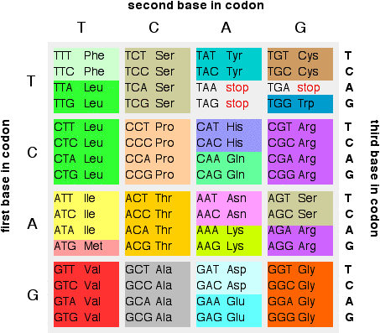
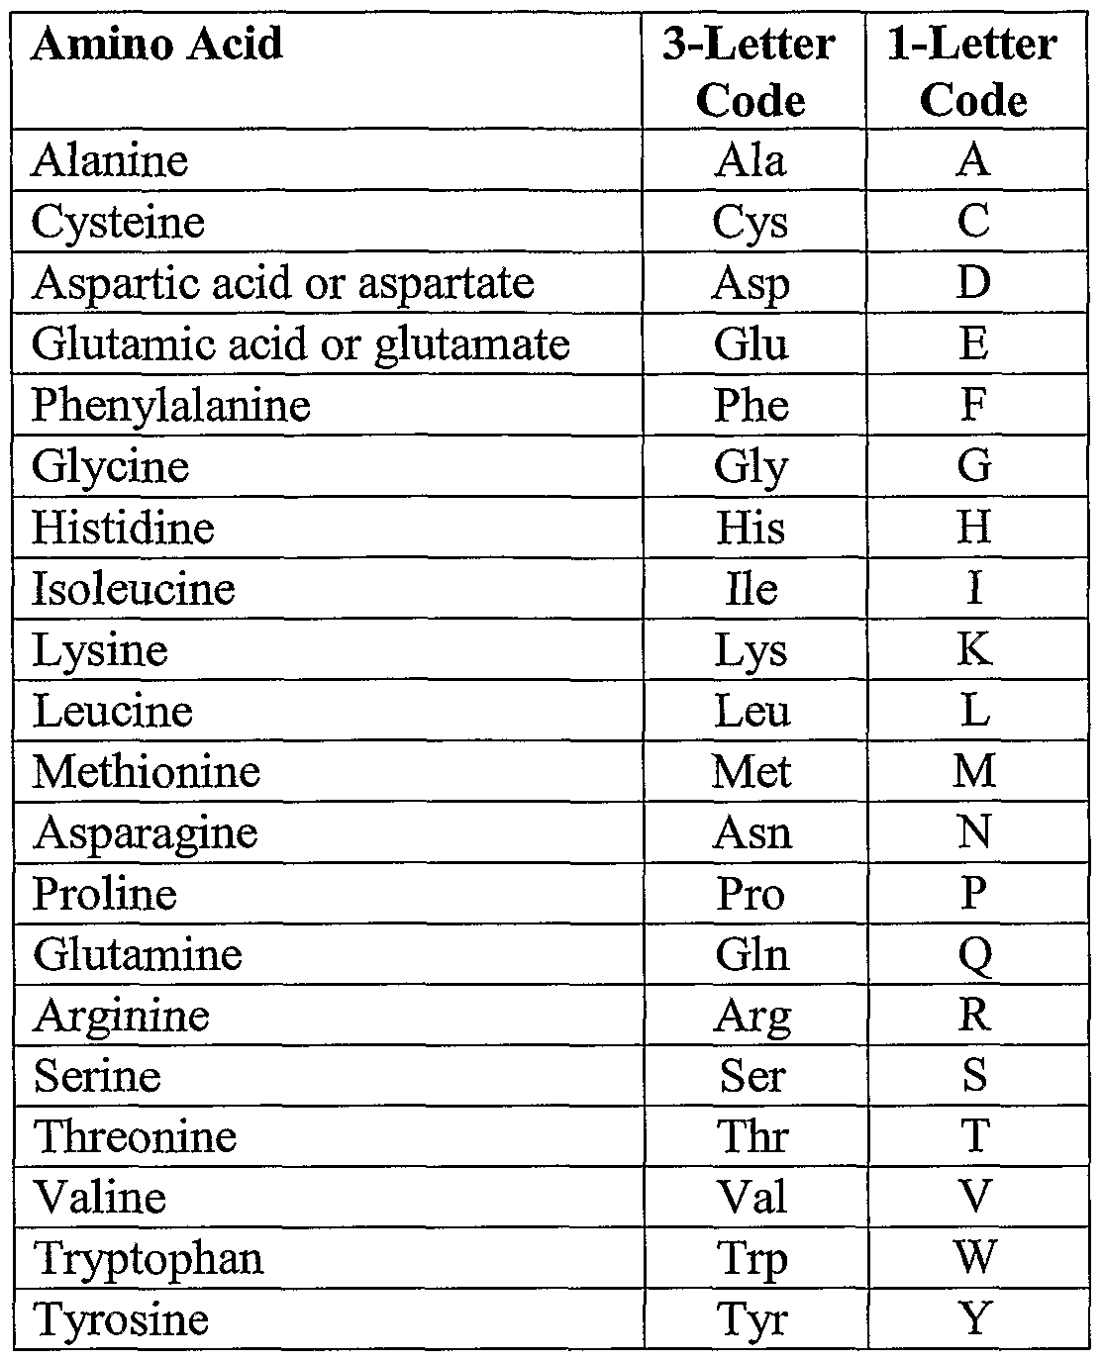

Slide 28
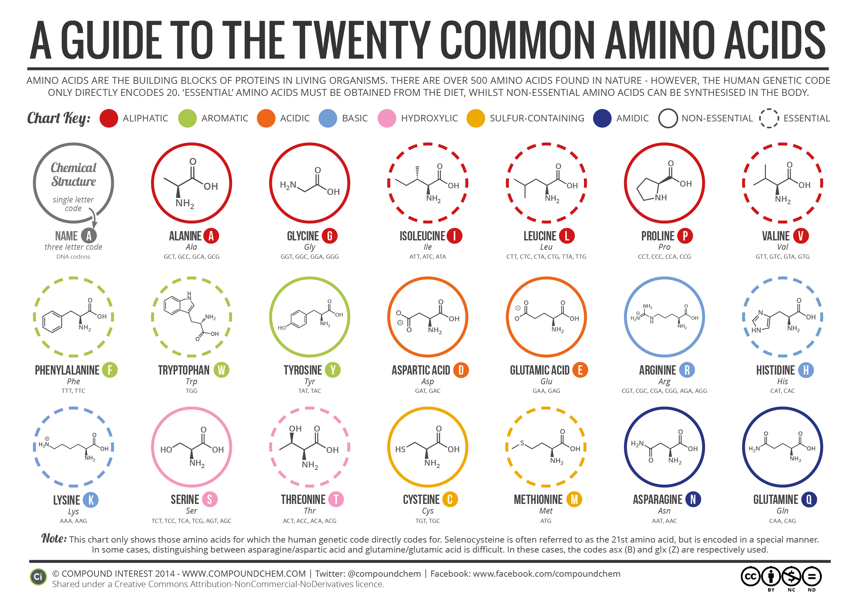

Slide 29
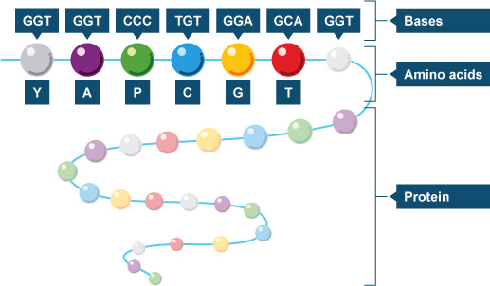

Slide 30
Steps in Protein Synthesis
There are two main steps in protein synthesis:
1. Transcription
Where a copy (blueprint) of the DNA is made (transcribed)
mRNA formed
Occurs in the nucleus of the cell
2. Translation
Where the blueprint (mRNA) is used to create proteins
Involves tRNA
Occurs in the cytosol

Slide 31
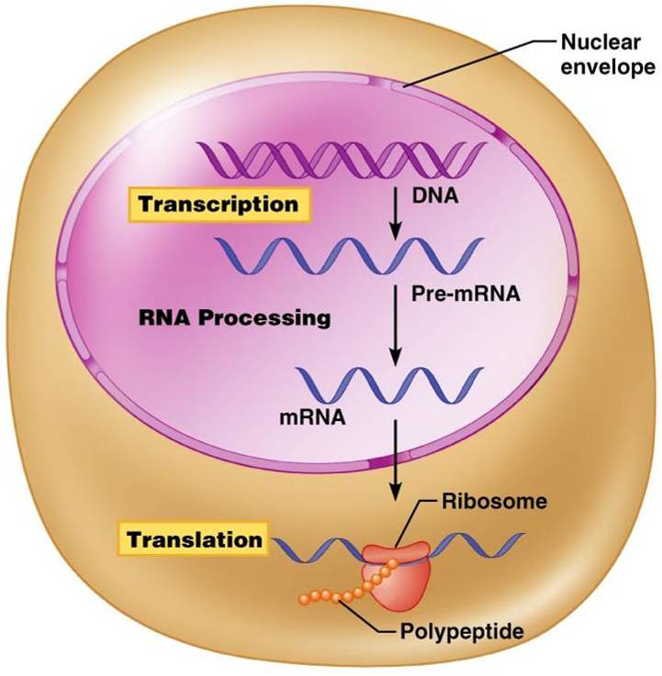
Transcription – The formation of mRNA
Note: the DNA is too large to leave the nucleus via the nuclear pores. Therefore mRNA is created as it is only single stranded and can fit through the pores to enter the cytosol (where translation occurs)

Slide 32
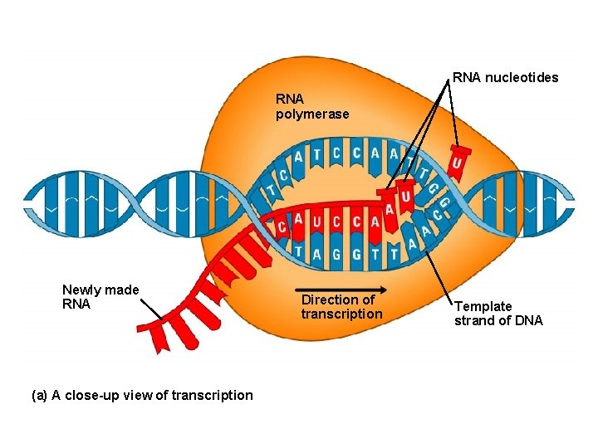
Transcription – The formation of mRNA
The two strands of DNA split (using enzymes known as helicases)
RNA Polymerase (enzyme) triggers the production (transcription) of mRNA from the unzipped DNA strands.
Complimentary molecules of mRNA are formed using the base pairs on the unzipped DNA strand.
A – U
C – G
At the end of the gene a sequence of bases tells the mRNA to stop copying (stop codon). mRNA molecule is now released.
mRNA moves into the cytosol via the nuclear pore

Slide 33
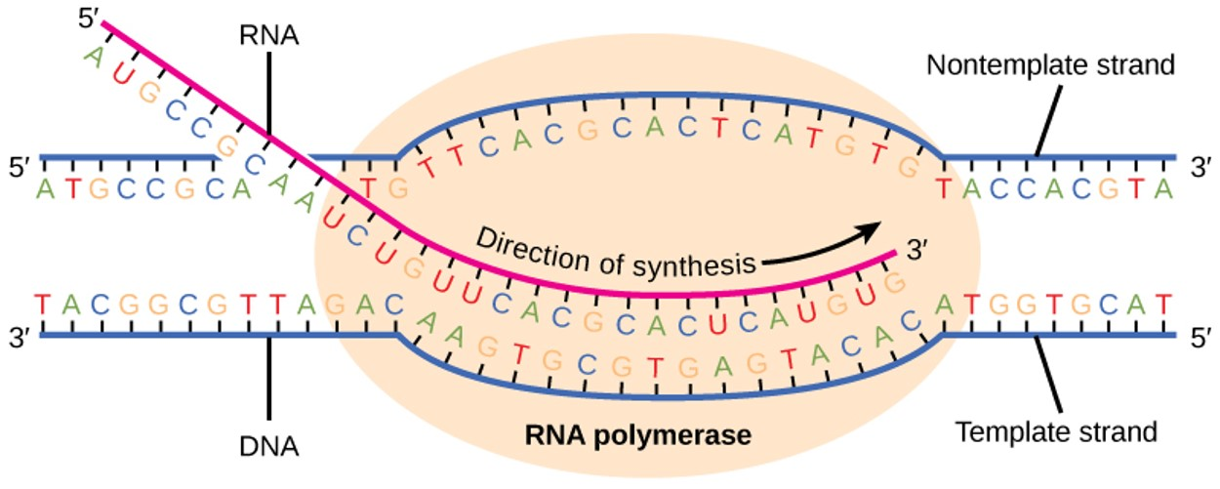
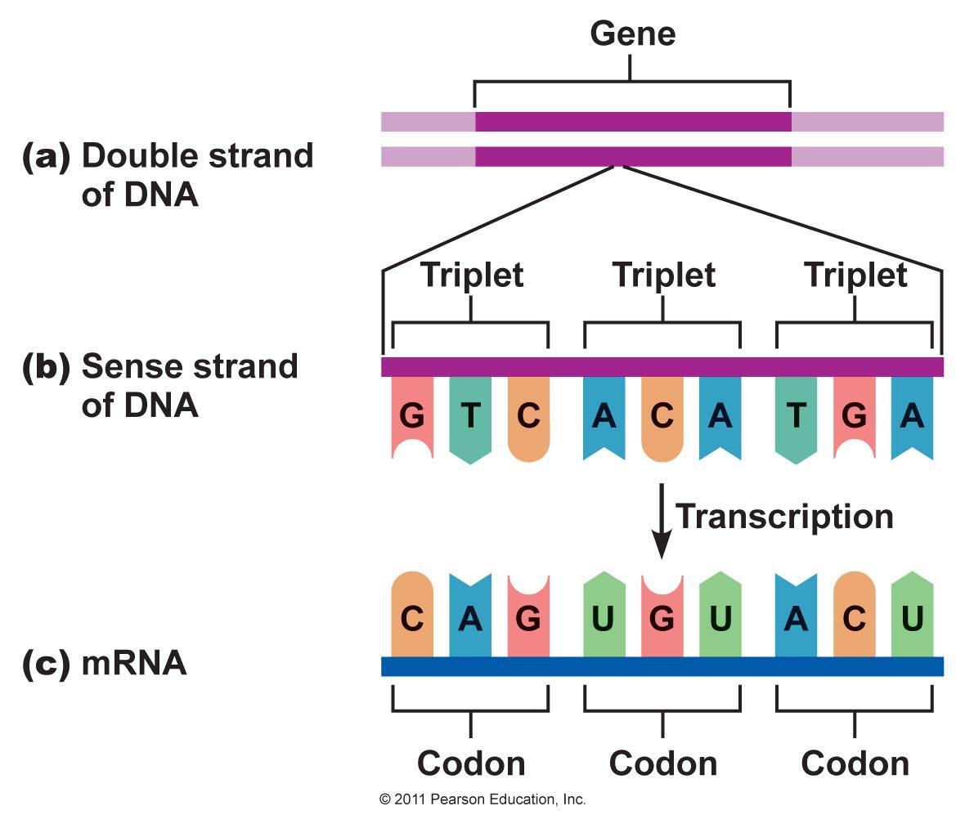
Transcription – The formation of mRNA
During the formation of mRNA, only of the unzipped strands of DNA is copied.
The strand that is copied is called the template strand.
The other strand of DNA is called the coding strand. (the mRNA molecule will have the same code as the coding strand – with the exception of the base uracil)

Slide 34
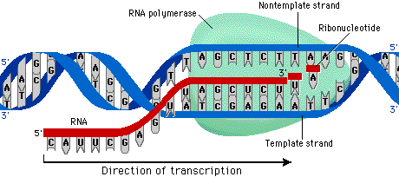

Slide 35
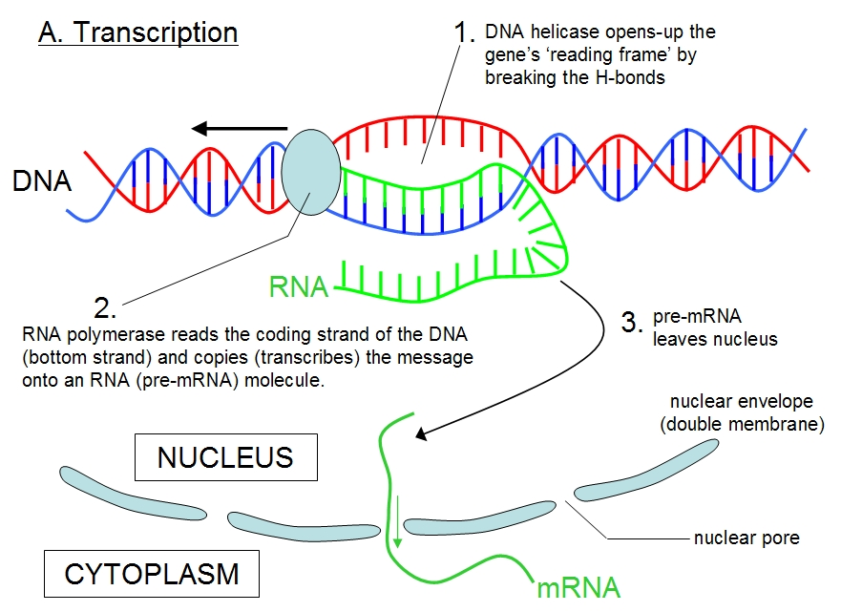

Slide 36
Transcription – The formation of mRNA
Postman Pat is like the ‘Messenger’ RNA
He delivers the important information from the DNA in the nucleus to the Ribosome

Slide 37
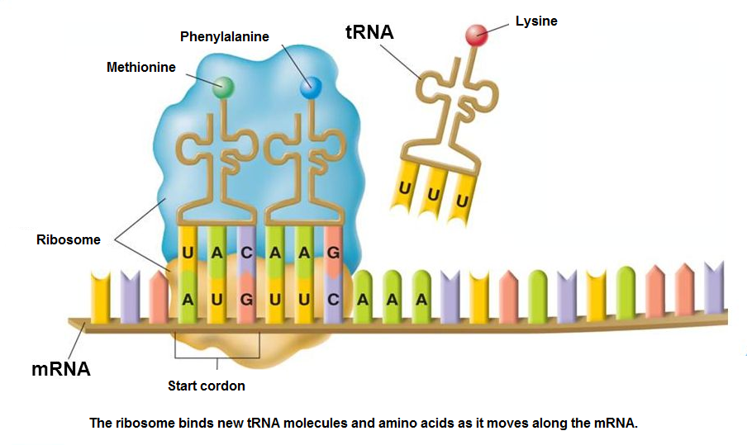
Translation – The production of proteins
In the cytosol one end of the mRNA attaches to a ribosome
The ribosome then moves along the mRNA three bases at a time (codon)
When the ribosome reaches the start codon (AUG) it starts making the protein
For each mRNA codon, tRNA will brings and attach a matching anti-codon. The tRNA brings along an amino acid.
The ribosome continues along the mRNA until all codons are matched with anti-codons (and amino acids)
Peptide bonds bind all the amino acids. This creates a protein molecule. Each peptide bond requires 1 ATP molecule.
Note: once the tRNA has delivered it’s amino acid, it detaches from the ribosome and can then pick up another amino acid from the cytosol

Slide 38
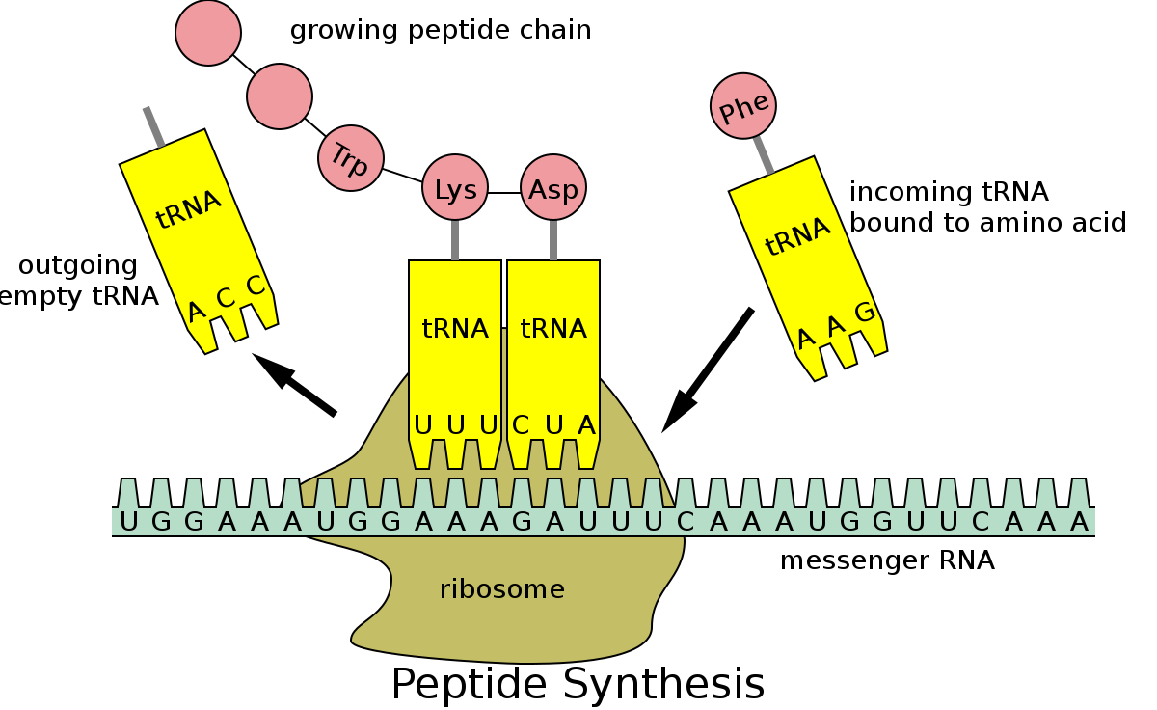

Slide 39
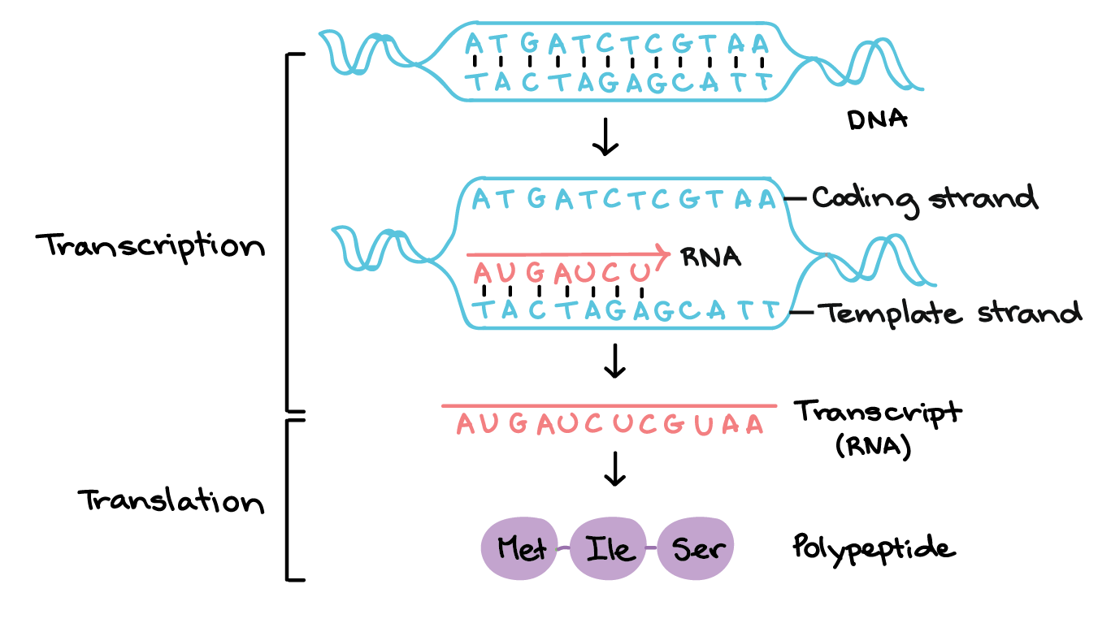

Slide 40
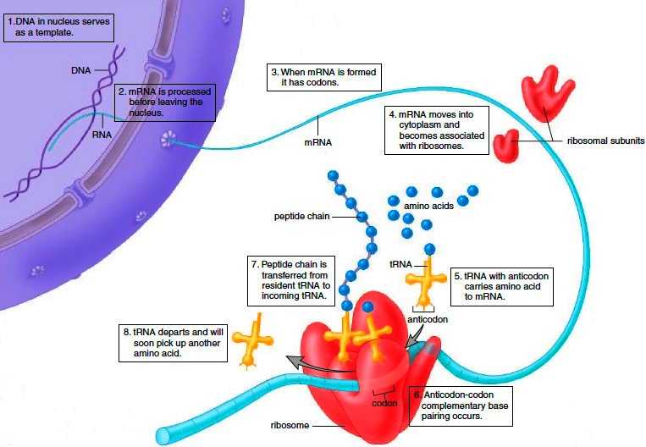

Slide 41
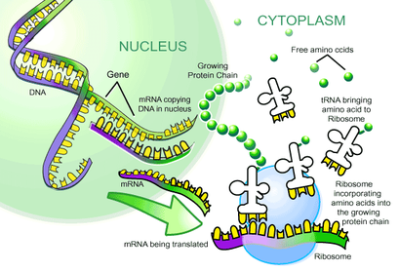

Slide 42
Protein synthesis summary
https://www.youtube.com/watch?v=oefAI2x2CQM
https://www.youtube.com/watch?v=x5ZXQo-xeMo
https://www.youtube.com/watch?v=gG7uCskUOrA
See annotated diagram of this process on page 239 of your text

Slide 43
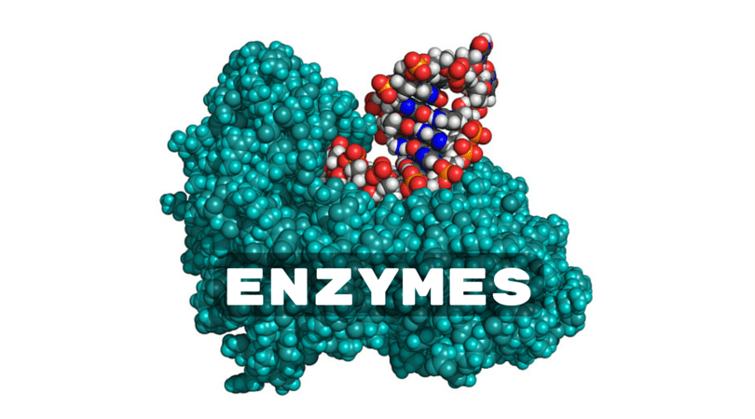
Lipid and Carbohydrate Synthesis
There are no genes that carry instructions for the production on lipids and carbohydrates.
Production of lipids and carbohydrates requires enzymes
Enzymes are proteins
Therefore genes indirectly control the production of lipids and carbohydrates in the body

Slide 44
Gene Expression
Gene expression is the production of a protein using the information encoded in a gene
Genes contain instructions for making mRNA, but at any given time a cell is making mRNA for only a fraction of its genes. It doesn’t make all the possible mRNA at once
Genes that are currently in use are ‘switched on’ (the gene is being expressed)
Genes that are not currently in use are ‘switched off’
Factors that effect whether a gene is expressed or not include:
Age of cell
Time of day
Signals sent from other cells
The environment the cell is exposed to
Whether the cell is undergoing cell division
Many of these factors impacting gene expression are inherited

Slide 45
Epigenetics
Factors that alter gene expression without changing gene structure (which is inherited)
There are many environmental factors (epigenetic changes) that can effect gene expression.
Actions of parents during their lifetime could cause changes to how the genes of their children are expressed
Genome = hereditary information encoded on DNA which effects gene expression
Epigenome = sum of all factors (hereditary and other environmental) that determine gene expression
Abnormal epigenomes can sometimes cause diseases, as cells function differently
https://www.youtube.com/watch?v=_aAhcNjmvhc

Slide 46
Environment and the Epigenome
Environmental factors that can effect the epigenome include:
Severe stress
Nutrition
Exposure to toxins and drugs
These factors do no change the DNA. They interfere with transcription and translation. This changes the proteins produced by the cell.
There are two processes that effect gene expression
Histone modification – Acetylation
Methylation

Slide 47
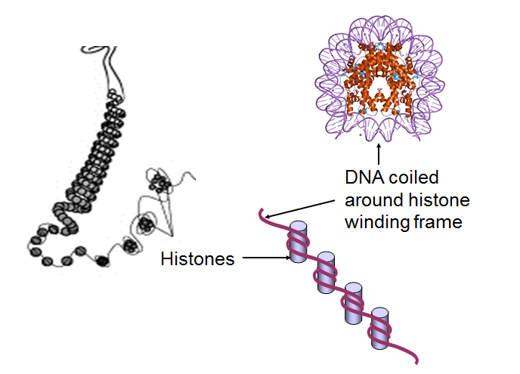
Histone Modification Acetylation
Every cell nucleus contains approx. 2-3 meters of DNA
To prevent strands of DNA becoming tangled, the strands are coiled around proteins called histones
As well as organising the DNA, histones also affect gene expression

Slide 48
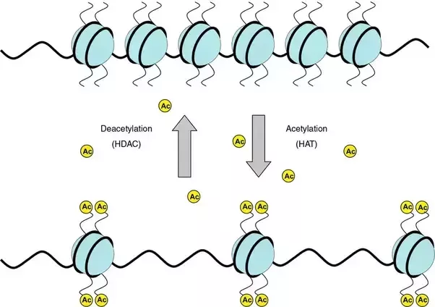
Histone Modification Acetylation
Molecules (e.g. acetyl group = acetylation) can attach to the histone tails, changing the shape of the histone
This will alter the way the DNA wraps around them and the way the gene
Acetylation enhances gene expression
The acetyl group promotes a lose chromatin structure = permits transcription
When there is no acetyl group the chromatin are compact = prohibits transcription

Slide 49
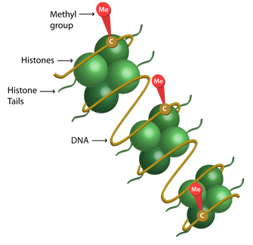
DNA Methylation
Human DNA has small methyl-based (CH₄) molecules attached to some cytosine (C) bases
This is called DNA methylation
These act as an “on/off switch” to silence genes
Genes can be switched on or off by changing the methylation pattern
If genes are switched off accidentally, problems may result (e.g. disease)
The methylation pattern on DNA can be passed on as cells divide (and is therefore heritable)
Methylation inhibits gene expression

Slide 50
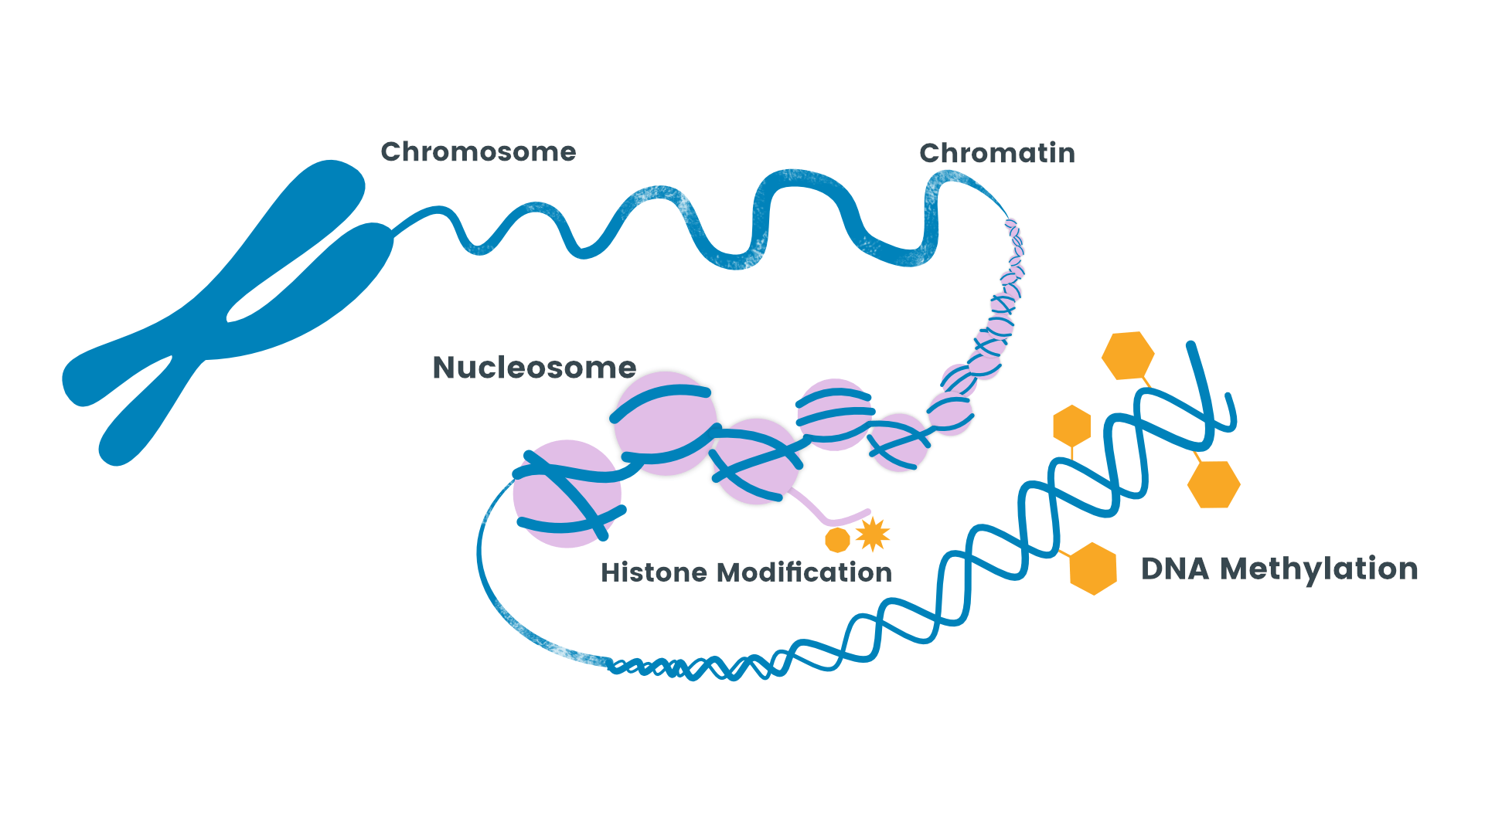

Slide 51
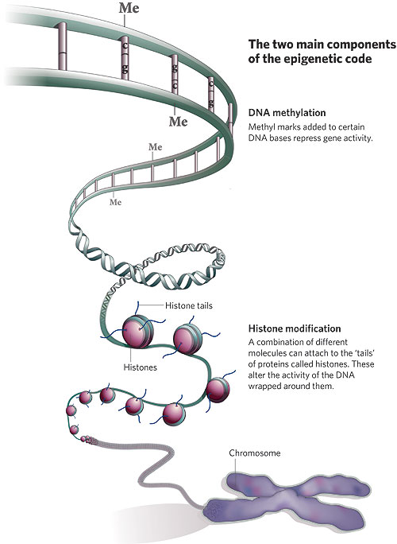

Slide 52
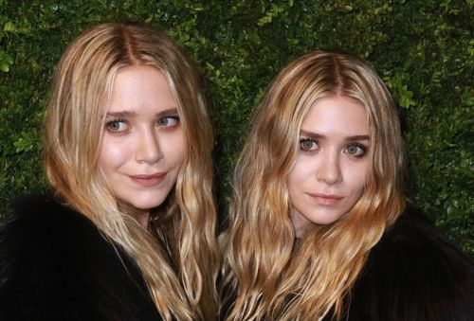
Twin Studies….

Slide 53
Twin Studies
Twin studies look at identical twins (monozygotic twins), because they have identical genotypes
Epigenetic differences (e.g. DNA methylation) can be seen at birth
Studies have shown that epigenetic changes occur rapidly in the first year of life
Twin studies have shown that identical twins accumulate more phenotypic differences as they grow older.

Slide 54
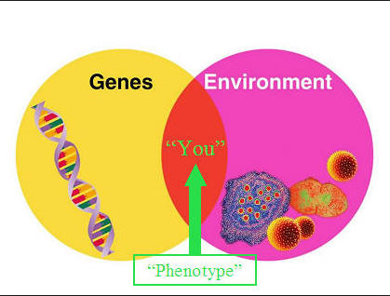
Nature v Nurture
Some traits (e.g. blood type) are determined genetically (‘nature’) and some (e.g. our ability to learn a language) are determined largely by our environment (‘nurture’)
Many are determined by the interaction of genetic and environmental factors

Slide 55
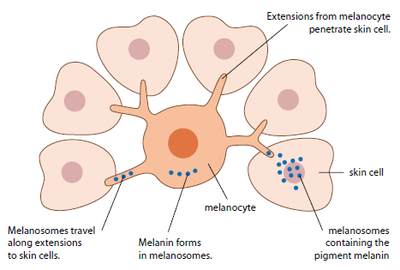
Because everyone loves a tan….
Skin colour depends on the amount of melanin (a pigment) present
Special skin cells called melanocytes produce melanin
Variation in melanin is largely due to genes which affect melanin production
Melanocytes will also produce large amounts of melanin when stimulated by UV light (tanning)
Effect of tanning can be reversed, effect of genes can not be reversed

Slide 56
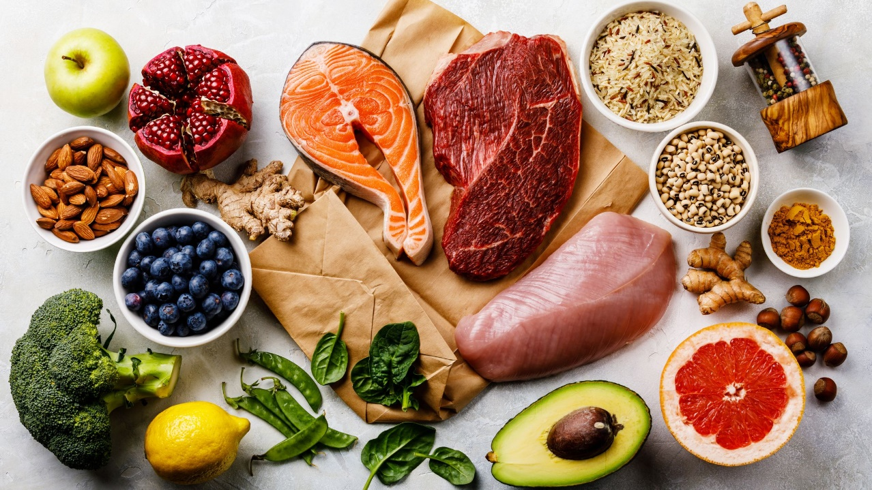
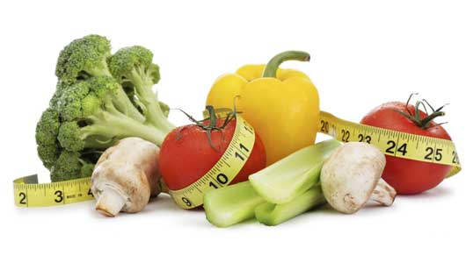
You are what you eat??
A diet deficient in essential proteins and minerals can result in a person not achieving potential height
Excessive food intake results in an increase in adipose (fat) tissue

Slide 57
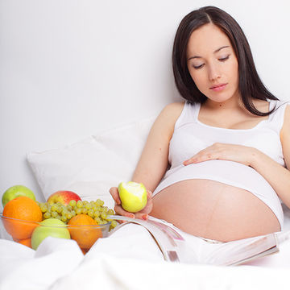
You are what you mum eats????
A deficiency in the diet of a pregnant mother can affect the development of the child:
deficiency of iodine may lead to cretinism (retarded physical and mental development)
deficiency of folate can result in spina bifida (neural tube defect)

Slide 58
Other examples of epigenetic factors….
Hormones – e.g. male pattern baldness influenced by high levels of testosterone
Drugs – e.g. thalidomide influences foetal limb development
Exposure to disease affects immunity
Education affects intelligence

Slide 59
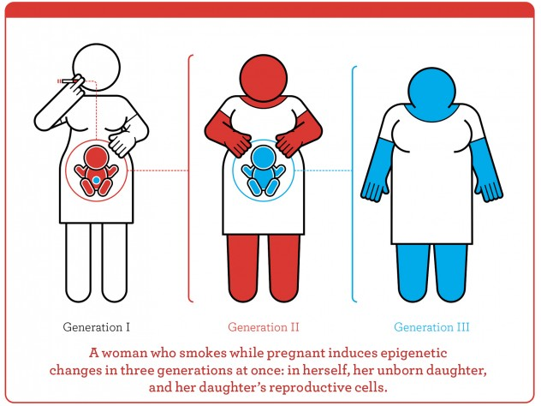

Slide 60
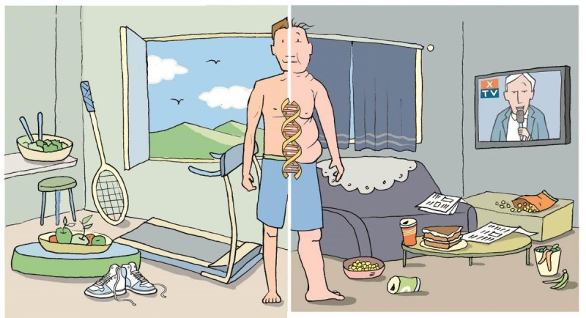

Slide 61
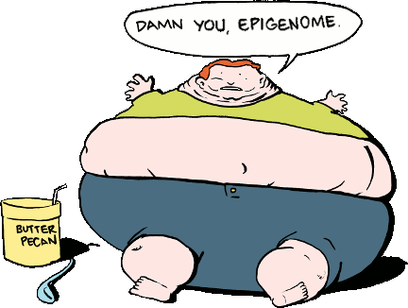
Chapter Review Questions
Complete the CRQ’s on page 246 - 247

