Slide 1
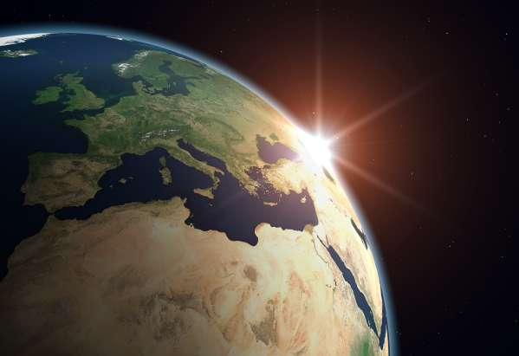
YEAR 9 REVISION
Geography

Slide 2
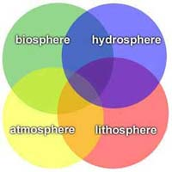
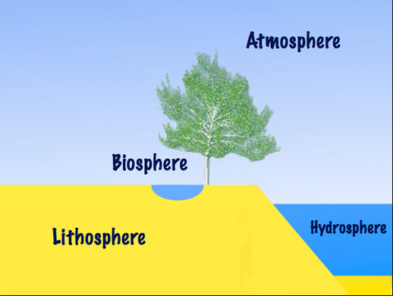
The Earth is a dynamic structure.
The Earth is composed of four spheres:
lithosphere
hydrosphere
biosphere and
atmosphere

Slide 3
Lithosphere
The upper shell of the solid earth comprising the crust and the upper mantle
There are two basic types of lithospheric crust
oceanic lithosphere – this is a thin (<10km thick) dense crust made up of younger volcanic basalt less than 300 million years old
continental lithosphere – thicker (20-80km thick) less dense made up of older granites, sedimentary, volcanic and metamorphic rock as much as 2 billion years old

Slide 4
The Lithosphere
Copy this diagram into your notes

Slide 5
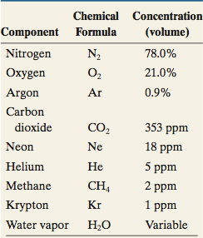
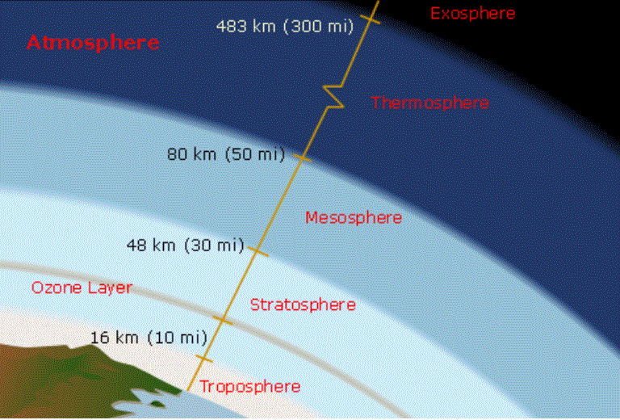
Atmosphere
A relatively thin layer of odourless, tasteless and colourless gasses (air) and dust surrounding the earth
note down the three major components of the atmosphere and copy the diagram showing the layers of the atmosphere

Slide 6
Earth atmosphere vs. neighboring planets
Earths atmosphere is dominated by nitrogen and oxygen unlike Mars and Venus where the atmospheres are mainly carbon dioxide

Slide 7
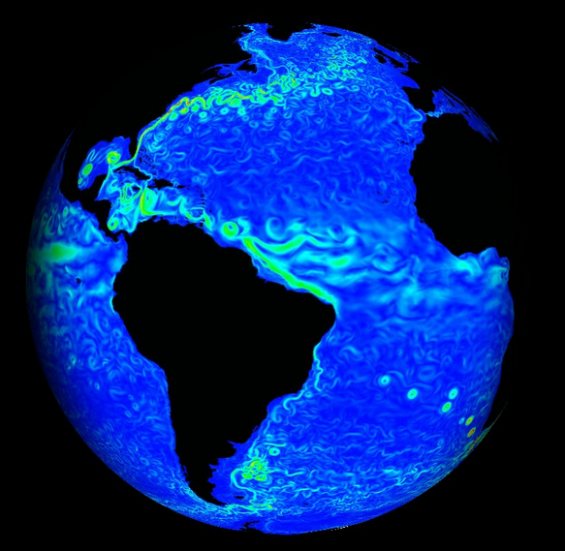
Hydroshere
All water of the earth including water found on the surface, underground and in the atmosphere
Most of the Earth’s water resides in seas which cover 70% of the Earth’s surface and contain 97% of the Earth’s water

Slide 8
HYDROshere; Liquid, Vapour, Solid
The hydrosphere includes water that is on the surface of the planet, underground, and in the air.
Liquid water exists on the surface in the form of oceans, lakes and rivers. It also exists below ground as groundwater, in wells and aquifers.
Water vapor is most visible as clouds and fog.
The frozen part of Earth's hydrosphere is made of ice: glaciers, ice caps and icebergs. The frozen part of the hydrosphere has its own name, the cryosphere.

Slide 9
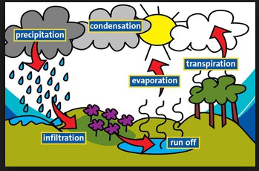
The Water Cycle
Water moves through the hydrosphere in a cycle. Water collects in clouds, then falls to Earth in the form of rain or snow. This water collects in rivers, lakes and oceans. Then it evaporates into the atmosphere to start the cycle all over again. This is called the Water Cycle.
Draw the water cycle

Slide 10
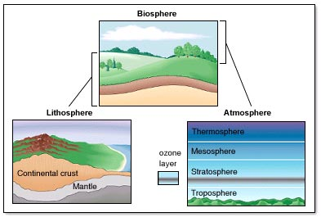
Biosphere
Those zones of the earth where all life exists

Slide 11
Introduction to systems
A system is a network of parts (or elements) that interact to form an overall pattern
Key features of a system include:
The elements or different parts
The interactions between the elements to form the characteristic pattern of that system
Adaptions or changes to the pattern when elements change
An ecosystem is an example of a system with elements, interactions and adaptions

Slide 12
Natural and social systems
Systems are divided into natural and social systems
Natural systems are not created by humans (although humans are elements within them and have an impact on them). Examples include the solar system, water cycle, ecosystems and river catchments.
Social systems are created and controlled by humans. Examples include economic systems, political systems and education systems

Slide 13
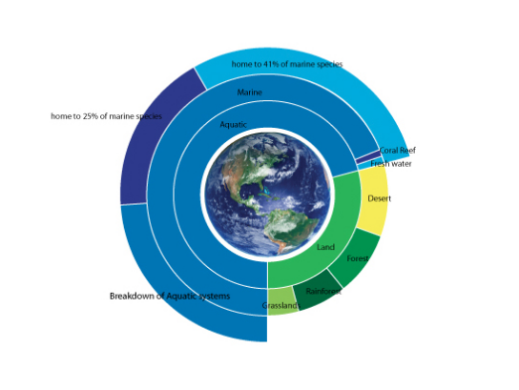
Ecosystems
An ecosystem is composed of living and non-living things which interact with each other within a particular environment

Slide 14
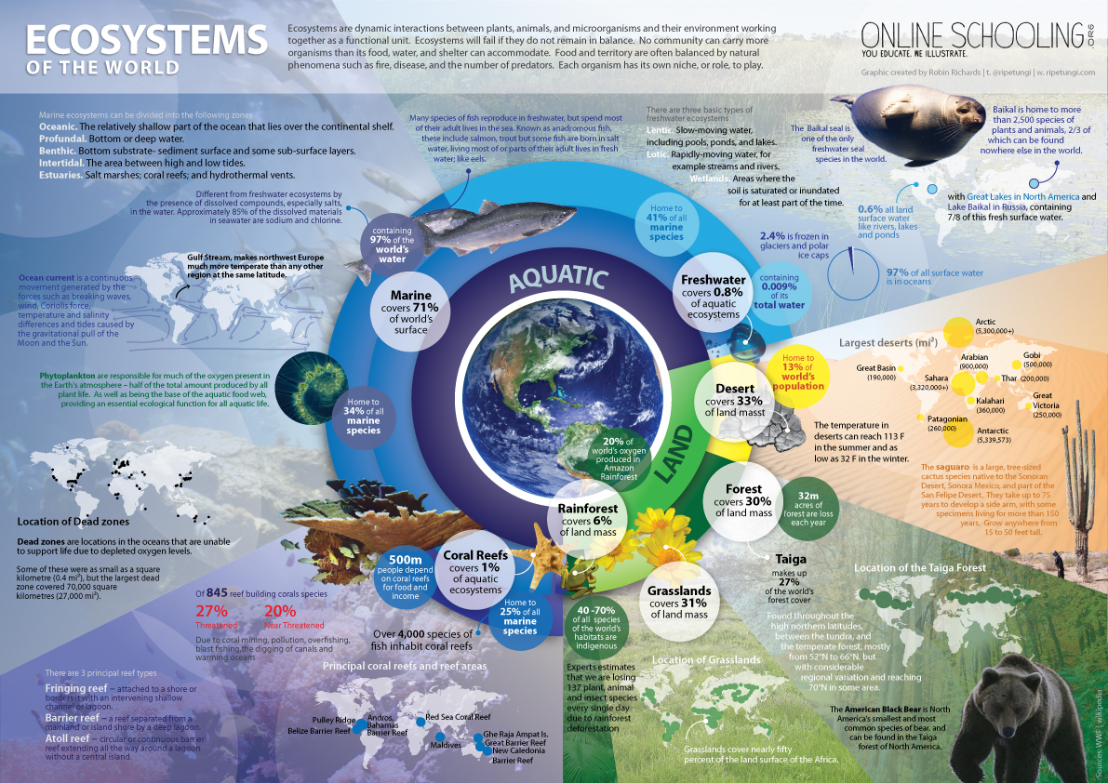

Slide 15
Components of an ecosystem
The living component – this is the organic or biotic component. All living things together with their by-products are included in this category
Living plants and animals (fish reptiles, insects, plants, birds) and micro-organisms
Dead plant and animal tissue
Body wastes such as urine and faeces
The Non Living Component – is the inorganic or abiotic component. The most important of these being the sun which radiates sunlight(solar energy) to the earth and provides energy for all the processes occurring within ecosystems. The other non-living components include;
The atmosphere; vital gasses of oxygen, carbon dioxide, nitrogen and water vapour)
The lithosphere; soils, rocks, minerals and landforms
The hydrosphere; water and dissolved minerals

Slide 16
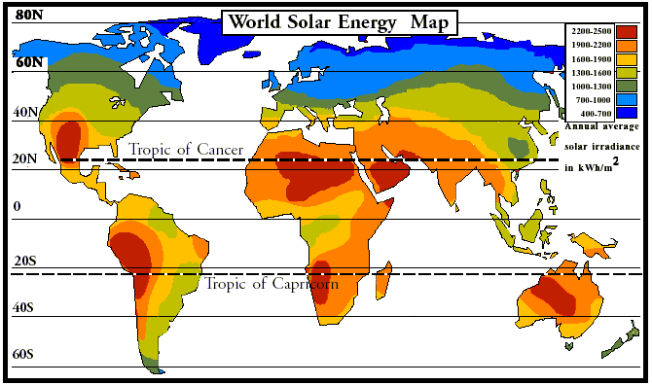
Solar map

Slide 17
World climate zones

Slide 18
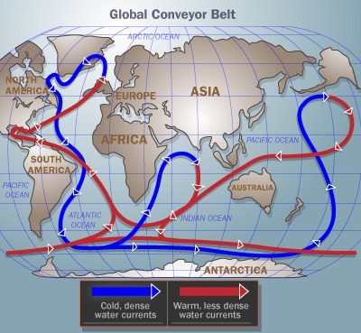
World climate zones

Slide 19
Factors the effect the local climate
LAPDOG
Latitude – how far you are from the equator
Altitude – the higher you are from sea level the colder it is
Prevailing winds – does the wind mainly come from cold or warm areas
Distance from the sea – oceans moderate climate
Ocean currents – warm ocean currents bring warm moist air
Geography - what is the area like; topography, vegetation & nearness to mountains

Slide 20
World Biomes

Slide 21
Biomes
A Biome is a large area with a similar physical environment that is home to a distinct community of living things. Each of these living communities contain species that are adapted to the climate and soil and to living with each other
Biomes have changed and moved many times during the history of life on Earth
More recently, human activities have drastically altered these communities. Thus, conservation and preservation of biomes should be a major concern to all

Slide 22
Categorizing biomes
The seven major types of biomes are;
Water (freshwater or ocean)
Rainforest (tropical or temperate)
Tundra and mountain
Desert
Taiga (coniferous forests)
Deciduous forests
Grassland

Slide 23
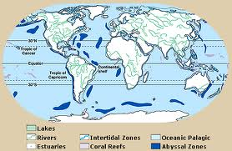
Aquatic biomes
Water is the common link among the five biomes and it makes up the largest part of the biosphere, covering nearly 75% of the Earth’s surface. Aquatic regions house numerous species of plants and animals, both large and small. In fact, this is where life began billions of years ago when amino acids first started to come together.
Fresh Water
Ponds and lakes
Rivers and streams
Wetlands
Salt Water
Oceans, seas, coral reefs
and estuaries

Slide 24
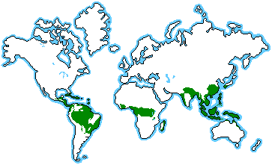
Rainforest biomes
Rainforests are thick, warm and wet forests. They are forests that get at least 250 cm a year of rain, often more.
There are two kinds of rainforest: tropical and temperate. Both kinds are endangered.
Tropical rainforests are millions of years old, and temperate rainforests are about 10,000 years old.

Slide 25
Tundra
Tundra is the coldest of all the biomes. Noted for its frost-molded landscapes,
extremely low temperatures, little precipitation,
poor nutrients, and short growing seasons.

Slide 26
Desert biomes
Deserts cover about one fifth of the Earth's surface and occur where rainfall is less than 50 cm/year. Although most deserts, such as the Sahara of North Africa and the deserts of the southwestern U.S., Mexico, and Australia, occur at low latitudes, another kind of desert, cold deserts, occur in the basin and range area of Utah and Nevada and in parts of western Asia

Slide 27
TAiGA forest biomes
Taiga, also called boreal forests, is the largest land biome. These forests are found in a broad belt across Europe, Asia and North America : about two thirds are in Siberia, and the rest are in Scandinavia, Alaska and Canada.
In this biome, summers are short and mild and the winters are long, cold and dry.

Slide 28
Temperate forest biomes
The deciduous forest has four distinct seasons, spring, summer, autumn, and winter. In the autumn the leaves change color. During the winter months the trees lose their leaves.

Slide 29
Grassland biomes
Grassland biomes are large, rolling terrains of grasses, flowers and herbs. Latitude, soil and local climates for the most part determine what kinds of plants grow in a particular grassland. A grassland is a region where the average annual precipitation is great enough to support grasses, and in some areas a few trees. The precipitation is so eratic that drought and fire prevent large forests from growing

