Slide 1
NATURAL SELECTION

Slide 2
What is natural selection?
Natural selection is the evolution of species due to beneficial alleles being passed to future generations. Environmental factors play an important role in natural selection.
Genetic variation describes the differences in alleles within a population
For example: different coat colours
Genetic variations allow natural selection to occur

Slide 3
Adaptations
Adaptations are changes in a species over a period of time which can help the organism to survive. Adaptations occur over generations due to mutations. There are 3 types of adaptations:
Structural – Physical features of the organism
Behavioural – How the organism acts
Physiological – How the internal systems of the body respond to stimulus

Slide 4
What type of adaptation?
Kangaroo has a long thick tail
Elephants dilate blood vessels in their ears when they are hot
Birds migrate at various times of the year
Snails retract into their shells
Spiders produce venom which is injected into their prey
Polar bears have white fur

Slide 5
Natural Selection and environmental factors
The environmental facts that acts on the population is called the ‘selective pressure’
Selective pressures select adaptations that help an organism survive in its environment
The selective pressure may be biotic (living) such as predation, bacterial infection or competition
Or it may be abiotic (physical) such as temperature, water, fire or soil nutrients
Those species which are not affected by this pressure breed and pass on their favourable genes to the future generations

Slide 6
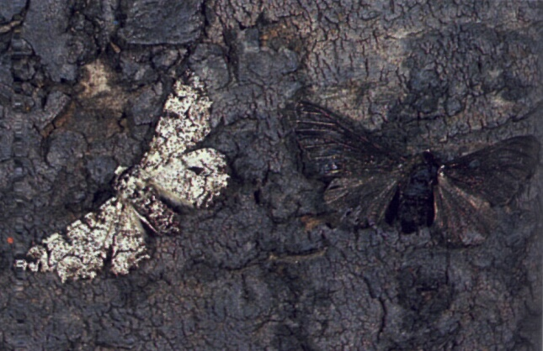
Peppered Moth
How many moths can you see here?
Which moth do you think would best survive predation and why?

Slide 7
Peppered moth
The peppered moth is a classic example of natural selection
The selective pressure in this case was predation
Light coloured pepper moths were abundant over 200 years ago. These moths camouflaged with the light coloured bark on the trees
During the industrial revolution the huge increase in pollution cause the bark of the trees to darken
The lighter coloured moths were no longer camouflaged and begin to become victims of predation
The darker coloured moths which were less abundant at the time began to increase their population as they were able to avoid predation
Light coloured pepper moths were abundant in the country side
Dark coloured pepper moths were abundant in the urban areas

Slide 8
Lets play a game...

Slide 9
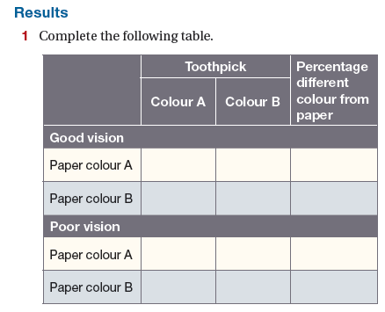

Slide 10
Natural Selection
Many selective agents act by killing individuals. These individuals are seen as ‘less fit’
For example: the slowest runner in a herd of sheep
However not all selective agents act by killing.
Charles Darwin called this ‘sexual selection’. This is because often females will select the brightest and most beautiful male to mate with. The offspring will therefore have similar genes and most likely have a higher chance of producing more offspring.

Slide 11
Variation
Darwin discovered that natural selection could only occur if their was genetic variation (natural differences) within a population
Variation is a difference in genes, which results in difference in characteristics
The difference in genes allows species carrying a particular trait to be more ‘fit’ in varying conditions

Slide 12
Focus Question
What would happen if all individuals in a population contained the same identical genetic makeup?
What would happen if a disease affected this population?

Slide 13
Resistance to disease
As we have seen from the ‘breeding like rabbits’ exercise species can become resistant to diseases
Can we think of any other examples of resistance?

Slide 14
Case study - Insects and insecticides
Insecticides have been used quite readily for the past century
At first these appeared to work well, however over time farmers and scientists found that the effectiveness of the insecticides was decreasing.
Farmers resulted to increasing the concentration of these insecticides
The found that some, but not all the insects died
Eventually the insecticides had no effect on the insect populations
How is this the case?

Slide 15
Case study - Insects and insecticides
This is a classic example of natural selection
Every time the farmers sprayed, there would be a larger portion of insects who survived. This meant they were able to pass on the desired gene which was resistant to the insecticide.

Slide 16
Bacteria and Antibiotics
Similar to the insect scenario, bacteria can become immune to antibiotics via natural selection
Bacteria reproduce asexually – by making an identical copy of itself
If we have an infection we often take antibiotics to kill the bacteria in our body that is making us sick
Often some of the bacteria will be resistant to the antibiotic. This bacteria will remain in your body and will reproduce. As the offspring are identical to the parent cell they will also be resistant to the medication

Slide 17
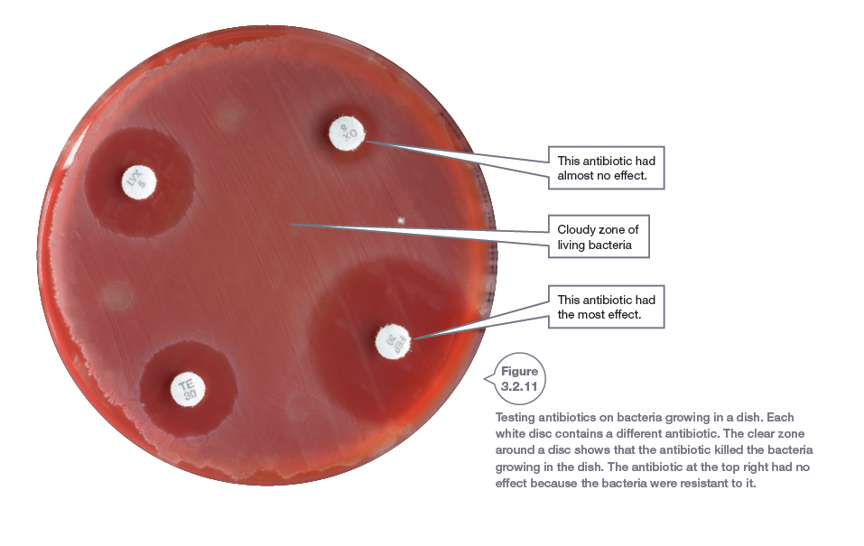
Bacteria and Antibiotics

Slide 18
Evolution
Charles Darwin proposed that new species could occur as a result of natural selection
The theory of evolution states that similar species must be closely related to each other. For example: Primates and humans
Darwin studied finches on the Galapagos Islands and found that the finches on different islands had different beaks…… how could this be???

Slide 19
Speciation
Speciation is the process where one species separates into two or more separate species
Speciation is responsible for the high biodiversity around the earth
Biodiversity is the number and range of different species that exist around the world
Did you know: the South West of Australia is the only biodiversity hotspot in Australia!!

Slide 20
Speciation
The are 3 main factors required for speciation (and therefore evolution) to occur:
1. Variation (Difference in genes)
2. Isolation
3. Selection

Slide 21
Isolation
Isolation as the name suggests is simply where a group of the same species are separated by one another
This causes a change in the genetic makeup of those species and new species evolve over time
The main causes of isolation are geographical (oceans, rivers, deserts, mountains) or climatic (Rainfall, temperature, salinity, sunlight)

Slide 22
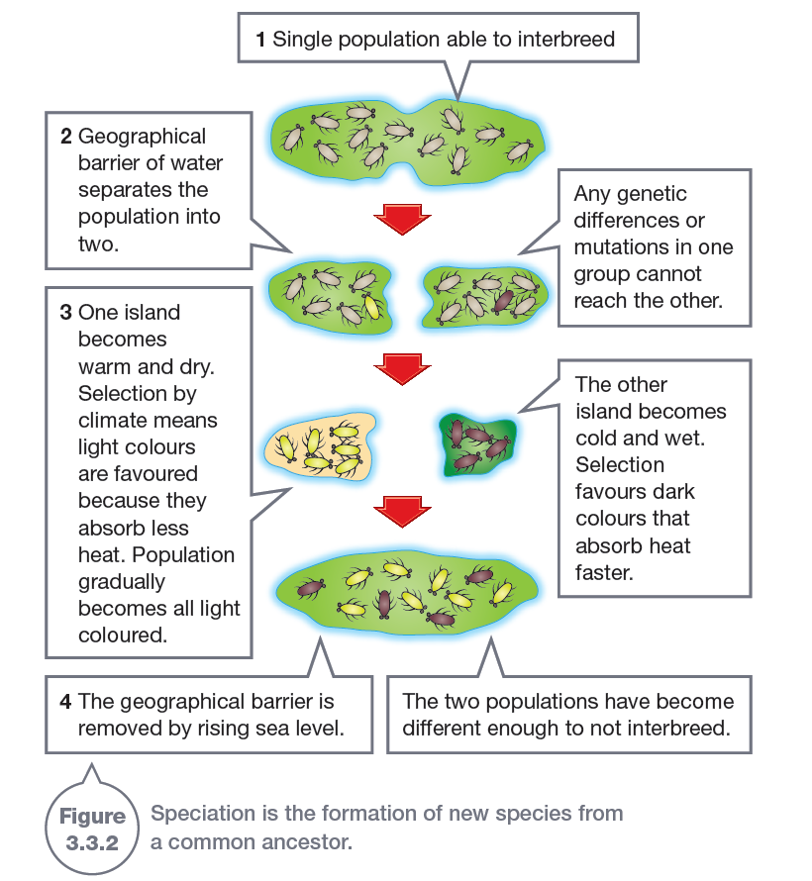
Isolation

Slide 23
Selection
Selection is all about mating
Once a species is separated by a barrier (geographical or climatic) changes in the selection processes can occur. Such as:
1. Courtship Behaviour
2. Breeding Seasons
3. Sterility (Mule)
4. Chemical Barriers (Sperm killed by chemical makeup of females)

Slide 24
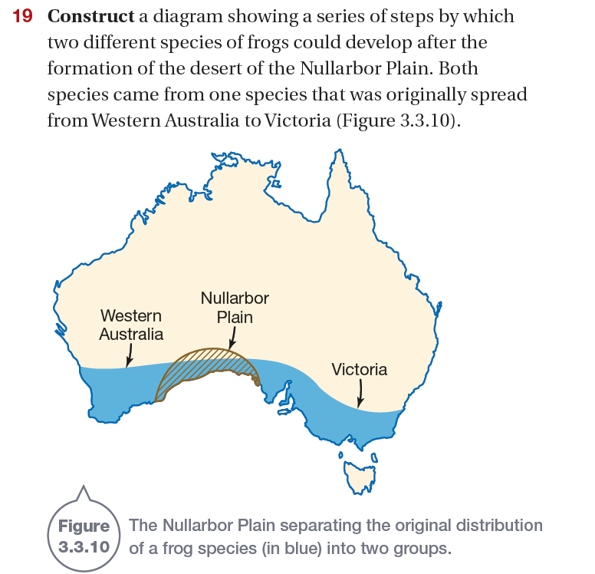
Worked example
The frogs within the original population had variation in there genes
The population was the divided into two isolated populations
Those frogs who best survived the conditions of those 2 populations (climate, predation, food etc.) then reproduced. This passed on favourable genes

Slide 25
Linking it together….
As the populations have isolated and there was variation within those populations, the fittest individuals are those which survive and are most successful at reproduction (passing on genes)
Both populations are faced with different environmental conditions and therefore often evolve to display varying traits
The finches on the Galapagos were isolated by geographical barriers. As each island has a slightly different biodiversity the finches evolved to grow different beaks based on the food supply available to them.

Slide 26
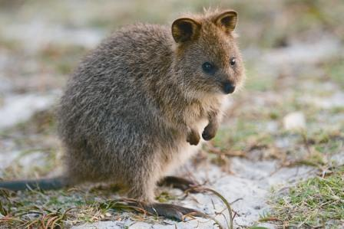
Examples
Can you think of an example of speciation right here in Perth?
Quokkas on Rottnest Island

Slide 27
Biodiversity
Biodiversity is the number and range of different species that exist around the world
Biodiversity impacts evolution as the biodiversity of an area affects the interactions and survival of the species
To ‘fittest’ individuals of a species survive the conditions and produce the most offspring

Slide 28
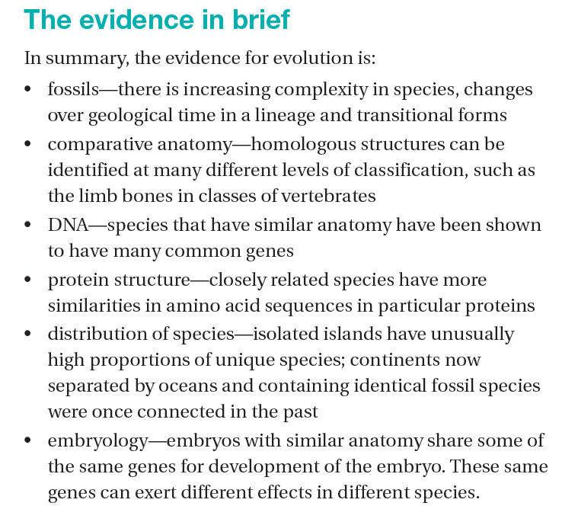
Evidence for Evolution

