Slide 1
Topic 12: Mitosis, Cancer & Meiosis
r. Johansen 2021

Slide 2
The cell cycle

Slide 3
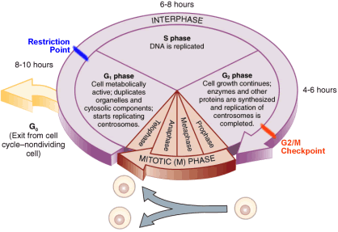
The Cell Cycle

Slide 4
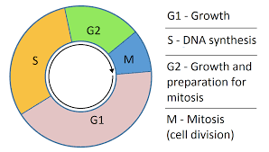
The Cell Cycle
Cells need to reproduce for a number of reasons:
When organisms grow
Replace old, dead of damaged cells
The Cell cycle is the events that take place from one cell division to the next!
It is called the cell cycle because the events keep repeating as the cell divides over and over again.

Slide 5
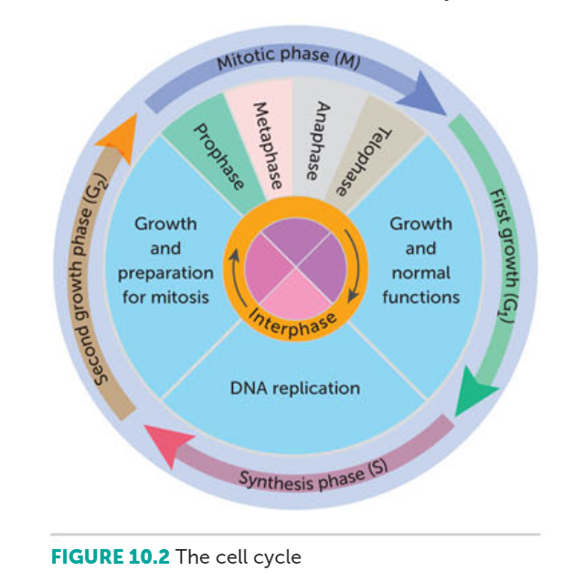
Phases of Cell Cycle

Slide 6
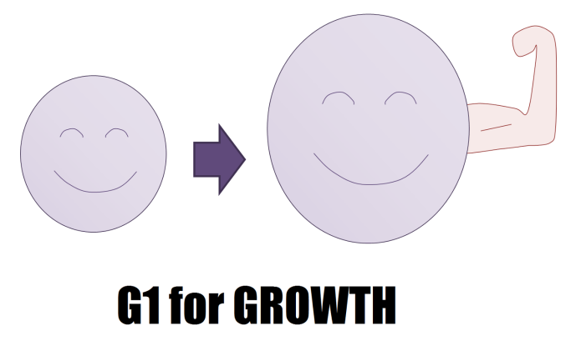
Phases of Cell Cycle – G1
G1 Phase or first growth phase
The cell produces new proteins, grows and carries out its normal tasks for the body
The phase ends when the cell’s DNA begins to duplicate

Slide 7
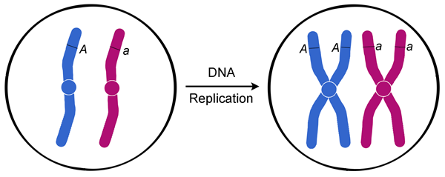
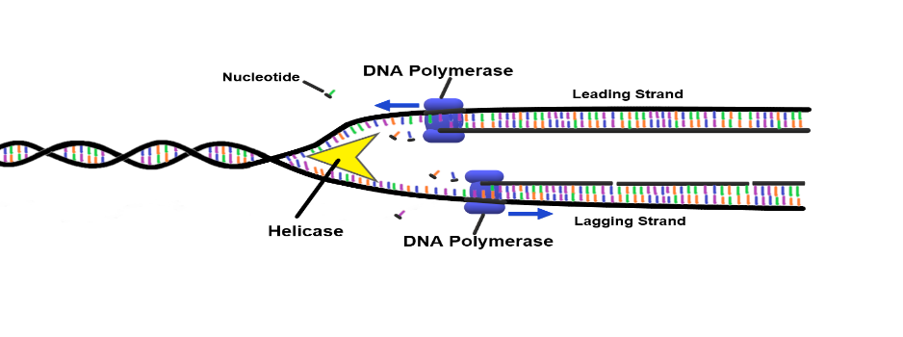
Phases of Cell Cycle – s
S Phase or synthesis phase
DNA molecules in the cells nucleus form exact copies of themselves (DNA replication)

Slide 8
Phases of Cell Cycle – G2
G2 Phase or second growth phase
This is a relatively short phase
This involves preparation for cell division (growth)

Slide 9
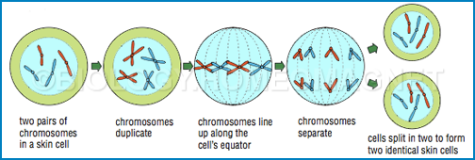
Phases of Cell Cycle – M
M Phase or mitotic phase
The cell divides into 2 daughter cells

Slide 10
Phases of Cell Cycle – G1 OR G0
After mitosis, cells may continue the cell cycle and re-enter the G1 phase.
Some cells leave the cell cycle and enter to G0 phase.
G0 Phase or no growth phase
Some cells will leave the cell cycle and stop dividing for days, years or even the rest of the persons life.

Slide 11
Mitosis production of body cells

Slide 12
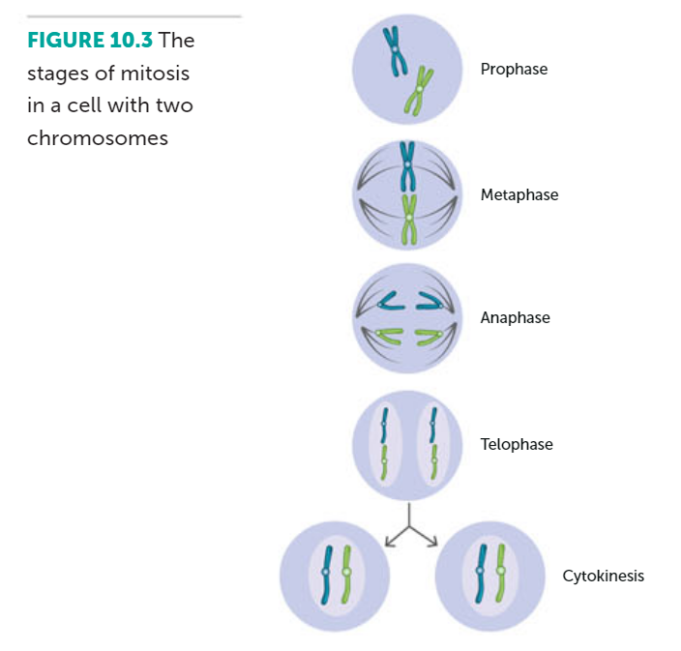
Mitosis
When cell reproduces, it is vital each new cell gets exactly same DNA as parent cell
Therefore, each new cell must contain the same genetic information as the parent cell
This is achieved by division of the nucleus, known as Mitosis

Slide 13
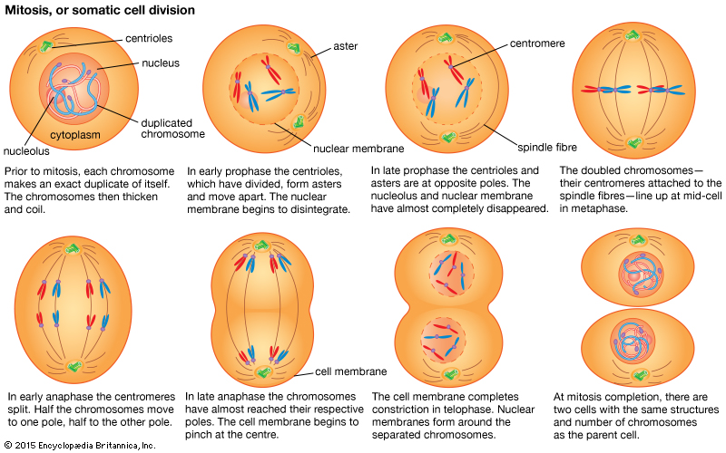
Mitosis
Interphase, Prophase, Metaphase, Anaphase,Telophase
Cytokinesis

Slide 14
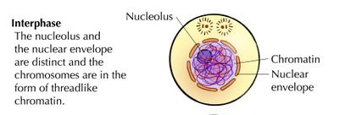
The Phases of Mitosis: Interphase
Period between nuclear division
During this phase the cell will complete G1, S & G2 of the cell cycle.
S phase: DNA forms exact copies of themselves.
Thus, in the period between one cell division and the next, the quantity of DNA doubles

Slide 15
The Phases of Mitosis: Prophase
This is the first phase of mitosis
2 pairs centrioles become visible early
Move to opposite poles & microtubules begin to radiate from them
Nucleolus disappears & nuclear membrane breaks down
Chromatin become tightly coiled and from chromosomes

Slide 16
The Phases of Mitosis: Prophase -Chromosomes-
Each chromosome consists of 2 chromatids
Joined at central point called centromere
2 chromatids that make up a chromosome are identical
Coiling allows easier
distribution of DNA
to daughter cells

Slide 17
The Phases of Mitosis: Prophase
By end of prophase, centrioles reached opposite poles & microtubules have formed framework called spindle
Nuclear membrane completely disappeared
Chromatid pairs begin to migrate toward centre (equator) of the cell

Slide 18
The Phases of Mitosis: Metaphase
Chromatid pairs line up on equator of spindle
Centromere of each pair attached to spindle fibre

Slide 19
The Phases of Mitosis: Anaphase
Each pair of chromatids separates at centromere
Now called chromosomes & pulled to apart toward opposite poles
Centromeres still attached to spindle fibres
Appear to pull chromosomes apart

Slide 20
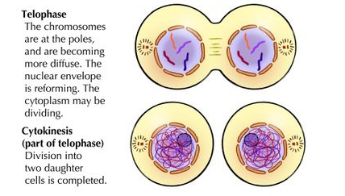
The Phases of Mitosis: Telophase
2 sets of chromosomes form tight groups at each pole
Nuclear membrane forms around each group
Nucleolus appears in each new nucleus
Spindle fibres disappear
Chromosomes gradually uncoil to become chromatin once more

Slide 21
Cytokinesis
Cytokinesis = division of cytoplasm
Cytoplasm usually begins to divide during telophase
Furrow develops in cytoplasm between 2 nuclei, gradually deepens until cut into 2 parts

Slide 22
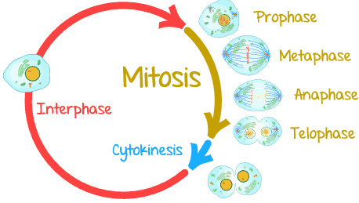
The Cell Cycle and mitosis
Mitosis & cytokinesis has now resulted in 2 daughter cells
These daughter cells are now in Interphase
Each daughter cell has exactly same number and type of chromosomes as parent cell
http://www.sciencehq.com/biology/cell-division.html

Slide 23
Stem cells introduction
This concept will be revised later in the term(with embryonic development)

Slide 24
Differentiation and stem cells
Cells can be classified as either stem cells or specialised cells.
The process in which cells become specialised is called differentiation.
As stem cells proliferate different genes become activated. Resulting in differentiation into specialised cells.
Internal signals: controlled by genes that carry coded instructions for all structures and functions of cells.
External signals: chemicals secreted by other cells, physical contact with neighbour cells, molecules in immediate surroundings (microenvironment).

Slide 25
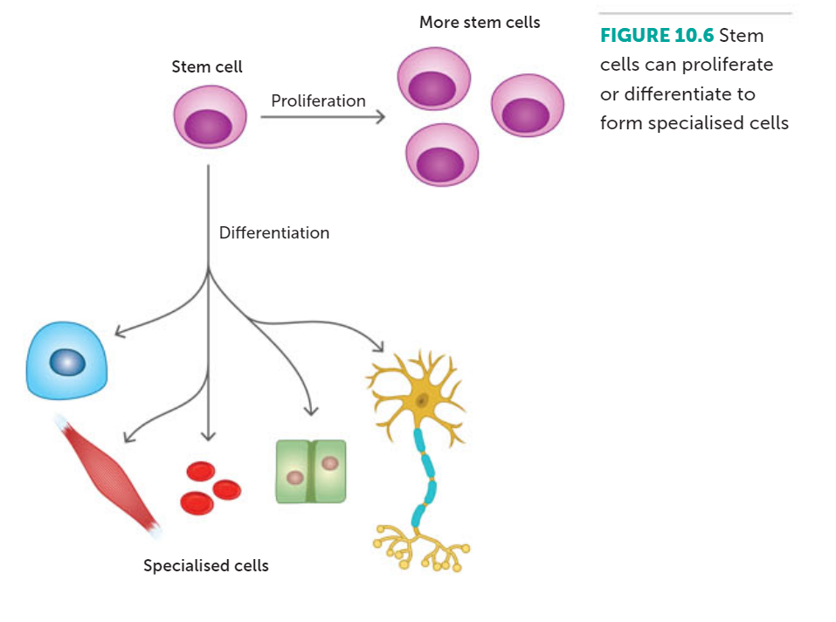
Differentiation and stem cells

Slide 26
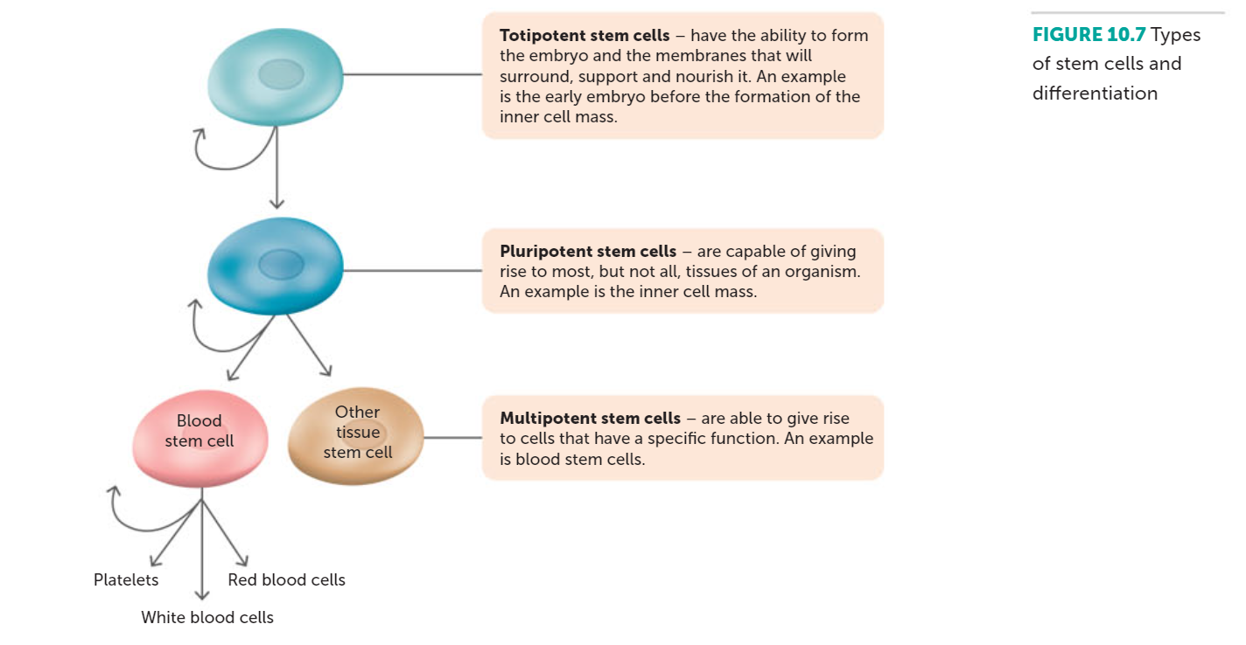
STEM CELL POTENCY

Slide 27
Meiosis The Production of gametes

Slide 28
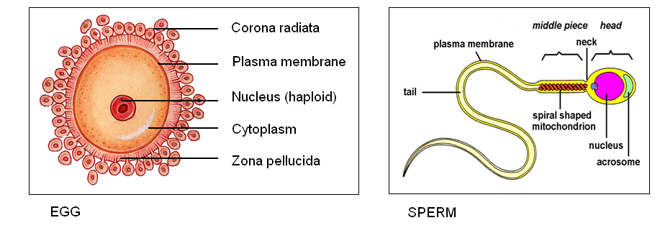
Meiosis
Type of cell division to produce gametes (sex cells – sperm and ova)
Sex cells have half the usual number of chromosomes (haploid – 23)

Slide 29
Gametogenesis – covered again in topic 14
Gametogenesis: Process of gamete development, which includes meiosis.
Takes place in the sex organs
Two types:
Spermatogenesis: formation of spermatozoa in the testis
Oogenesis: formation of ova in the ovary

Slide 30
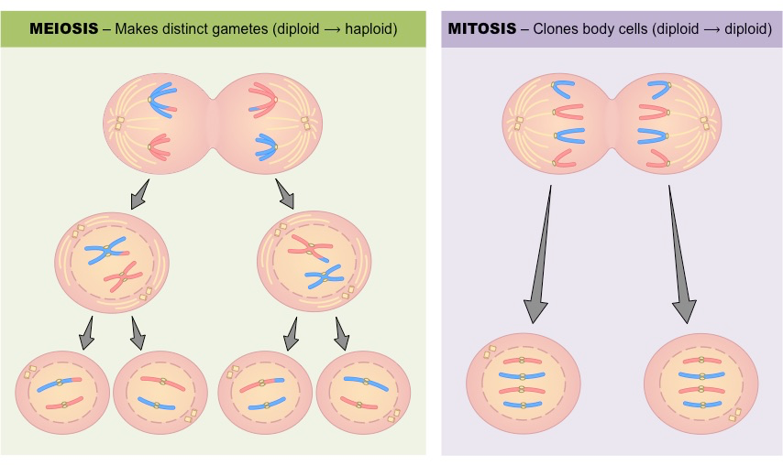
Meiosis
Results in production of four cells with half number of chromosomes present in original cell
Daughter cell has half number of chromosomes compared with its parent cell
Process involves 2 nuclear divisions, but the chromosomes duplicate only once

Slide 31
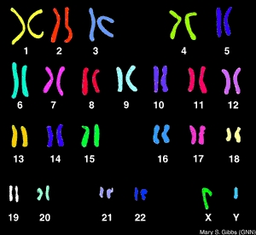
Meiosis
Prior to undergoing meiosis, cell goes through an interphase stage where it grows and DNA is replicated
First division of meiosis is similar to mitosis (except for the addition of homologous chromosomes)
At beginning of both types of cell division the number of chromosomes is the same.

Slide 32
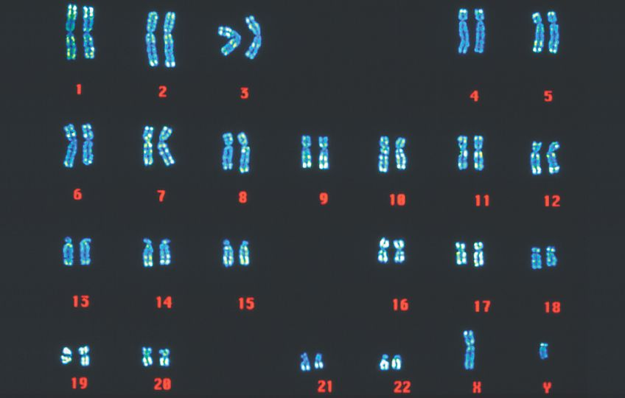
Karyotype

Slide 33
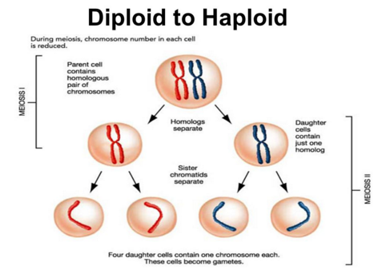
Meiosis: definitions
Diploid: Number of chromosomes present in the body (or somatic) cells of an individual. Represented by 2n. Humans 2n= 46
Haploid: Number of chromosomes present in gametes (sex cells). Represented by n. Humans 2n=23

Slide 34
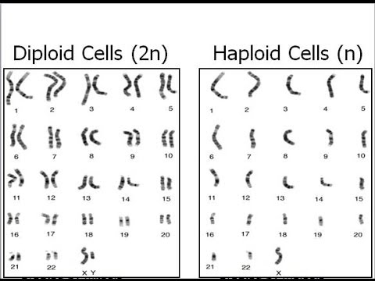

Slide 35
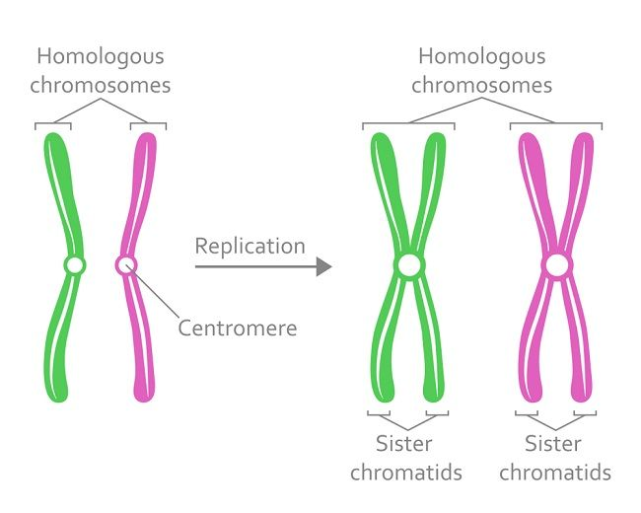
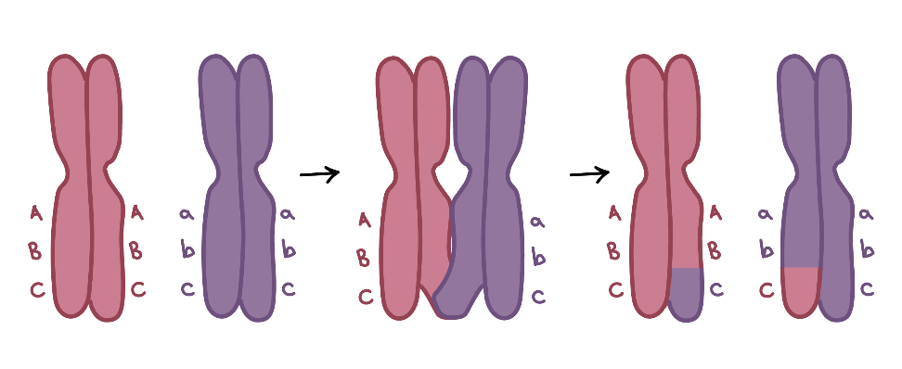
Meiosis: definitions
Homologous chromosomes: Pair of chromosomes identical in shape and size
Crossing over: When homologous chromosomes are paired, the chromatids may cross, break and exchange segments. Resulting in a new combination of alleles along the chromosome = recombination

Slide 36
Meiosis: First Division
Interphase
Prior to undergoing meiosis, a cell goes through an interphase stage where it grows and the DNA is replicated.
This occurs that same way as mitosis!

Slide 37
Meiosis: First Division
Prophase 1:
Chromosomes become visible as long threads
Chromosomes shrink & thicken while spindle is forming
Nuclear membrane disappears
Paired homologous chromosomes move toward spindle fibres

Slide 38
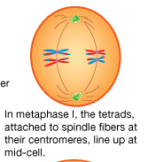
Meiosis: First Division
Metaphase 1:
Homologous chromosomes arranged on spindle fibres across centre of cell
Crossing over occurs

Slide 39
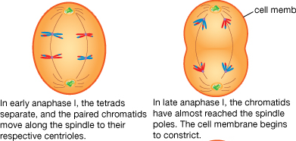
Meiosis: First Division
Anaphase 1:
Pairs of homologous chromosomes move apart, one member of each pair (consisting of 2 chromatids) move to one pole, other moves to opposite pole
Centromeres do not divide, pairs of chromatids remain intact
23 chromosomes move to each pole

Slide 40
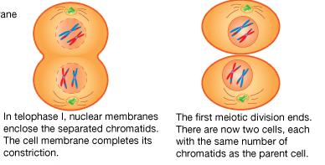
Meiosis: First Division
Telophase 1:
Nucleus forms and cytoplasm begins to divide
Cytokenesis occurs
2 haploid cells are formed (23 chromosomes, each with 2 chromatids)

Slide 41
Meiosis: First Division
First division results in half the number of chromosomes of the original cell assembling at each pole
Major difference in comparison to Mitosis
At beginning of second division, 2 cells are haploid (23 chromosomes)

Slide 42
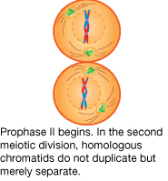
Meiosis: Second Division
Prophase II:
New spindle forms at each end of original spindle, usually at right angles to original
Nuclear membrane dissappears
Chromosomes move toward the equator

Slide 43
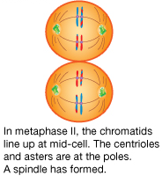
Meiosis: Second Division
Metaphase II:
Arranged at the centre of the cell on a new spindle
Spindle attaches to centromere

Slide 44
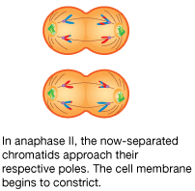
Meiosis: Second Division
Anaphase II:
Centromeres divide
Each chromatid is now a separate chromosome
Chromosomes migrate toward opposite poles

Slide 45
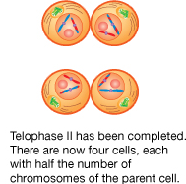
Meiosis: Second Division
Telophase II:
Nuclear membranes begin to form
Cytoplasm starts to divide (cytokinesis)
Four new cells are now formed each with half the number (haploid) of chromosomes of original cell

Slide 46
Comparison mitosis & meiosis

Slide 47
COMPARISON | Mitosis | Meiosis
Duplication of chromosomes | One | One
Nuclear Divisions | One | Two
Cells produced | 2 Diploid Cells | 4 Haploid Cells
Homologous chromosomes pair? | No | Yes
Chromatid division | Chromatids separate so each new cell gets a complete set of daughter chromosomes | At first meiotic division, members of homologous pairs separate so that new cells get a haploid set of chromosomes. Second divison, chromatids separate, giving 4 haploid cells
Chromosome make up (variation) | Do not change genetic make up | Genetic make up can be changed through crossing over
Purpose | New cells for growth and repair | Haploid gametes for sexual reproduction

Slide 48
Watch
Meiosis process
https://www.youtube.com/watch?v=VzDMG7ke69g
Karyotypes
https://www.youtube.com/watch?v=mBq1ULWJp_M
Mitosis and Meiosis Comparison
https://www.youtube.com/watch?v=zrKdz93WlVk
Diploid and haploid explained
https://www.youtube.com/watch?v=gcz1FOWw0Cg

Slide 49
Meiosis causes variation
Covered again in inheritance

Slide 50
Sources of variation
Random assortment of chromosomes during meiosis
Crossing over
Non-disjunction
Random fertilisation
Inheritance of epigenetic factors (last topic)

Slide 51
Random Assortment of Chromosomes
Remember that each individual must have two genes (alleles) for a particular characteristic. These give an individual their genotype.
During meiosis each gamete (sperm and egg) receives one of these factors (alleles)
When the 23 pairs of homologous chromosomes move apart during the first meiotic division, they do so independently!
Every gamete receives one of two possible chromosomes (containing alleles) 23 times.

Slide 52
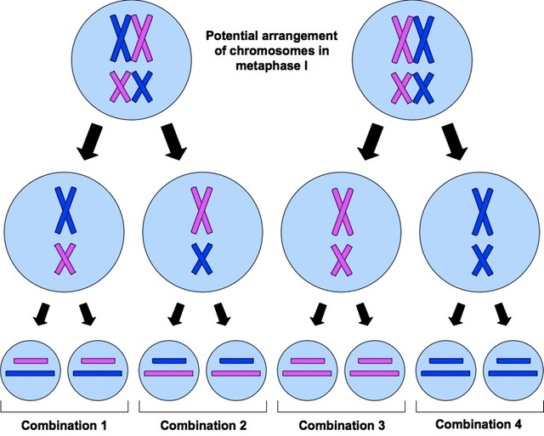

Slide 53
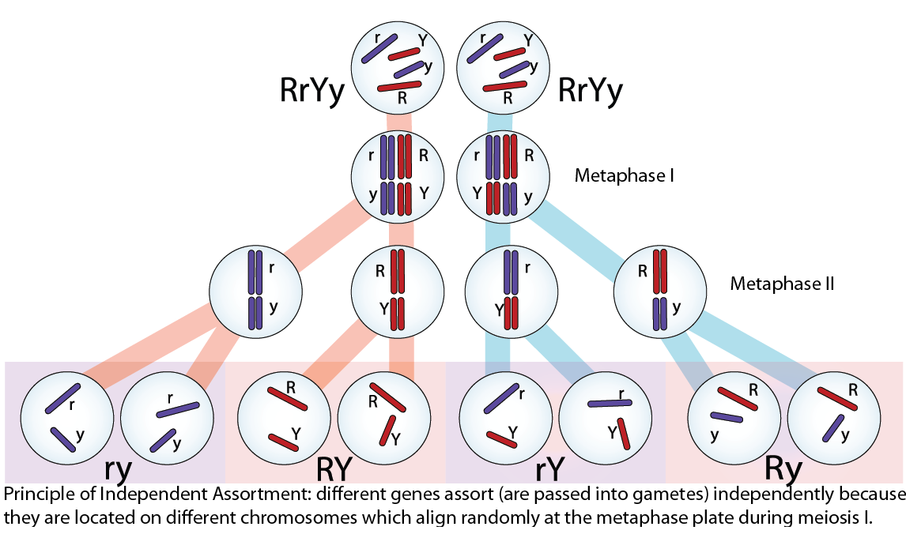

Slide 54
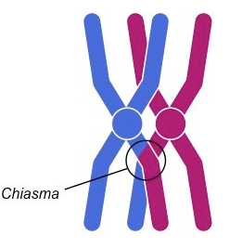
Crossing Over
When the homologous chromosomes pair during the first meiotic division the chromatids may get tangled with one another. This is known as crossing over.
The point where the two chromatids cross is called the chiasma.

Slide 55
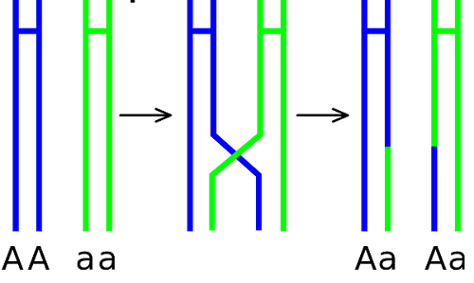
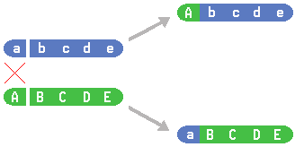
Crossing Over
When crossing over, part of the chromatids may break and reattach to a chromatid of a different chromosome.
This results in a different combination of alleles along the chromosome. This is called recombination.
The combination of alleles is now different to that possessed by either parent.

Slide 56
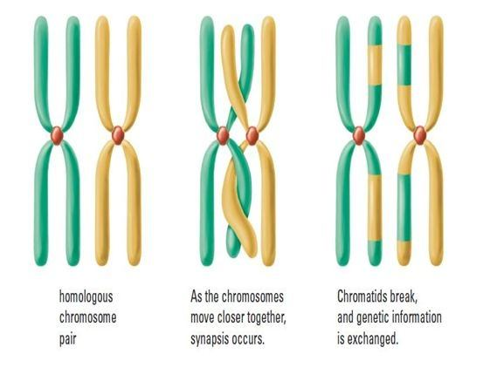

Slide 57
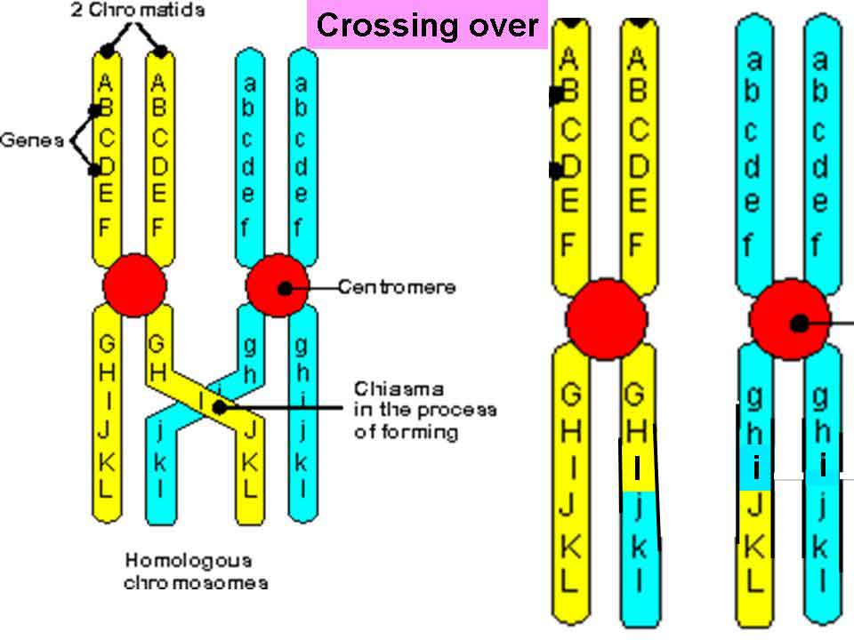

Slide 58
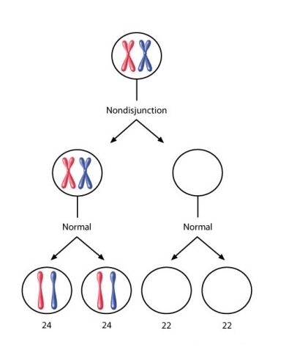
Non-disjunction – Meiosis 1
During the first division of meiosis the homologous chromosomes separate
Sometimes one or more pairs of chromosomes fail to separate = non disjunction

Slide 59
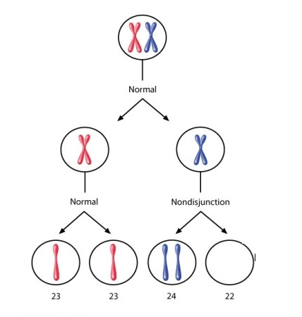
Non-disjunction – Meiosis 2
During the second division of meiosis the chromatids separate at the centromere to form two chromosomes
Sometimes these chromatids fail to separate = non disjunction

Slide 60
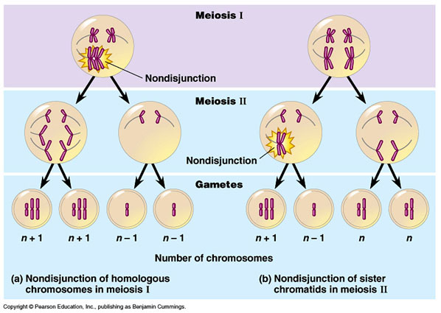

Slide 61
Unusual number of chromosomes
When non disjunction occurs gametes have an usual number of chromosomes
Gametes will either have:
Too many = 24 chromosomes
Too few = 22 of chromosomes

Slide 62
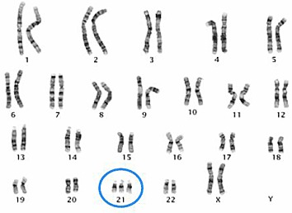
Trisomy
When an individual inherits an extra copy (three copies instead of two) of a chromosome they have a trisomy.
Trisomy 21 = three chromosomes (instead of two) on the 21st pair. Commonly know as Down Syndrome

Slide 63
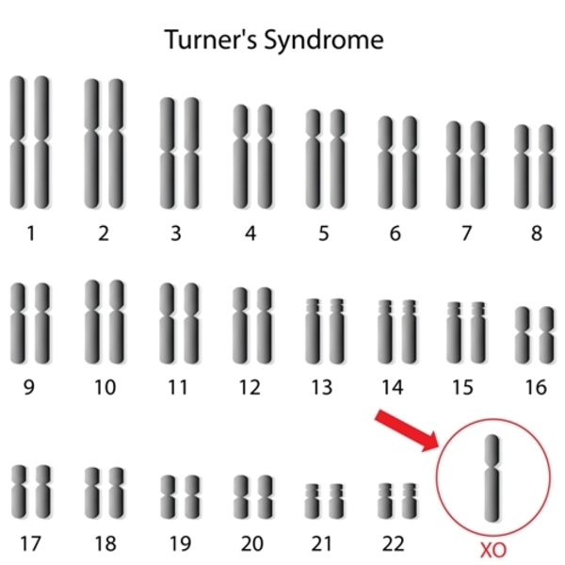
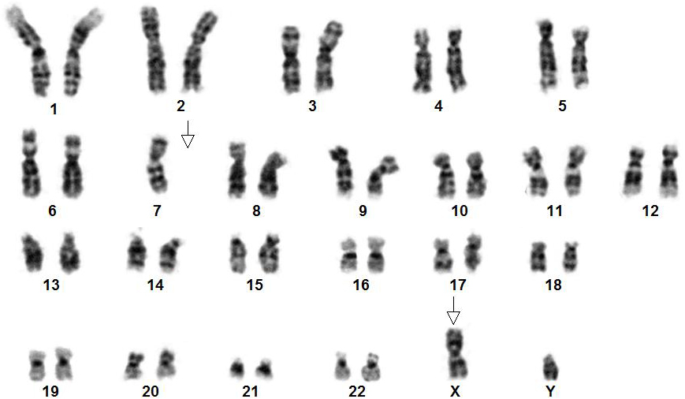
Monosomy
When an individual inherits only one copy (instead of two) of a chromosome they have a monosomy.
Can result in malformations and often miscarriage

Slide 64
Random fertilisation
After random assortment of chromosomes has occurred, all sperm and egg cells receives its own unique combination of genes
Any kind of sperm cell can fuse with any kind of egg cell = random fertilisation
Hundreds of millions of sperm are released into the females reproductive tract after intercourse.
All of these have a different survival rate.
Therefore, the sperm that actually fertilises the egg is decided completely by chance.
Offspring will have a different set of alleles from their parents, as well as their siblings = variation!

Slide 65
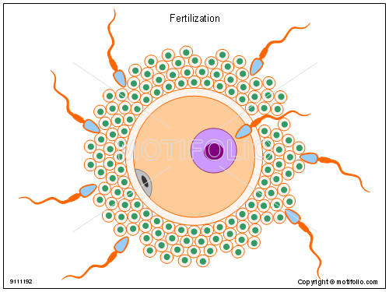
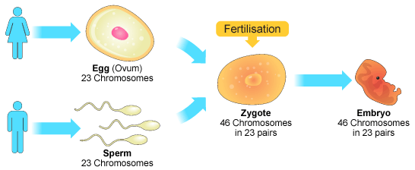

Slide 66
Cancer

Slide 67
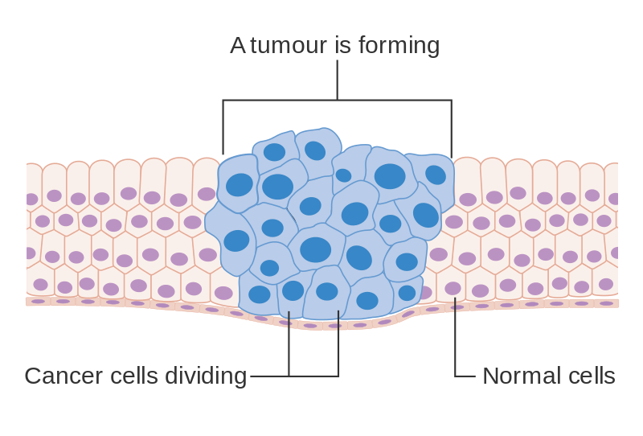
Cancer
An uncontrolled division of abnormal cells in a part of the body
Cell growth leads to the development of a tumour (mass of tissue)

Slide 68
watch
Cancer video (Ted-Ed):
https://www.youtube.com/watch?v=BmFEoCFDi-w
What is cancer?:
https://www.youtube.com/watch?v=SGaQ0WwZ_0I
How is cancer spread?
https://www.youtube.com/watch?v=OcigJn8UJNQ

Slide 69
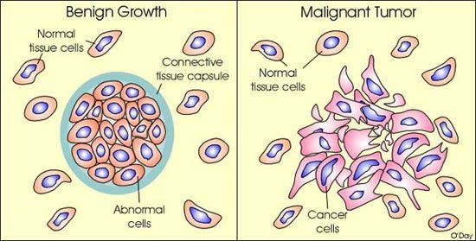
TUMOUR TYPES
Malignant tumours are cancerous = invade/spread to other parts of the body (metastasis).
poorly differentiated
primary → secondary tumour
Benign tumours are encapsulated and do not spread (non-invasive).
well differentiated
tumour can still put pressure on surrounding structures

Slide 70
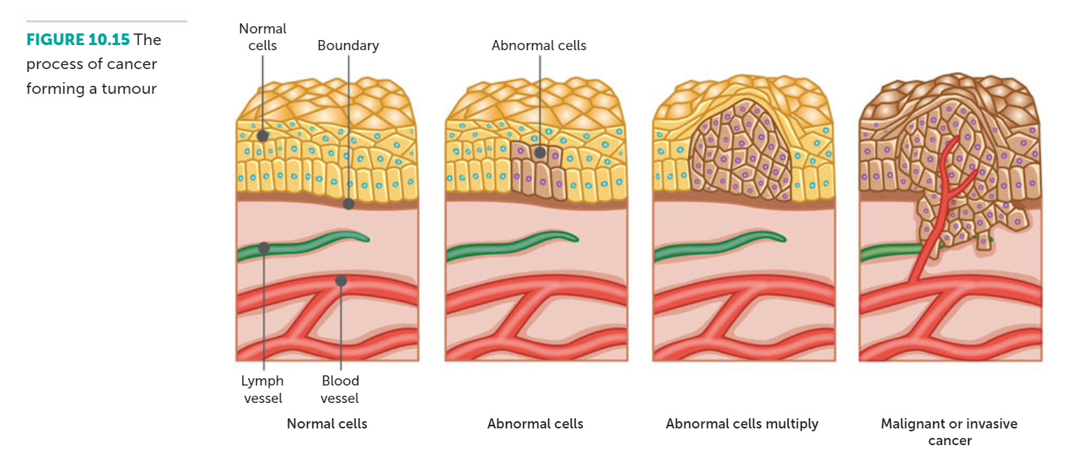

Slide 71
Common CANCERS
Breast cancer: A cancer that forms in the cells of the breasts.
Prostate cancer: A cancer in a man's prostate, a small walnut-sized gland that produces seminal fluid.
Melanoma: The most serious type of skin cancer.
Basal cell cancer: A type of skin cancer that begins in the basal cells.
Colon cancer: A cancer of the colon or rectum, located at the digestive tract's lower end.
Lung cancer: A cancer that begins in the lungs and most often occurs in people who smoke.
Leukaemia: A cancer of blood-forming tissues, hindering the body's ability to fight infection.
Lymphoma: A cancer of the lymphatic system.

Slide 72
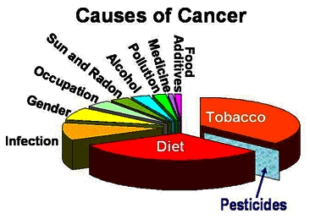
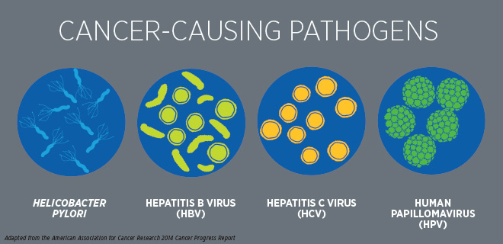
CAUSES
Carcinogen: any substance or agent that causes cancer in the body.
Radiation:
Ultraviolet radiation
Ionising radiation: such as X-rays
Chemicals:
Such as tobacco smoke, asbestos, arsenic, alcohol
Viruses:
HPV, Hepatitis B/C

Slide 73
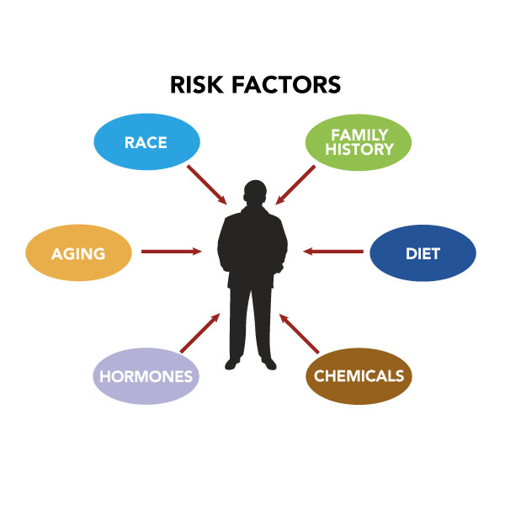
RISK FACTORS
Family history
Age
History of smoking
Obesity
Poor diet
Diabetes
Skin colour

Slide 75
Age & Cancer
Cancer can occur at any age (depending on the type of cancer). Some are inherited, while others are acquired.
Age is the greatest risk factor for developing cancer. In fact, 60% of people who have cancer are 65 or older.
With ↑ age:
the normal cell division process/differentiation of cells is more likely to go wrong today
Increase exposure to carcinogens over life time (↑ mutations = faults that have potential to cause cancer)

Slide 76
Signs & Symptoms
Change in bowel or bladder habits
A sore that does not heal
Unusual discharge or abnormal bleeding
Thickening or lump in part of the body
Indigestion or difficulty swallowing
Obvious change in size, colour, shape or thickness of a wart, mole or mouth sore
Noticeable weight loss and loss of appetite
Symptoms can vary based on type of cancer, age, gender.
List of symptoms could be related to other diseases

Slide 78
Prevention of caners
In Australia, incidence of cancers can be reduced in two ways:
By Education
Advertising E.g ‘Slip, slop, slap, slide & seek’
Schooling
By legislation
Laws have been passed to control exposure to carcinogens
No smoking in public places, banned advertising of tabacco, warming signs on labels
Standards imposed for the manufacture and operation of X-rays
Asbestos products banned

Slide 79
Early detection/SCREENING methods
Skin Cancer
Regular skin and mole checks
Breast Cancer
Mammogram
Cervical Cancer
Pap smear every two years
Prostate Cancer
Digital rectal examination, prostate-specific antigen blood test
Colon Cancer
Faecal occult blood test
See page 264 – 265 of text for more information

Slide 80
CANCER TREATMENTS
Chemotherapy: the use of chemical substances (cytotoxic and other drugs) to destroy the cancer cells.
Radiotherapy: using high energy radiation to destroy cancer cells or stop their growth
Surgery: removal of cancerous cells (and surrounding tissue) by an operation. Not possible for some types of cancers.
Immunotherapy: a drug treatment focusing on using the body’s immune system to attack cancer

