Slide 1
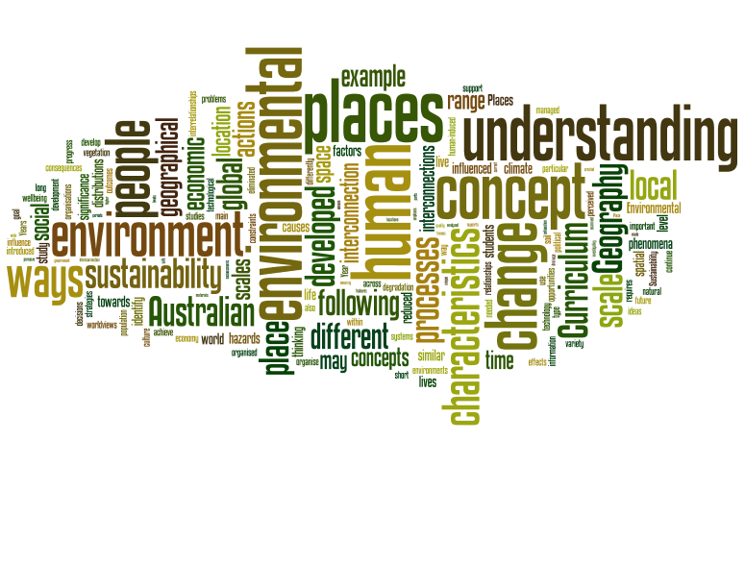
Geography Is…
GEOGRAPHY IS…

Slide 2
What is it?
Geography is a structured way of exploring, analysing and understanding the characteristics of the places that make up our world
Using the concepts of place, space, environment, interconnection, sustainability, scale and change.
It addresses scales from the personal to the global and time periods from a few years to thousands of years.

Slide 3
Rationale-Why Study It?
Geography integrates knowledge from the natural sciences, social sciences and humanities to build a holistic understanding of the world.
Students learn to question why the world is the way it is, reflect on their relationships with and responsibilities for that world, and propose actions designed to shape a socially just and sustainable future.

Slide 4
Key Concepts
Space
Place
Interconnection
Change
Environment
Scale
Sustainability
= SPICESS

Slide 5
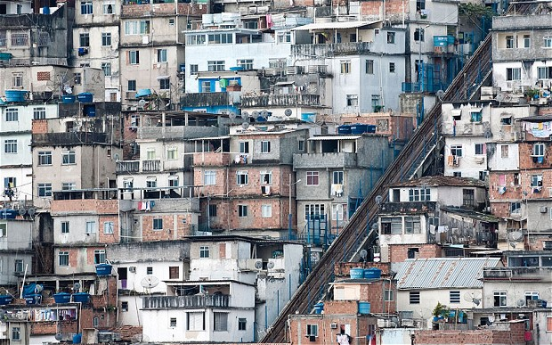
Space
Significance of location and spatial distribution and ways that people organise and manage the spaces that we live in
Favela’s in Brazil

Slide 6
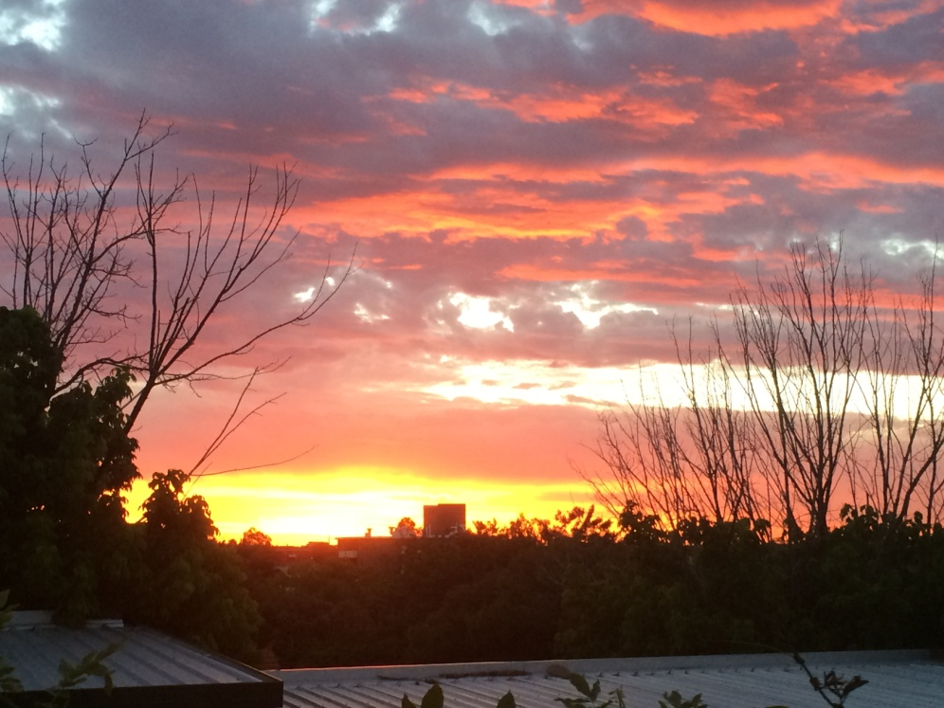
Place
The significance of places and what they are like. Places are areas identified as having specific meaning to someone. They may be perceived, experiences, understood and valued differently.

Slide 7
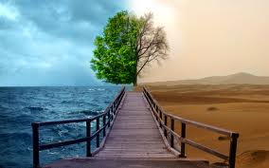
Environment
The significance of the environment in human life and the important interrelations between humans and the environment.

Slide 8
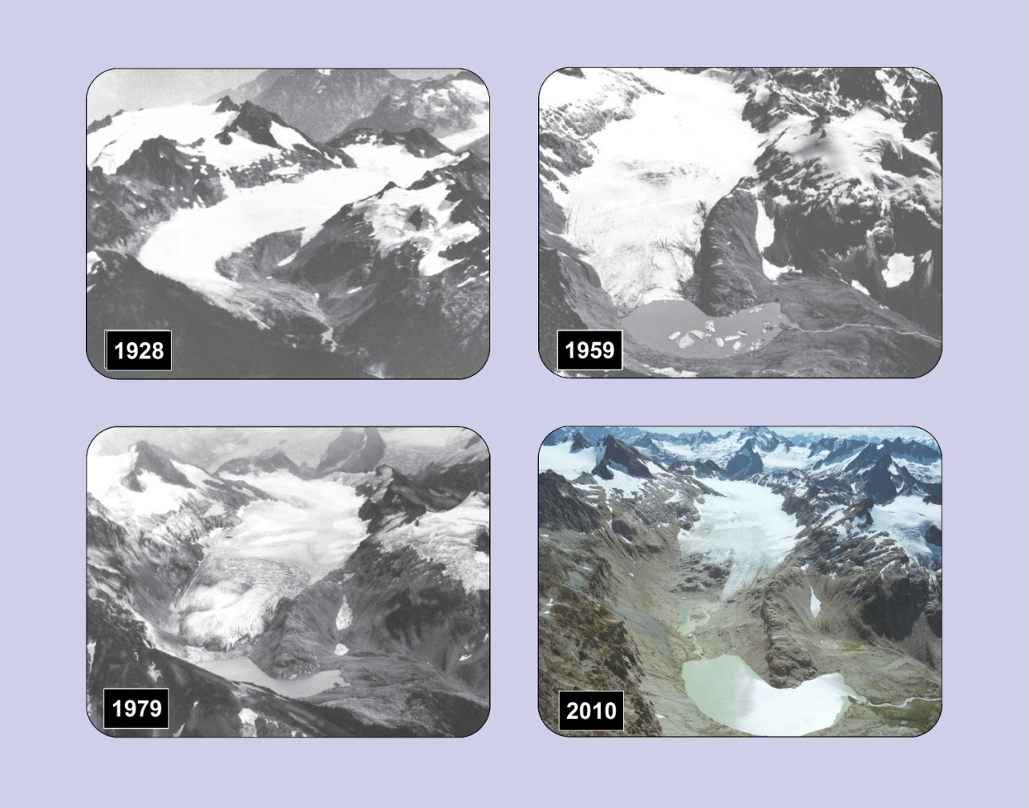
Change
Explaining geographical phenomena by investigating how they have developed over time.
South Cascade Glacier USA

Slide 9
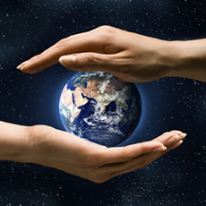
Interconnection
This concept emphasis that no object of geography study can be viewed in isolation.

Slide 10
Scale
The concept of scale is about the way that geographical phenomena can be examined at different spatial levels

Slide 11
Sustainability
The capacity for our environment to continue to support our lives and the lives of other living creatures in the future

