Slide 1
Organisational Structure

Slide 2
Objectives
Understand the need for organisational structure.
Describe and explain workforce roles and hierarchy in an organisation.

Slide 3
Internal structure of firms
In small firms:
Each worker may undertake a range of roles
The structure may be informal and fluid
As firms grow bigger:
The roles and responsibilities of each worker must become clearer
A more formal structure is necessary

Slide 4
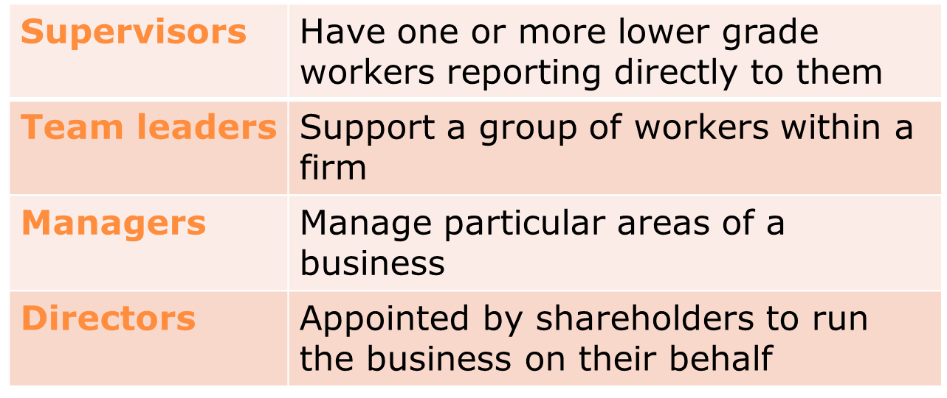
Workforce roles
Leadership & managerial roles include:

Slide 5
Organisation charts
Board of directors
HR Manager
4 HR Officers
Finance Manager
Operations Director
Marketing Manager
6 Accounts Clerks
Factory A Manager
8 Sales Reps
3 Quality controllers
20 Factory workers
Factory B Manager
2 Quality controllers
15 Factory workers

Slide 6
Tall organisations
These have:
Many layers
Small spans of control
Characteristics of tall organisations:
High levels of control (appropriate for unskilled workers)
More opportunities for promotion
Poor communication as information has to pass through the many layers

Slide 7
Flat organisations
Flat organisations have:
Few layers
Large spans of control
Characteristics of flat organisations:
Low levels of control (suitable for skilled, experienced & motivated workers)
Better communication
Managers must delegate work due to larger spans of control, motivating employees

