Slide 1
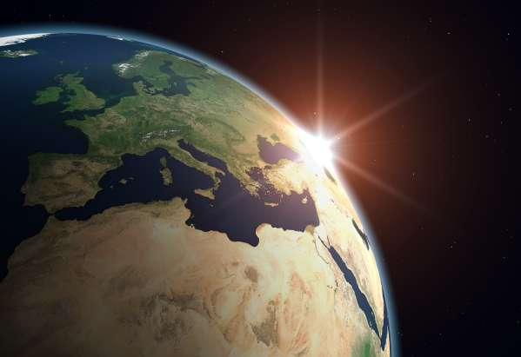
Ecosystems & biomes
Geography

Slide 2
Introduction to systems
A system is a network of parts (or elements) that interact to form an overall pattern
Key features of a system include:
The elements or different parts
The interactions between the elements to form the characteristic pattern of that system
Adaptions or changes to the pattern when elements change
An ecosystem is an example of a system with elements, interactions and adaptions

Slide 3
Natural and social systems
Systems are divided into natural and social systems
Natural systems are not created by humans (although humans are elements within them and have an impact on them). Examples include the solar system, water cycle, ecosystems and river catchments.
Social systems are created and controlled by hunmans. Examples include economic systems, political systems and education systems

Slide 4
Ecosystems
An ecosystem is composed of living (biotic) and non-living things (abiotic) which interact with each other within a particular environment
Each ecosystem is the result of interactions between the four spheres
The way that the spheres interact with each other determines the nature of the ecosystem
For example the high rainfall in a tropical rainforest has led to the evolution of very different plants and animals to those that live in a desert

Slide 5
Classifying Ecosystems
Ecosystems are classified according to;
Climate (polar vs. desert)
Elevation (alpine)
Vegetation (tropical rainforest)
The plants and animals of an ecosystem are classified into 3 categories
Community - animals of the savannah grasslands of Africa – zebras, elephants, giraffes and lions)
Population – group of the same animals
Organism – and individual animal such a single zebra living on the savannah

Slide 6
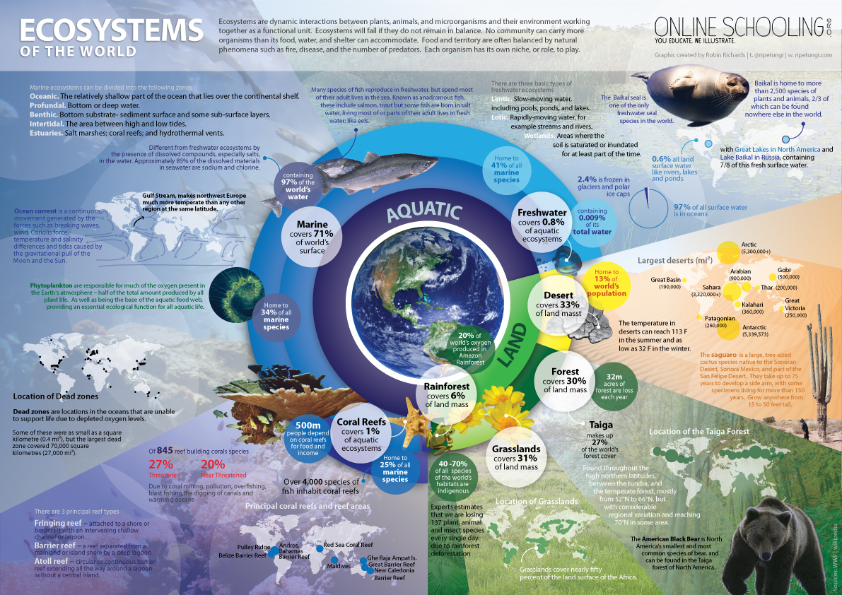

Slide 7
Components of an ecosystem
The living component – this is the organic or biotic component. All living things together with their by-products are included in this category
Living plants and animals (fish reptiles, insects, plants, birds) and micro-organisms
Dead plant and animal tissue
Body wastes such as urine and faeces
The Non Living Component – is the inorganic or abiotic component. The most important of these being the sun which radiates sunlight(solar energy) to the earth and provides energy for all the processes occurring within ecosystems. The other non-living components include;
The atmosphere; vital gasses of oxygen, carbon dioxide, nitrogen and water vapour)
The lithosphere; soils, rocks, minerals and landforms
The hydrosphere; water and dissolved minerals

Slide 8
Activities - remember and understand
Distinguish between biotic and abiotic elements of an ecosystem
Explain why the sun is an important part of all ecosystems
How are ecosystems classified?
Explain the difference between a community and a population
What is an organism
Define an ecosystem

Slide 9
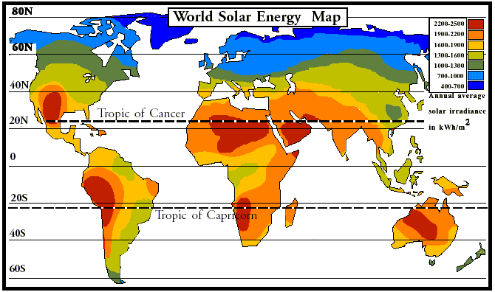
Solar map

Slide 10
World climate zones

Slide 11
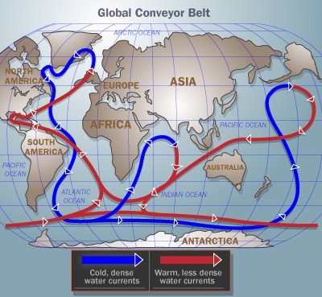
World climate zones

Slide 12
Factors the effect the local climate
LAPDOG
Latitude – how far you are from the equator
Altitude – the higher you are from sea level the colder it is
Prevailing winds – does the wind mainly come from cold or warm areas
Distance from the sea – oceans moderate climate
Ocean currents – warm ocean currents bring warm moist air
Geography - what is the area like; topography, vegetation & nearness to mountains

Slide 13
World Biomes

Slide 14
Biomes
A Biome;
covers a large area
with similar physical environment
is home to a distinct community of living things
each community contains species adapted to the climate, soil and to living with each other

Slide 15
Biomes
Biomes have changed and moved many times during the history of life on Earth
More recently, human activities have drastically altered these communities
Conservation and preservation of biomes should be a major concern to all

Slide 16
Categorizing biomes
Within terrestrial ecosystems the largest subdivision is a biome
A biome is a very large ecosystem made up of specific plants and animals
Biomes occur on different continents with similar climates
They are classified according to their vegetation, which develops in response to the availability of soil, water and heat

Slide 17
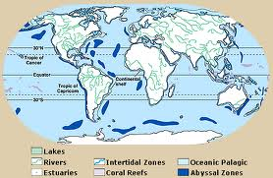
Aquatic biomes
Water is the common link among the five biomes and it makes up the largest part of the biosphere, covering nearly 75% of the Earth’s surface. Aquatic regions house numerous species of plants and animals, both large and small. In fact, this is where life began billions of years ago when amino acids first started to come together.
Fresh Water
Ponds and lakes
Rivers and streams
Wetlands
Salt Water
Oceans, seas, coral reefs
and estuaries

Slide 18
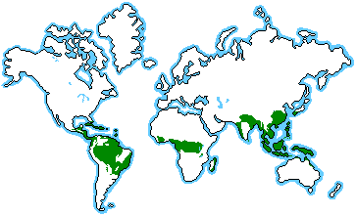
Rainforest biomes
Abundant soil, water and heat
Rainforests are thick, warm and wet forests. They are forests that get at least 250 cm a year of rain, often more.
There are two kinds of rainforest: tropical and temperate. Both kinds are endangered.
Tropical rainforests are millions of years old, and temperate rainforests are about 10,000 years old.

Slide 19
Tundra
Tundra is the coldest of all the biomes. Noted for its frost-molded landscapes,
extremely low temperatures, little precipitation,
poor nutrients, and short growing seasons.
There is not enough heat to sustain vegetation growth throughout the year

Slide 20
Desert biomes
Extreme shortage of soil and water
Deserts cover about one fifth of the Earth's surface and occur where rainfall is less than 50 cm/year.
Although most deserts, such as the Sahara of North Africa and the deserts of the southwestern U.S., Mexico, and Australia, occur at low latitudes,
cold deserts, occur in the basin and range area of Utah and Nevada and in parts of western Asia

Slide 21
TAiGA forest biomes
Taiga, also called boreal forests, is the largest land biome.
These forests are found in a broad belt across Europe, Asia and North America
Two thirds are in Siberia, and the rest are in Scandinavia, Alaska and Canada.
In this biome, summers are short and mild and the winters are long, cold and dry.

Slide 22
Deciduous forest biomes
The deciduous forest has four distinct seasons,
spring, summer, autumn, and winter
In the autumn the leaves change color
During the winter months the trees lose their leaves.

Slide 23
Grassland biomes
Moderate shortage of soil and water
Grassland biomes are large, rolling terrains of grasses, flowers and herbs.
Latitude, soil and local climates for the most part determine what kinds of plants grow in a particular grassland.
A grassland is a region where the average annual precipitation is great enough to support grasses, and in some areas a few trees.
The precipitation is so erratic that drought and fire prevent large forests from growing

Slide 24
Activity
Complete the Biomes Summary Worksheet using your notes and the internet
On a blank map, with the aid of an atlas illustrate the distribution of the earths major terrestrial (land) ecosystems (biomes)

Slide 25
Group task Biomes
In your groups of 3-4 students research your allocated biome and present your findings to the class (movie, slideshow, podcast, 3D model, posters, leaflets, booklets etc..)
Your presentation should outline the location/s, elements (soil, landforms, climate, flora and fauna,) human impacts/threats, and conservation measures being undertaken.
Try to make your presentation interesting for your audience
Include some form of audience participation if possible
Give your audience some form of handout that summarises the main points of your presentation
Ensure that you educate your audience about your rainforest biome

