Slide 1
Gametogenesis & fertilisation
R. Johansen 2021

Slide 2
spermatogenesis

Slide 3
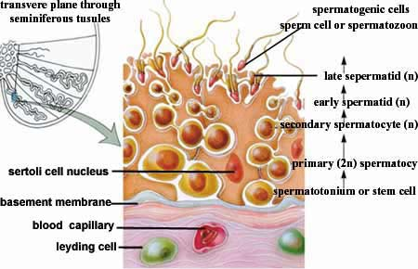
Spermatogenesis
Occurs in seminiferous tubules
Seminiferous tubules lined with immature cells called spermatogonia (diploid cell)
Begins occurring at puberty, providing a continuous source of new cells for production of spermatozoa.

Slide 4
Spermatogenesis
Spermatogonia: (immature cells) begin dividing by mitosis.
Primary Spermatocytes: Some daughter cells from spermatogonia are pushed inward toward centre of tubule, where they undergo a period of growth. These are diploid cells, and undergo the first stage of meiosis to produce secondary spermatocytes.
Secondary Spermatocytes: Haploid cells. Second meiotic division divides into two spermatids.
Spermatids: Four haploid cells are formed by meiosis.
All originate from one diploid spermatogonium.

Slide 5
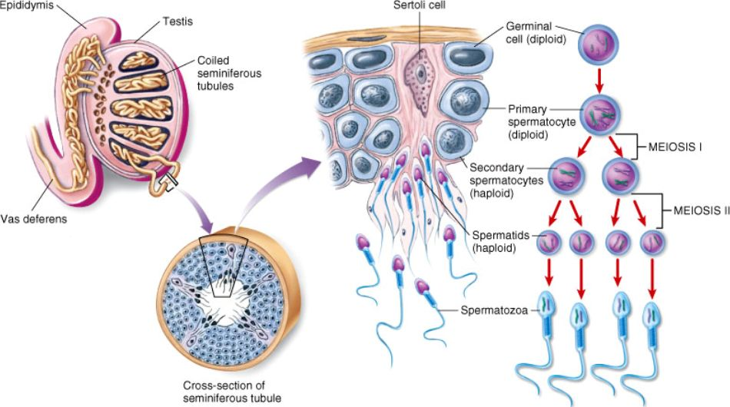

Slide 6
Spermatogenesis
Final stage of spermatogenesis occurs when spermatids mature into spermatozoa (sperm).
Cytoplasm lost and tail forms.
Maturing spermatozoa are nourished by special cells that extend from the outer portion of seminiferous tubules into the centre (sertoli cells).
Whole process from spermatogonium to spermatozoa takes about 72 days and occurs continually after puberty.

Slide 7
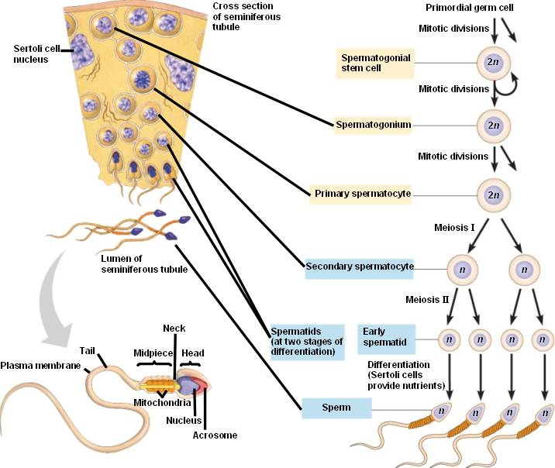

Slide 8
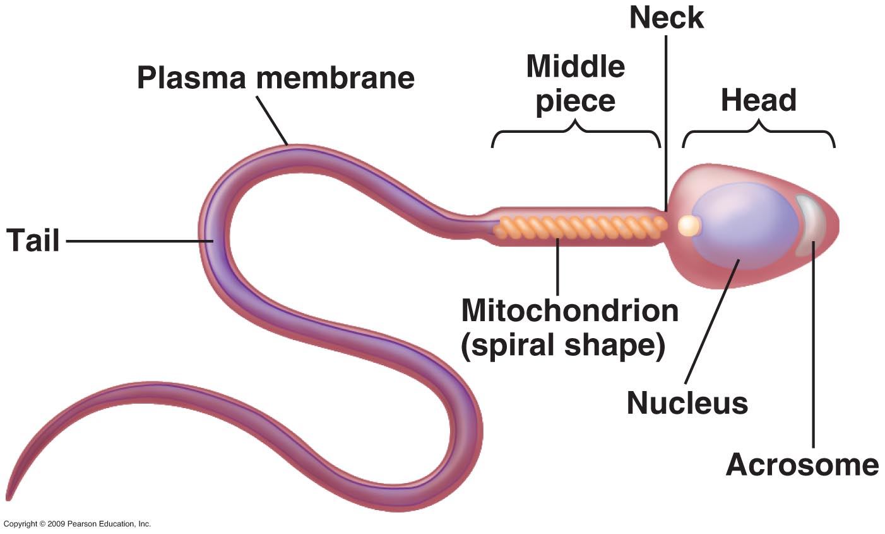
Structure of sperm

Slide 9
oogenesis

Slide 10
Oogenesis
Occurs in ovaries
Before female baby is born, millions of egg mother cells, or oogonia, develop in the ovaries.
Oogonia: diploid cells that divide by mitosis to produce cells that will eventually develop into ova.
Primary oocyte: Oogonia that have undergone growth phase. By birth, each ovary contains several hundred of these. They have begun prophase of the first meiotic division but process stops at this point, so at birth they are still in first prophase.
Each primary oocyte is surrounded by a single layer of cells, forming a primary follicle.

Slide 11
Oogenesis
At puberty the process of follicle growth and maturation begins.
As a follicle matures, primary oocyte contained within it completes the stages of the first division of meiosis, producing 2 haploid cells. These cells are of unequal size.
Secondary oocyte: Larger cell that receives half the chromosomes but nearly all the cytoplasm.
First polar body: Smaller cell receives other half of chromosomes but very little cytoplasm.

Slide 12
Oogenesis
Secondary oocyte immediately commences the second division of meiosis but stops at metaphase. At this stage ovulation occurs.
Ovulation: follicle ruptures, expelling secondary oocyte along with its polar body.
Secondary oocyte enters the uterine tube, and if penetrated by a spermatozoon, meiosis is quickly completed. Second division of meiosis also produces two cells of unequal size, both haploid.
Ovum (mature egg): larger one of haploid cells.
Second polar body: smaller of the haploid cells. All polar bodies disintegrate.

Slide 13
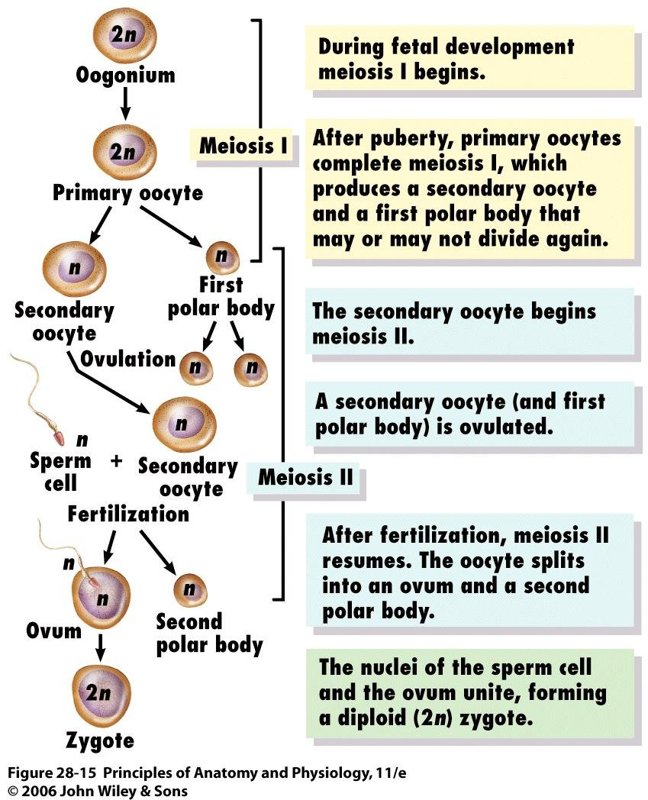

Slide 14
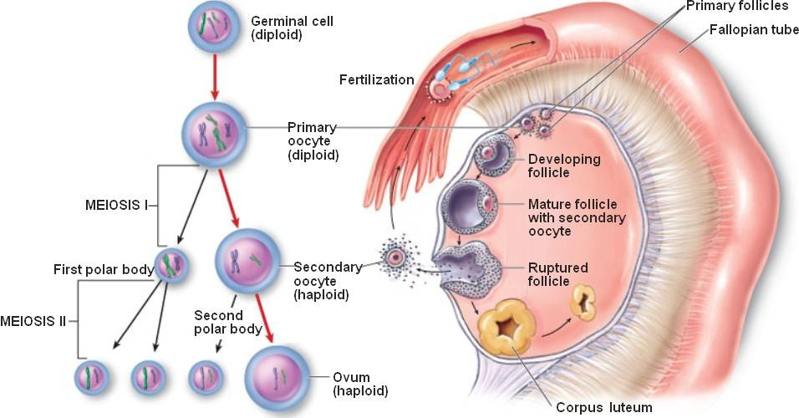

Slide 15
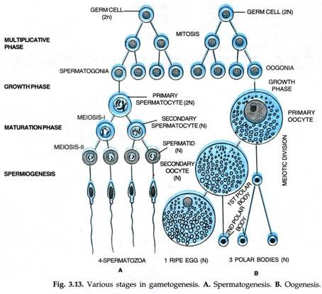

Slide 16
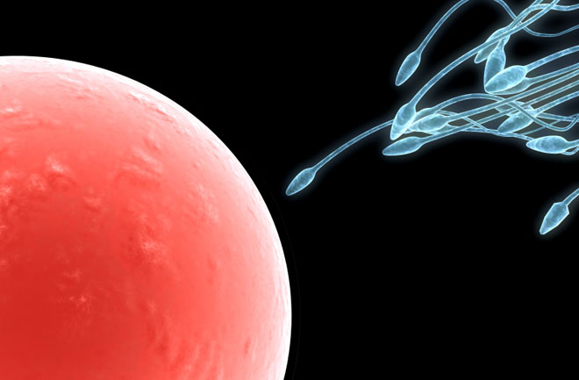
Gametogenesis – Males and Females
In female, oogenesis produces a single ovum from each primary oocyte.
In male, spermatogenesis produces 4 sperm from each primary spermatocyte.

Slide 17
Fertilisation

Slide 18
Secondary Sex Characteristics
Females:
Enlarging of breasts
Broadening of the hips (growth of pelvic bone & deposition of fat)
Pubic & armpit hair
Voice deepens
Males
Pubic & armpit hair
Face, chest and possibly back hair
Increase in larynx size & lengthening of vocal cords
Gradual deepening of voice (voice break)

Slide 19
Sexual intercourse: mALE
Ejaculation: The contractions propel the contents of the ducts and glands into the urethra and out of body. (Normally around 3mL semen, containing 250-300 million sperm)
Semen:
Testes & Vas Deferens: Sperm
Seminal Vesicles: thick fluid rich in sugars (60%)- nourishment for sperm.
Prostate Gland: Thin, milky, alkaline fluid-neutralises acid nature of male urethra and female vagina.
Bulbo-urethral Glands (Cowper’s Glands): Clear mucus- acts as lubricant.
Also contains enzymes that activate sperm once ejaculation has taken place.

Slide 20
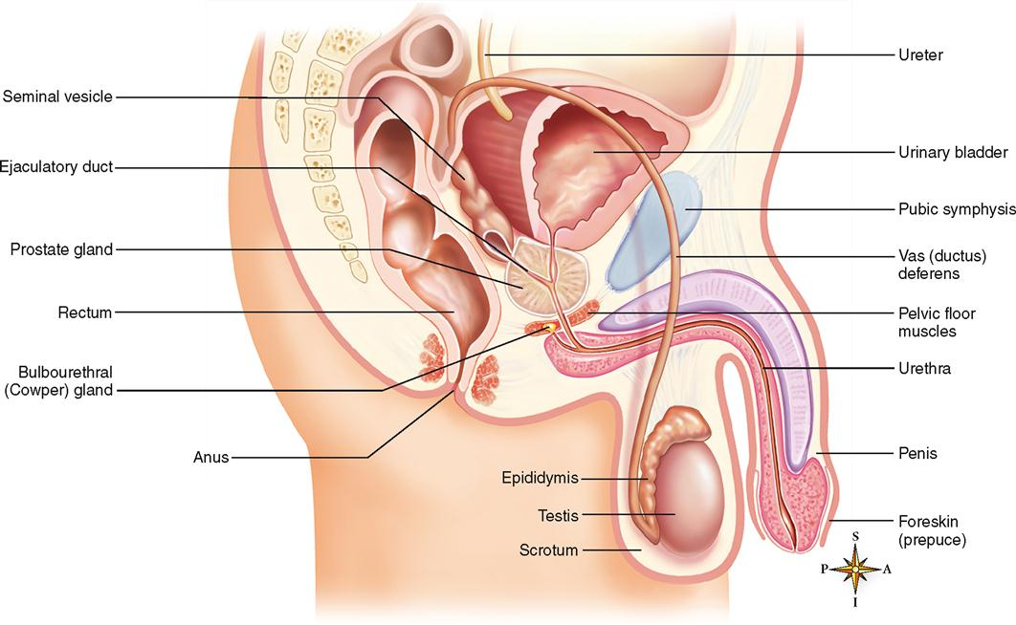
Ejaculation is accompanied by rapid heartbeat, increase blood pressure and breathing rate, intense sensation. Reactions constitute an orgasm.

Slide 21
Sexual Intercourse: Female
When female sexually stimulated, erectile tissue in vaginal opening fills with blood.
This reduces size of vaginal opening and can increase stimulation of the penis.
Arousal also results in secretions of mucus by glands located around the cervix and in the region of vaginal opening.
Secretions lubricate epithelial lining of vagina allowing for easy entry of penis.

Slide 22
Sexual Intercourse: Female
As intercourse progresses, external genitalia (vulva: labia majora, minora and clitoris) are rhythmically stimulated.
Climax: when sexual arousal reaches sufficient intensity, female undergoes an orgasm.
Similar to male, no ejaculation in female.
Can be increase in secretion of cervical mucus.
Female does not need to reach orgasm for fertilisation to occur, not known if orgasm helps fertilisation in any way.

Slide 23
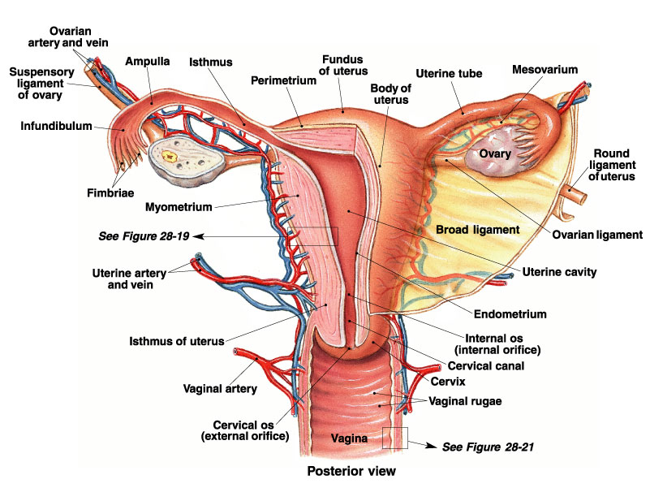

Slide 24
Fertilisation
Insemination: Process where male ejaculates, sperm released into the vagina at entrance of uterus.
Once in vagina, sperm travel through cervix and body of uterus into uterine (fallopian) tubes.
Sperm reach upper portions of uterine tubes quickly, often within minutes.
Muscular contractions of uterus and uterine tubes assist sperm movement through female reproductive tract.

Slide 25
Fertilisation
Hundreds of millions of sperm are deposited into vagina during sexual intercourse, only few thousand reach uterine tubes.
Sperm mortality: Death rate of sperm. Is high and is one reason why large numbers of sperm are required if fertilisation is to occur.

Slide 26
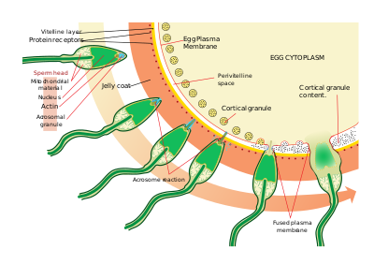
Fertilisation
Fertilisation usually occurs in the uterine tubes when egg is about one third of way down the tube.
Beating action of cilia in uterine tube has transported egg toward uterus.

Slide 27
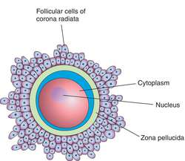
Fertilisation
Corona Radiata: mature egg surrounded by layer of follicle cells. An acid holds these cells together.
Tips of sperm contain acrosome (enzyme) capable of breaking down acid holding cells together.
Amount of enzyme contained in single sperm is extremely small & ineffective. Several thousand sperm surround egg & there’s enough enzyme to loosen cells of corona.
Allowing one sperm into egg to accomplish fertilisation.

Slide 28
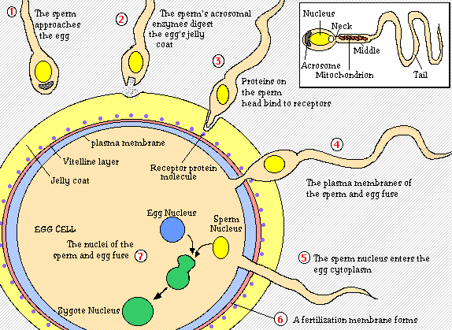
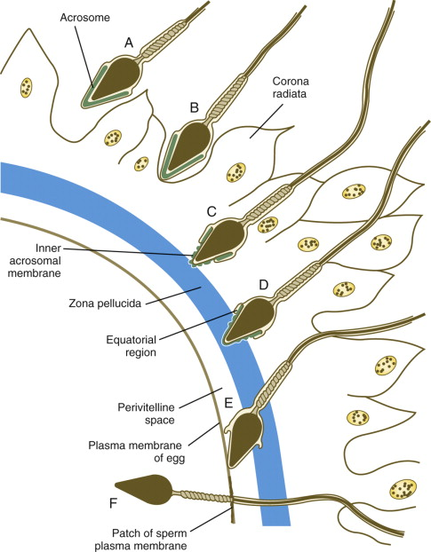
Fertilisation
Entrance of one sperm into egg stimulates formation of fertilisation membrane around the egg, which prevents entrance of any more sperm.

Slide 29
Fertilisation
Tail absorbed and head begins to move through cytoplasm of egg in the form of male pronucleus.
Entrance of sperm stimulates egg (secondary oocyte) to complete second meiotic division.
Nucleus of egg develops into female pronucleus, which fuses with male pronucleus to form single nucleus that now has diploid number of chromosomes.
Fertilisation complete: fertilised egg called a zygote.

Slide 30
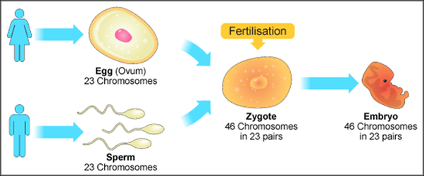
Fertilisation
Nucleus of egg develops into female pronucleus, which fuses with male pronucleus to form single nucleus that now has diploid number of chromosomes.
Fertilisation complete: fertilised egg called a zygote.

