Slide 1
Nutrients & Enzymes
A. Williams and R.Johansen 2021

Slide 2
Nutrients
Cells need nutrients to supply energy and matter for synthesis (building up). These nutrients may be organic or inorganic
Organic nutrients are carbohydrates (monosaccharides, disaccharides and polysaccharides), protein, lipids (saturated and unsaturated) and vitamins

Slide 3
Organic vs Inorganic molecules
Organic | Inorganic
Large molecules and a lot of them | Small molecules and only a few atoms
Always contain carbon Arranged in chains or rings | May contain carbon (but not large numbers)
Usually contain hydrogen and oxygen | E.g. sodium chloride, calcium carbonate, copper sulphate

Slide 4
4 major groups of organic compounds:
Carbohydrates
Proteins
Lipids
Nucleic Acids

Slide 5
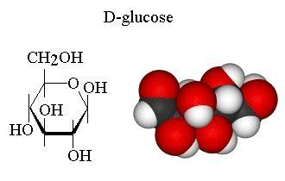
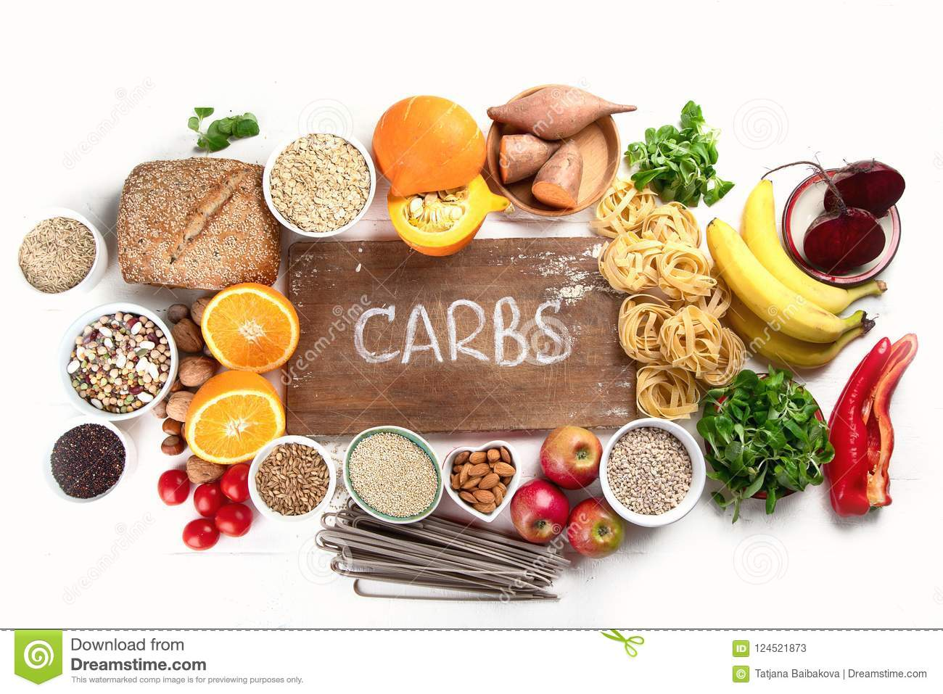
1. Carbohydrate
Contain carbon, hydrogen and oxygen
Twice as many H atoms as O atoms
Glucose: C₆H₁₂O₆, Sucrose: C₁₂H₂₂O₁₁
Terms relating to carbohydrates:
Simple sugars
Monosaccharides
Disaccharides
Polysaccharides

Slide 6
1. Carbohydrate
Monosaccharide: a simple sugar or single-unit sugar
glucose, fructose, galactose
Disaccharide: Two monosaccharide molecules joined together
Sucrose, maltose, lactose
Polysaccharide: A large number of monosaccharides joined together
Glycogen, starch, cellulose

Slide 7
1. Carbohydrate

Slide 8
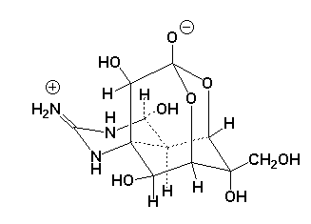
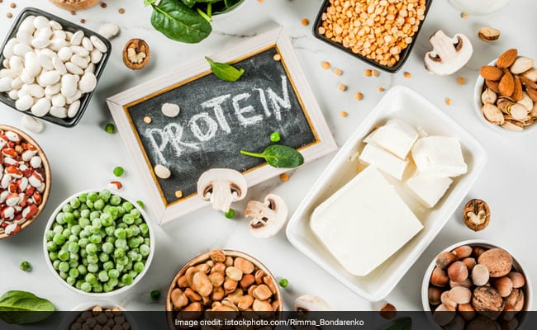
2. Protein
Contain carbon, hydrogen, oxygen and nitrogen
Many also contain sulfur and phosphorus
Protein molecules are made up of large numbers of smaller units called amino acids

Slide 9
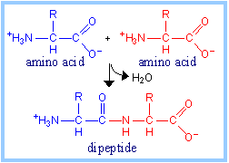
2. Protein
Peptide bond: bond between two amino acids
Dipeptide: Two amino acids joined by a peptide bond
Polypeptide: Ten or more amino acids joined by peptide bonds
Proteins consists of 100 or more amino acids joined by peptide bonds

Slide 10
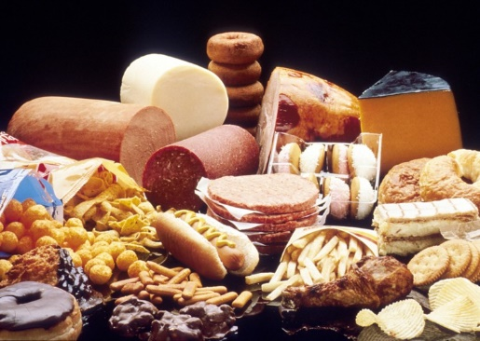
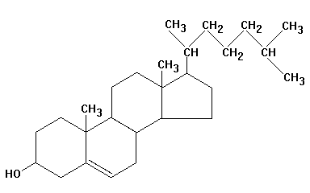
3. Lipids
Contain carbon, hydrogen and only a small amount of oxygen
Each fat (lipid) molecule is made up of one molecule of glycerol and one, two or three molecules of fatty acids.
Most fats are insoluble in water

Slide 11
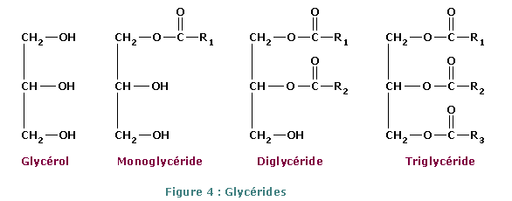
3. Lipids
Monoglyceride: Fats with glycerol and one molecule of fatty acid
Diglyceride: Glycerol and two fatty acids
Triglyceride: Glycerol and three fatty acids = (the form of fat stored by the body).

Slide 12
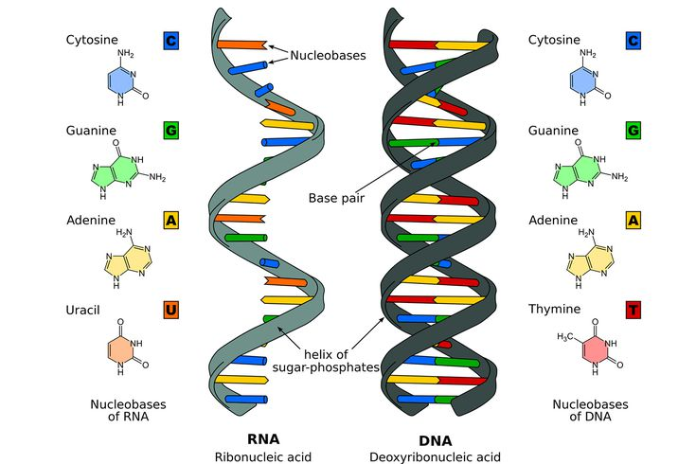
4. Nucleic Acids
Large molecules containing carbon, hydrogen, oxygen, nitrogen and phosphorus.
Nucleotides: The units that make up nucleic acids (each with nitrogen base, sugar and phosphate group)
Two main kinds:
DNA (deoxyribonucleic acid)
RNA (Ribonucleic acid)

Slide 13
Enzymes

Slide 14
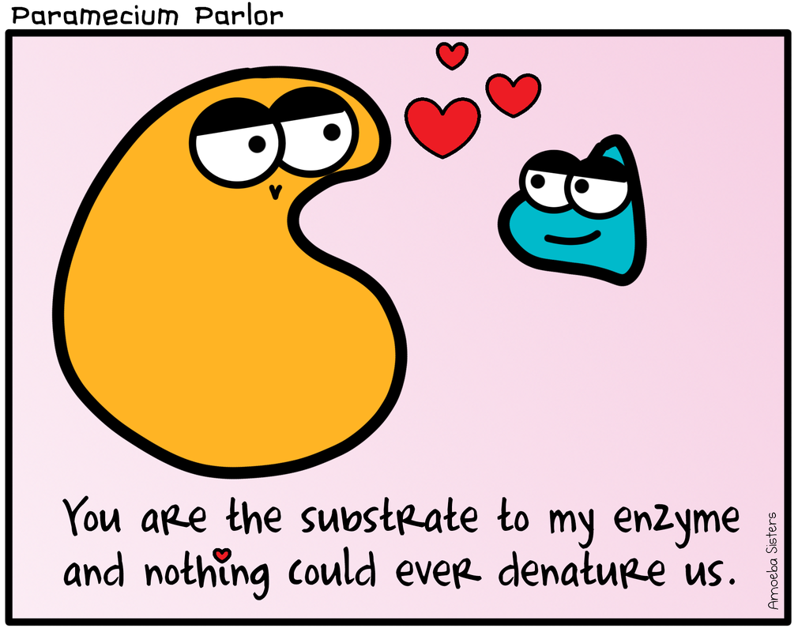

Slide 15
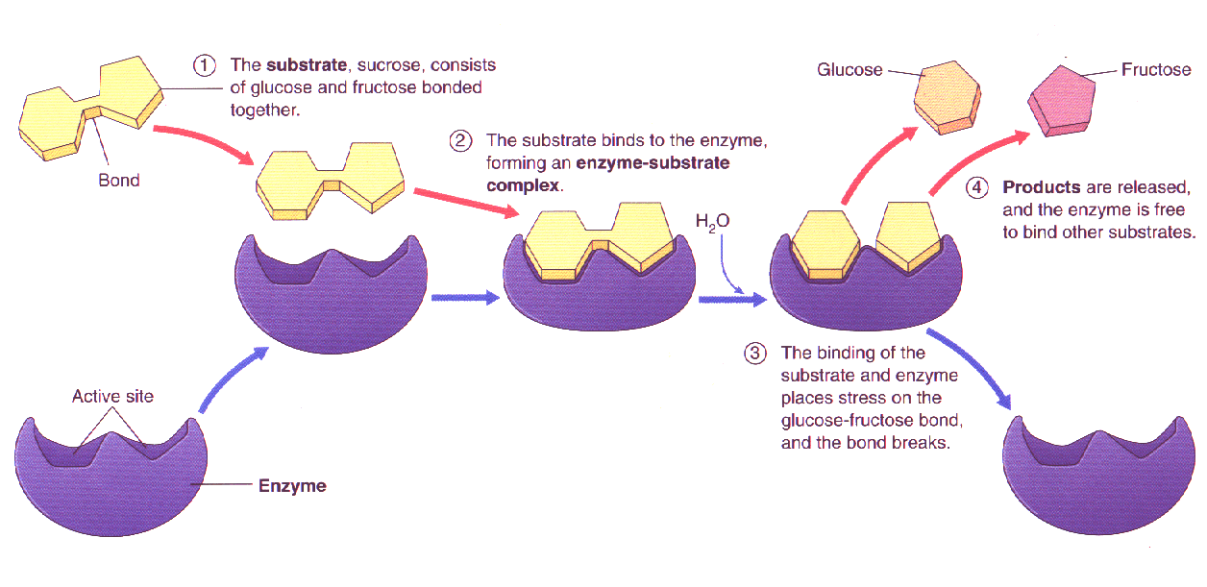
Enzymes and Metabolism
http://science.halleyhosting.com/sci/ibbio/chem/notes/chpt8/chpt8.htm

Slide 16
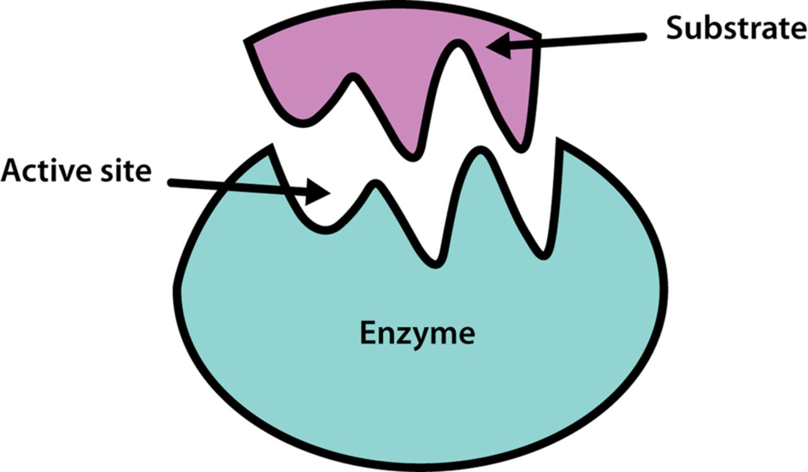
Enzymes
Enzymes are proteins that allow chemical reactions to take place at normal body temperature
Without enzymes these reactions would be too slow to be of any use to the body
https://www.tes.com/lessons/VUCPcE9FachHaA/enzyme

Slide 17
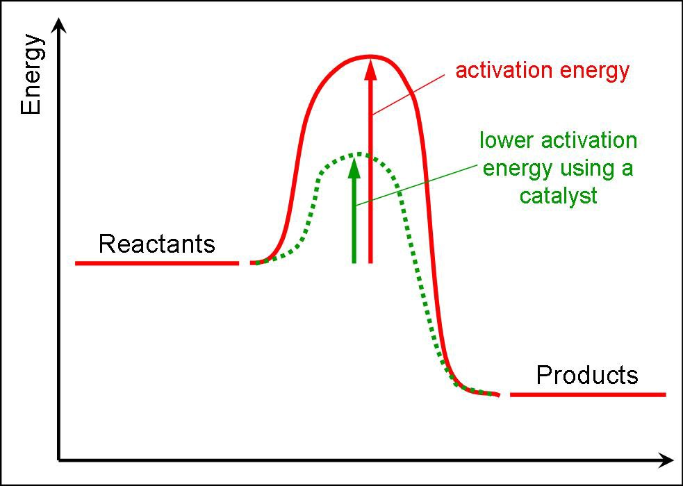
Activation energy
Chemical reactions require energy to get started, this energy is known as activation energy
Enzymes reduce the activation energy needed to begin a reaction
Not only do enzymes decrease activation energy, they also allow reactions to occur at a rate suited to body’s requirements

Slide 18
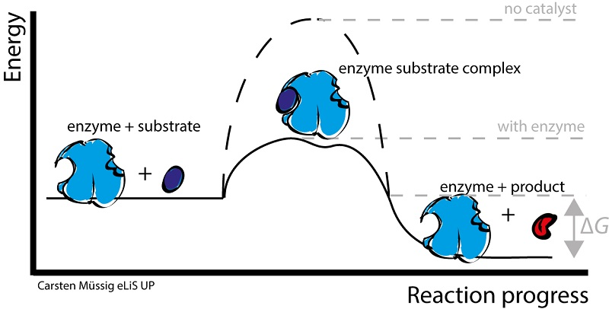
Enzyme-substrate complex
https://biologydictionary.net/enzyme-substrate-complex/

Slide 19
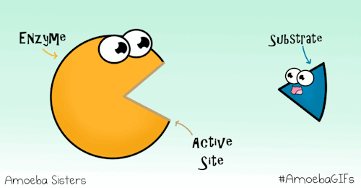
Enzyme-substrate complex
Substrate: molecules on which an enzyme acts
Enzymes are specific
Each enzyme will combine with only one particular substrate

Slide 20
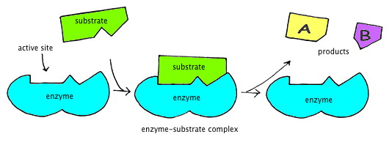
Enzyme-substrate complex
Enzyme & substrate have a shape & structure that allow them to fit together
Lock & key model
Active site: part of enzyme that combines with substrate
Enzyme-substrate complex: when enzyme & substrate are combined
http://www2.nau.edu/lrm22/lessons/enzymes/enzymes.html

Slide 21
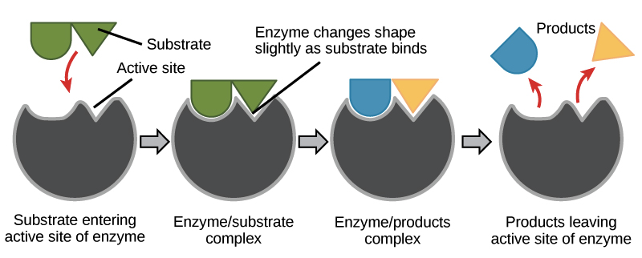
Enzyme-substrate complex
https://www.khanacademy.org/science/biology/energy-and-enzymes/introduction-to-enzymes/a/enzymes-and-the-active-site

Slide 22
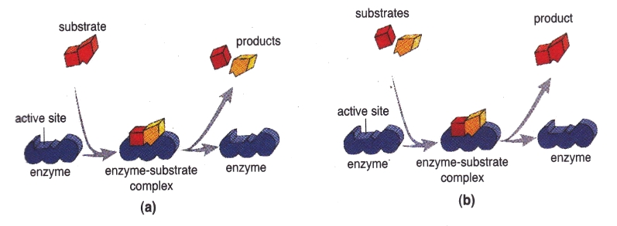
Catabolic and Anabolic Reactions
https://newsciencebiology.blogspot.com.au/2013/08/the-work-mechanism-of-enzyme.html

Slide 23
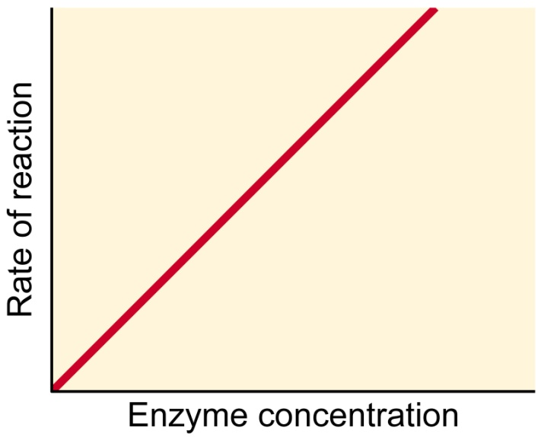
Factors affecting enzyme activity
1. The higher the concentration of enzyme, the faster the rate of chemical reaction
By regulating type & amount of enzyme present, body is able to control which reactions occur & what rate they proceed

Slide 24
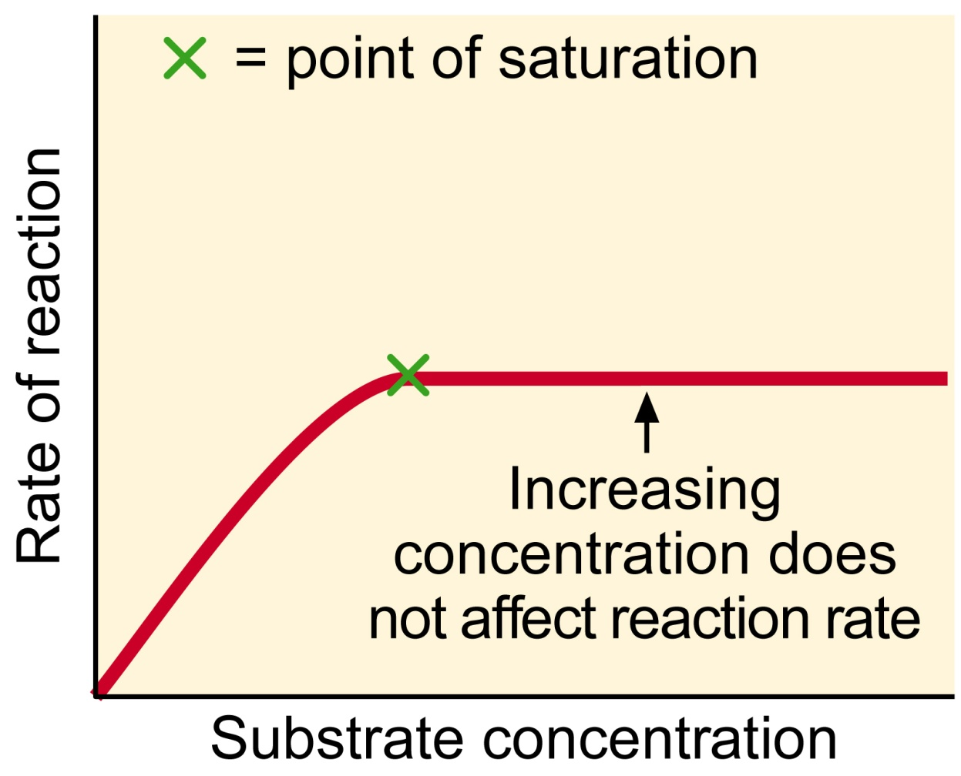
Factors affecting enzyme activity
2. Increasing substrate concentration also increases rate of reaction
This is because there will be more substrate molecules coming into contact with enzyme molecules
Beyond a certain concentration, increasing substrate will cease to have an effect because all enzyme molecules will be fully occupied (saturation)

Slide 25
Factors affecting enzyme activity
3. Products of reaction must be continually removed
Otherwise rate of reaction will slow because it becomes more difficult for substrate molecules to make contact with enzyme molecules

Slide 26
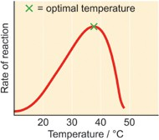
Factors affecting enzyme activity
4. Temperature influences enzyme activity
Rate of most chemical reactions increases as temperature increases
Only within a limited temperature range
Because enzymes are proteins, beyond about 45-50°C their structure changes and they are denatured (inactivated)
Optimum temperature: temp. at which enzyme works best. For most enzymes in human body this is between 30°C and 40°C

Slide 27
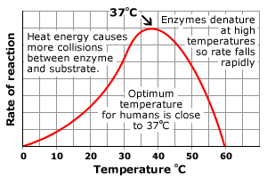
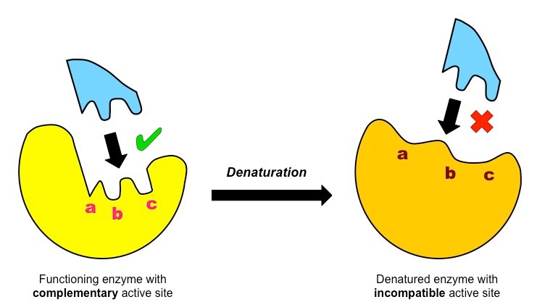
http://www.bbc.co.uk/schools/gcsebitesize/science/add_ocr_pre_2011/homeostasis/importancerev4.shtml
https://www.google.com/search?q=denaturing+active+site+of+enzyme&tbm=isch&ved=2ahUKEwj09Nag1NHtAhVDA7cAHa9SANkQ2-cCegQIABAA&oq=denaturing+active+site+of+enzyme&gs_lcp=CgNpbWcQAzoECAAQQzoFCAAQsQM6CAgAELEDEIMBOgcIABCxAxBDOgIIADoGCAAQCBAeOgQIABAYUOiGF1iirhdg6K8XaABwAHgBgAHxAogBiTSSAQkwLjE3LjEzLjGYAQCgAQGqAQtnd3Mtd2l6LWltZ8ABAQ&sclient=img&ei=PIzZX_TmHMOG3LUPr6WByA0&bih=969&biw=1920&rlz=1C1GCEA_enAU931AU931#imgrc=uTOpuN7EN7r49M

Slide 28
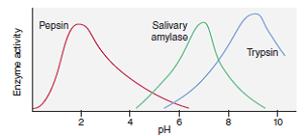
Factors affecting enzyme activity
5. Enzymes are sensitive to pH of the medium in which the reaction is taking place
Each enzyme has an optimal pH at which is works most effectively

Slide 29
Factors affecting enzyme activity
6. Many enzymes require the presence of co-factors: certain ions or non-protein molecules before they will catalyse a reaction
Co-factors change the shape of the active site so enzyme can combine with substrate
Without a co-factor the enzyme molecule is intact but cannot function
Co-enzymes: non-protein organic molecules. Many vitamins function as these

Slide 30
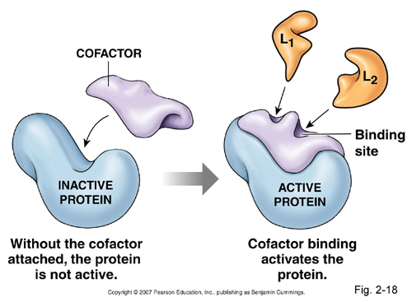
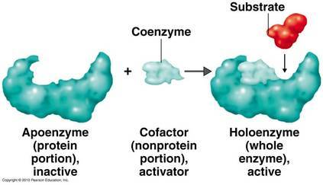
https://lovingubiology.wordpress.com/2015/12/13/enzymes-and-functions/

Slide 31
Factors affecting enzyme activity
7. Enzyme Inhibitors: substrates that slow or even stop the enzyme’s activity
Inhibitors may be used by cell to control reactions so that products are produced in specific amounts
Many drugs are enzyme inhibitors; eg. Penicillin inhibits an enzyme in bacteria that is involved in construction of cell wall

Slide 32
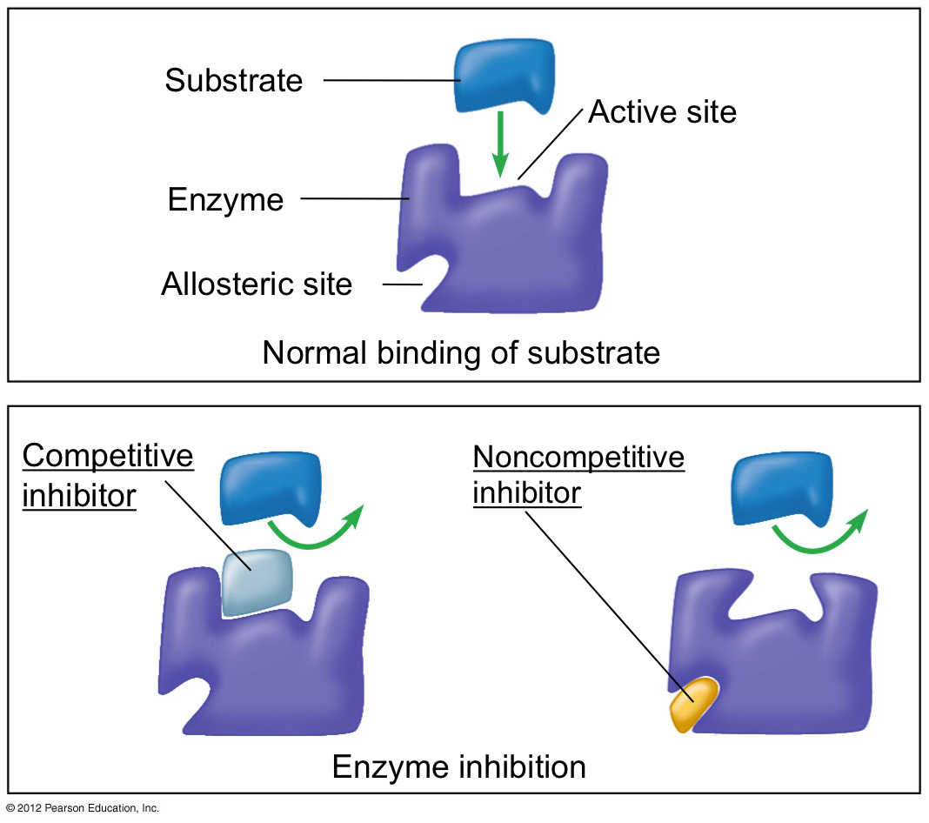

Slide 33
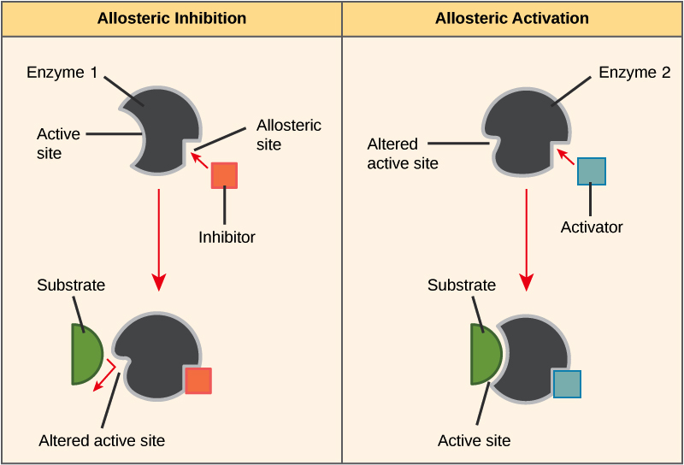

Slide 34
Factors affecting enzyme activity -Review-
Enzyme concentration
Substrate concentration
Removing products of reaction
Temperature
pH
Co-factors & co-enzymes
Enzyme inhibitors

Slide 35
DO: Questions in the text
Complete a glossary using the key words from chapter 3 (Page 81)
Complete all relevant Chapter 3 Review Questions (Page 83-84)
Prepare your own notes

