Slide 1
The Accounting Equation

Slide 2
OBJECTIVES
Students will be able to define and perform calculations using the accounting equation.

Slide 3
Accounting equation
The financial position of a company is measured by the following items:
Assets
Liabilities
Owner’s Equity

Slide 4
ASSETS
Assets are items of value owned by or owed to a business
Assets can include items such as cash, inventory, motor vehicles, debts owed to the business from others etc.

Slide 5
Activity
Make a list of assets that a hardware store might have.

Slide 6
Current and non-current assets
Two different categories: Current & Non-current
Current Assets - cash and other items that are likely to be converted to cash within a 12-month period. Examples include cash at bank, accounts receivable and inventory etc.
Non-current assets are items likely to be used over a period longer than 12 months. Examples include machinery, equipment etc.

Slide 7
ACTIVITY
Categorise the hardware store assets as current and non-current.

Slide 8
LIABILITIES
Liabilities are the debts owed by a business to others.
Current Liabilities are debts that must be paid within a 12-month period. Examples include accounts payable (creditors), bank overdrafts etc.
Non-current liabilities are debts that are likely to be repaid in a period longer than 12 months. Examples include mortgages etc.

Slide 9
EQUITY
Equity is the amount of money a business owes its owner. Made up of money or other assets contributed by the owner plus profits less any owner withdrawals. Examples include capital (money contributed), drawings (money withdrawn) and profit.

Slide 10
Accounting equation
The Accounting Equation can be expressed as the relationship between total assets (A), total liabilities (L) and Owner’s Equity (EQ) of a business at a specific point in time.
It is expressed as the following:
Assets = Liabilities + Owner’s Equity
Or
Assets – Liabilities = Owner’s Equity
Or
Owner’s Equity = Assets – Liabilities

Slide 11
Example
On 1 December 2015, J.Ott invests personal funds of $10,000 to start his business. The effect of this transaction on the accounting equation is:

Slide 12
On 2 December 2015, J. Ott withdraws $100 of cash from the business for his personal use. The effect of this transaction on the accounting equation is:

Slide 14
On 3 December 2015, $5,000 of cash was spent to purchase computer equipment for use in the business. The effect of this transaction on the accounting equation is:

Slide 15
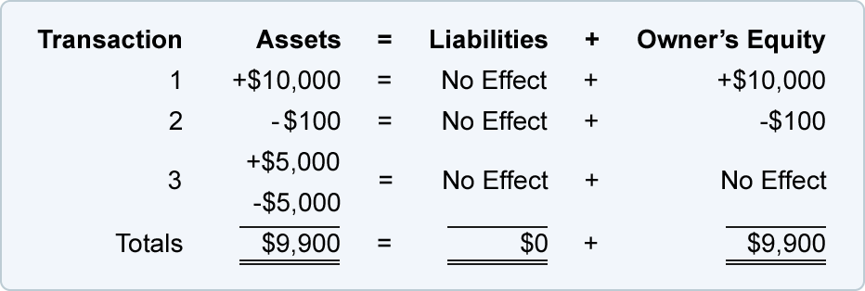

Slide 16
On 4 December 2015, the business obtains $7,000 by borrowing money from its bank. The effect of this transaction on the accounting equation is:

Slide 17
