Slide 1
Income Statement

Slide 2
Objectives
Understand the components of an income statement and prepare an income statement.

Slide 3
Income Statement
Details all the income and expense items for a business over a period of time. Used to calculate the profit/loss.
Revenue (income) > expenses = profit
Expenses > revenue = loss

Slide 4
Link to Balance Sheet
Profit made by the business belongs to owner(s), so it is transferred to the equity section of the balance sheet.
Profit increases equity.
Losses will reduce the equity of the business.

Slide 5
Income
The money received by the business.

Slide 6
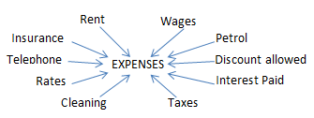
Expenses
Expenses are amounts paid by the business.

Slide 7
Income Statement for XYZ Business for the period ended 31 December 2015
INCOME | $ | $
Service Income | 94,600 | 94,600
EXPENSES
Salaries | 25,000
Telephone and Internet | 6,500
Water and electricity | 16,000
Property rates | 1,000
Insurance | 7,300
Advertising | 1,000
Fuel | 2,500
Stationery | 412
Bank charges | 654 | 60,366
PROFIT |  | 34,234

