Slide 1
Source Documents

Slide 2
What is the purpose of source documents?
Records the details of transactions and acts as evidence that those transactions took place.
They include:
Purchase orders
Tax invoices
Cheques
Receipts

Slide 3
Purchase Order
Used to order the goods businesses need from a chosen supplier.
Supplier completes the form by required time or advises the purchaser if goods are unavailable.
Purchaser keeps a copy to check goods received match those ordered.

Slide 4
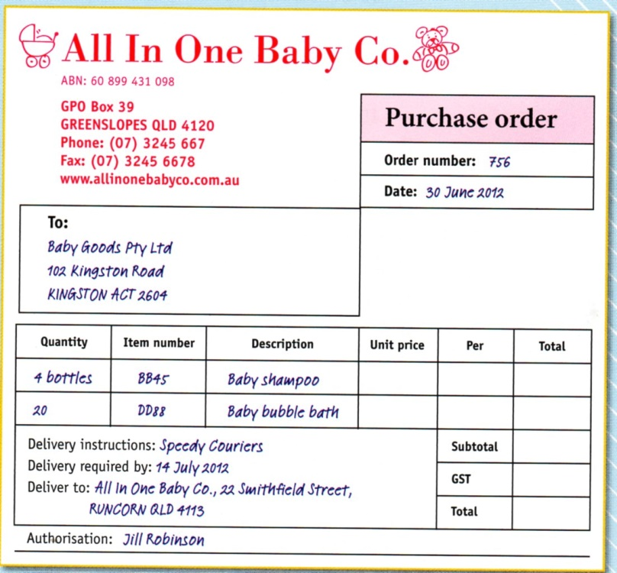

Slide 5
Tax Invoices
Bill that lists goods or services purchased and the total amount owed to supplier.
Goods and Services TAX (GST) of 10% applies to most goods and services.
Not required to prepare a tax invoice if value excluding GST less than $50.

Slide 6
Tax Invoices
For goods and services under $1000 tax invoice must include:
Words ‘tax invoice’
Suppliers name and address
Suppliers Australian Business Number (ABN)
Date
Total amount owing including GST
Statement such as ‘total including GST’ next to total amount owing

Slide 7
Tax Invoices
For goods and services over $1000 tax invoice must include:
Words ‘tax invoice’
Suppliers name and address
Suppliers Australian Business Number (ABN)
Date
Name of purchaser
Address or ABN of purchaser
Number of goods supplied
Brief description of each item supplied
Total amount owing including GST
Statement such as ‘total including GST’ next to total amount owing

Slide 8
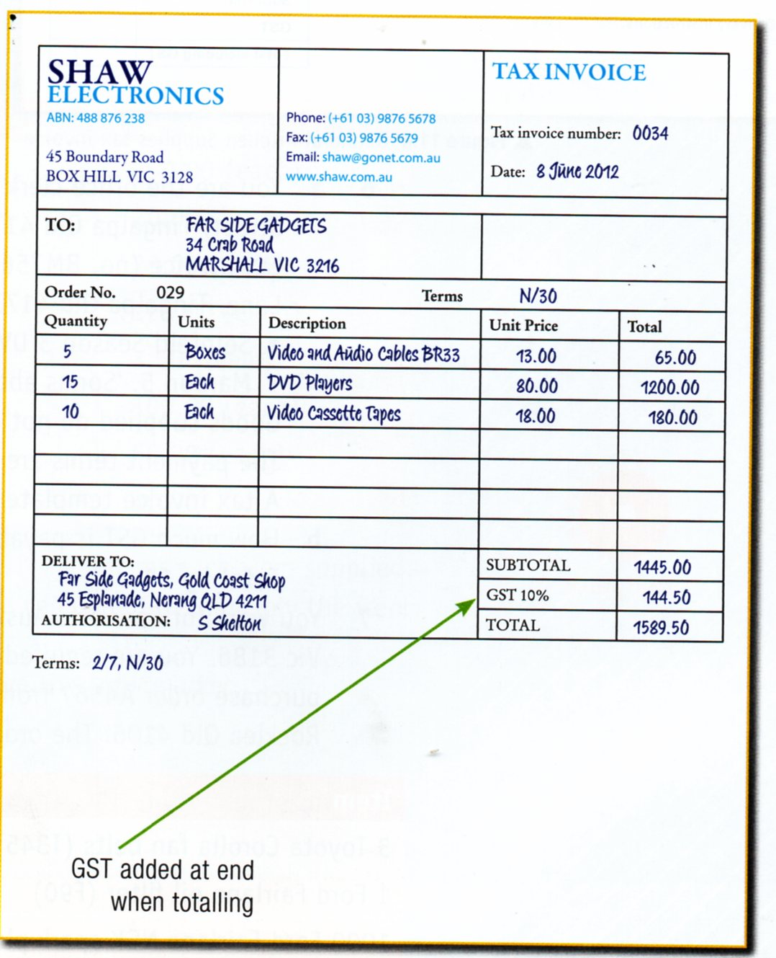

Slide 9
Cheques
Prepared by the purchaser and sent to the seller as payment.
Allows money to be withdrawn from the businesses bank account so must be signed by the authorised person.
Drawer – business whose account money is withdrawn from.
Drawee – financial institution from which money is to be taken from.
Payee – person receiving the money.
Cheque is made up of two parts:
The butt which records payment information and kept as proof of transaction
The form which is sent to the payee completed

Slide 10
Cheques
Cheques crossed with two parallel lines or words ‘non negotiable’ indicates cheque must be deposited into bank and cannot be immediately exchanged for cash.

Slide 11
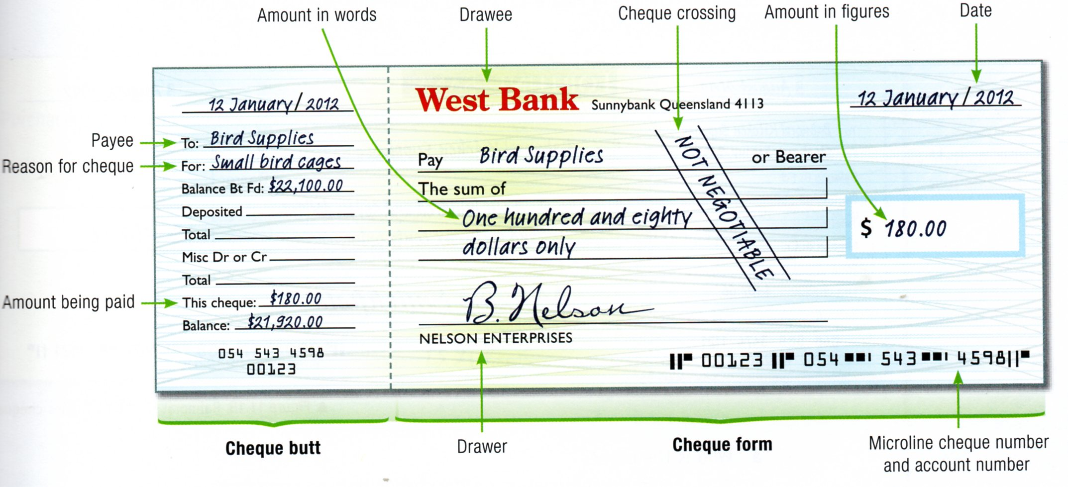

Slide 12
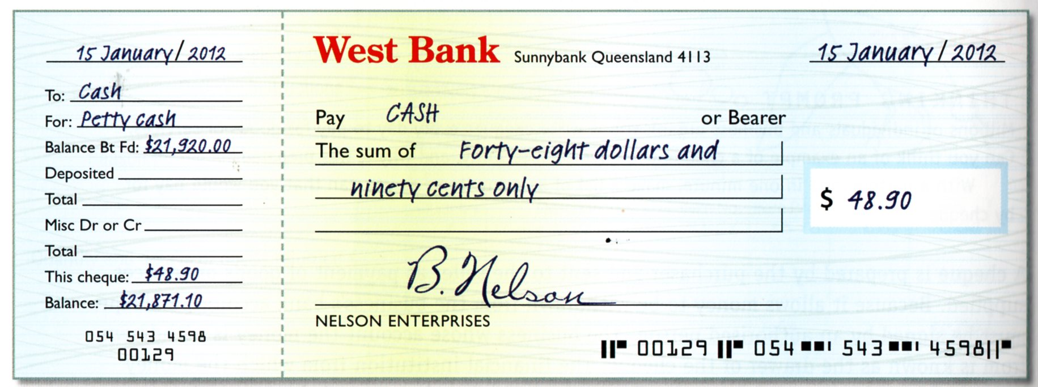
Cheques
If business wishes to withdraw cash from cheque account include ‘cash’ as payee. Cheque is uncrossed.

Slide 13
Receipts
Prepared by the supplier and forwarded to the purchaser as acknowledgement of payment.

Slide 14
