Slide 1
DIFFERENT KINDS OF MAPS

Slide 2
Maps
A map is a simplified plan of an area.
Maps are always drawn in pan view (directly from above)
-Maps are drawn this way to make sure the scale is the same across the whole area

Slide 3
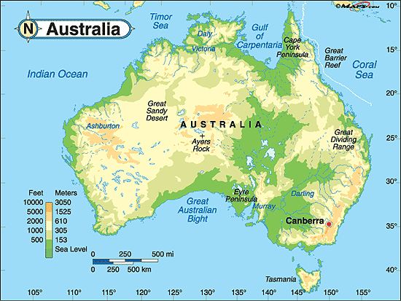
Physical maps
Show the location and names of natural features of the Earth.
-deserts, mountains, rivers, plains, oceans, reefs, volcanoes and lakes

Slide 4
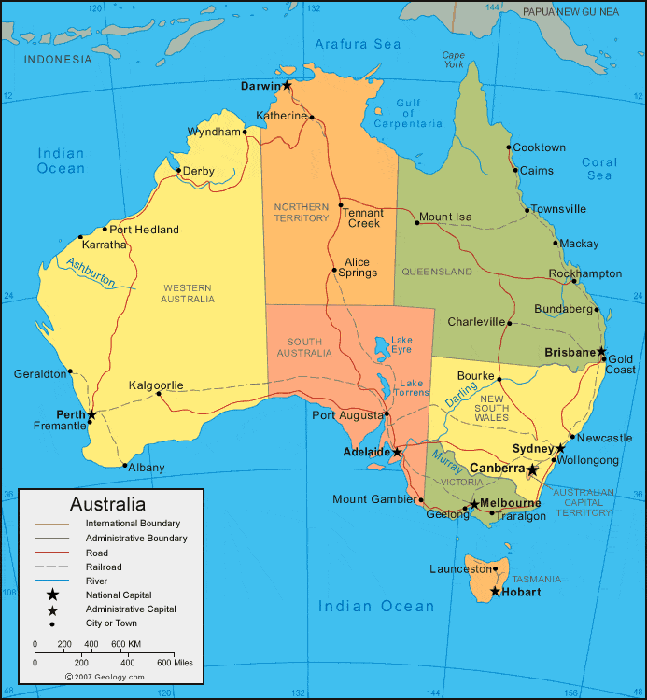
Political maps
Show the locations and names of built features of the Earth.
-country borders, state and territory borders, cities and towns

Slide 5
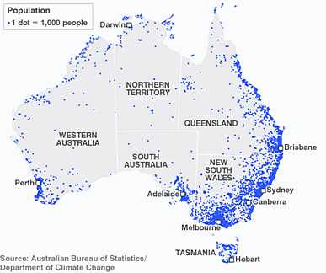
Dot distribution maps
Use dots (or shapes) to represent and compare a range of different features
The dots show the location of the feature.
The size and colour of the dots show different characteristics of the feature
-small towns v. large towns
Help show patterns and links between features

Slide 6
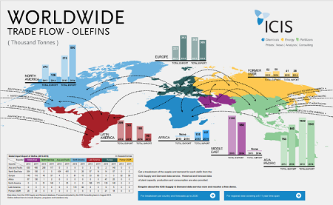
Flow maps
Show movement from one place to another
Shows where things are moving and numbers involved

Slide 7
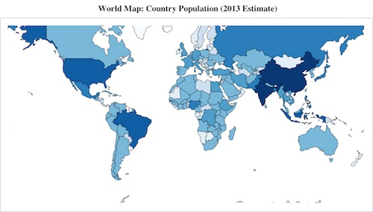
Choropleth Maps
Uses different shades of the same colour to show patterns being formed
Ex: darker shades = greatest amount
lighter shades = lease amount

Slide 8
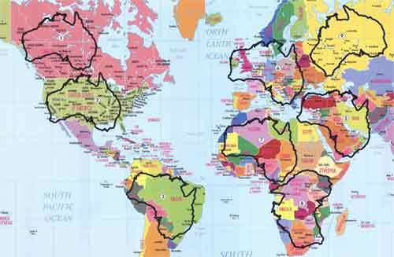
OVERLAY MAPS
Shows how features on the Earth’s surface might be related to each other

Slide 9
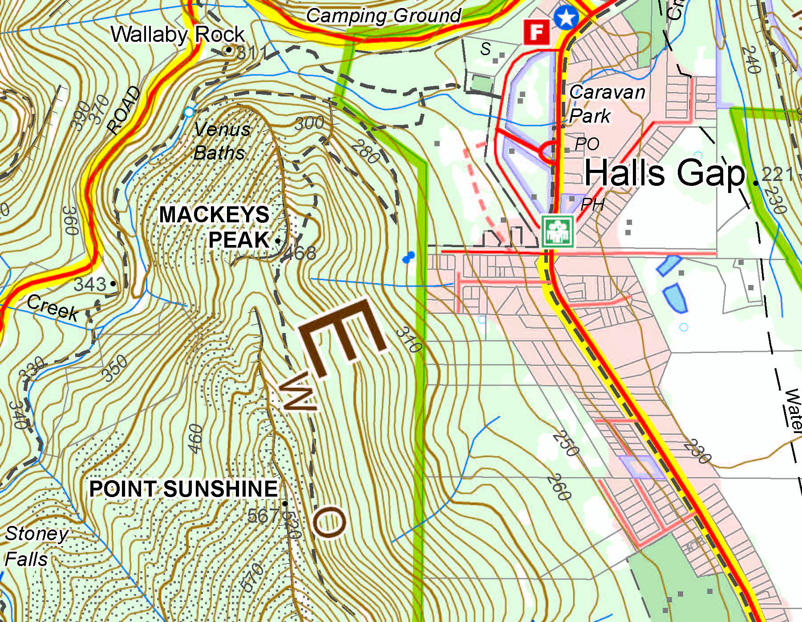
Topographic map
Shows the shape of the land (valleys, hills and ridges) by using contour lines.
Numbers on the lines show the height of land above sea level
The closer together the lines, the steeper the land

Slide 10
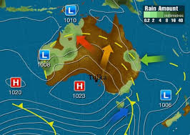
Weather map
Show conditions in the atmosphere (air pressure, wind speed and wind direction)
Shows size and location of weather fronts

Slide 11
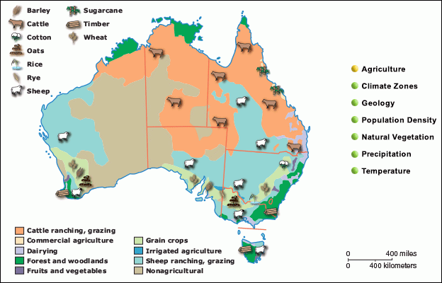
Thematic maps
Show a theme or topic
Ex: distribution of resources, different types of forests, access to safe drinking water, types of crops and animals farmed in Australia

