Slide 1
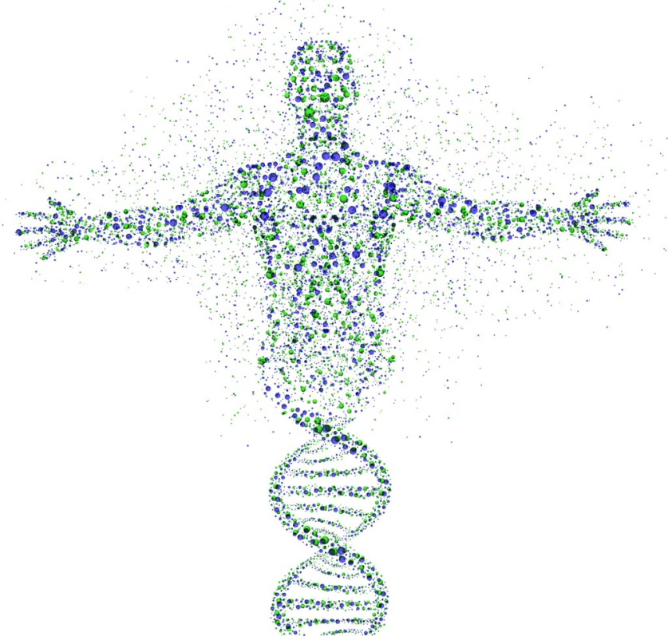
Chapter 22 Inheritance
R. Johansen 2018

Slide 3
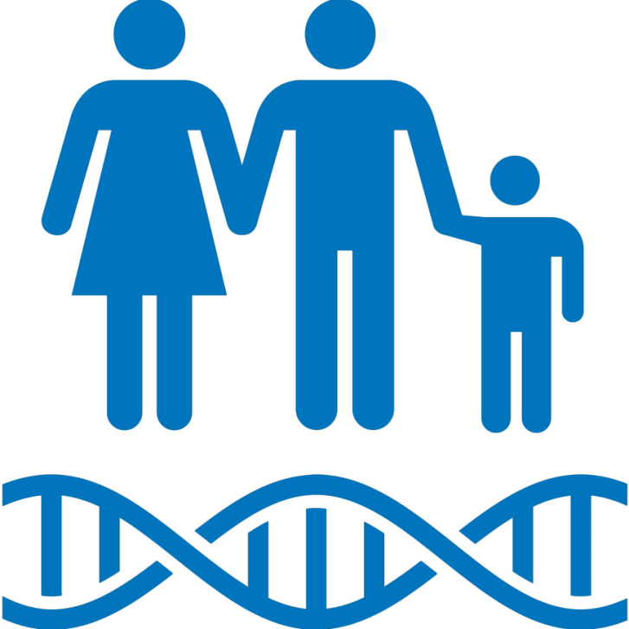
What is inheritance?
Genetic characteristics (traits) that are transmitted from parent to offspring.

Slide 4
Terminology
Gene
Allele
Dominant
Recessive
Homozygous
Heterozygous
Phenotype
Genotype

Slide 5
Sex determination

Slide 6
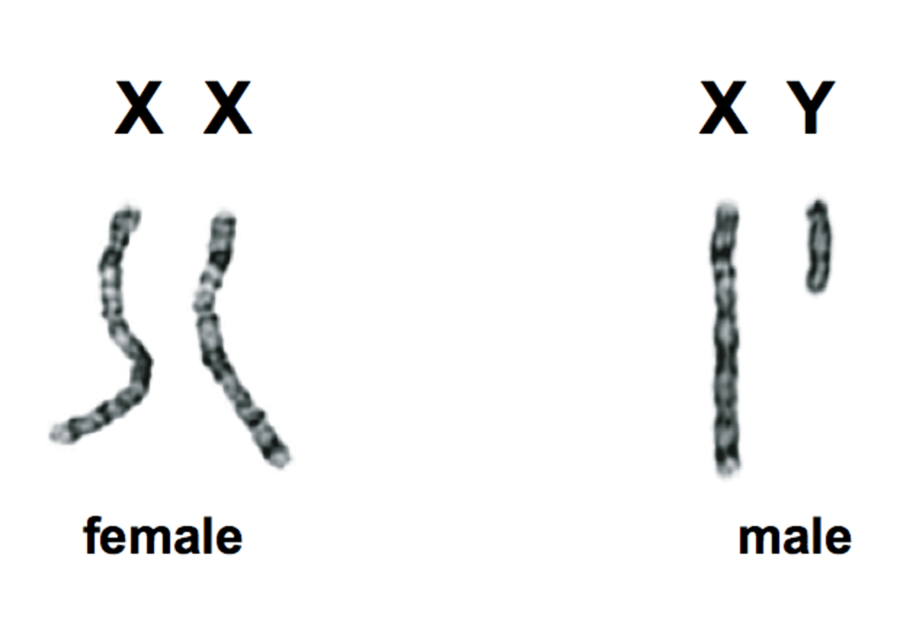
Sex Determination – Humans (mammals)
The 23rd pair of chromosomes determine the sex of an individual
Males have an X and Y chromosome
Females have two X chromosomes
X chromosomes are larger than Y chromosomes

Slide 7
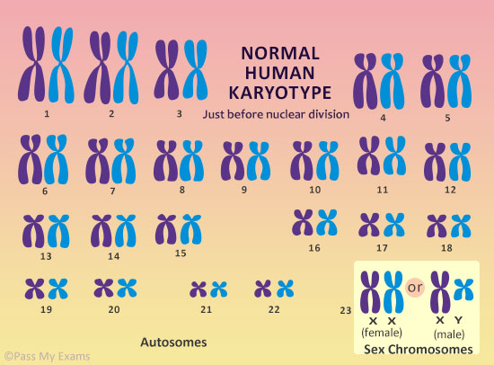

Slide 8
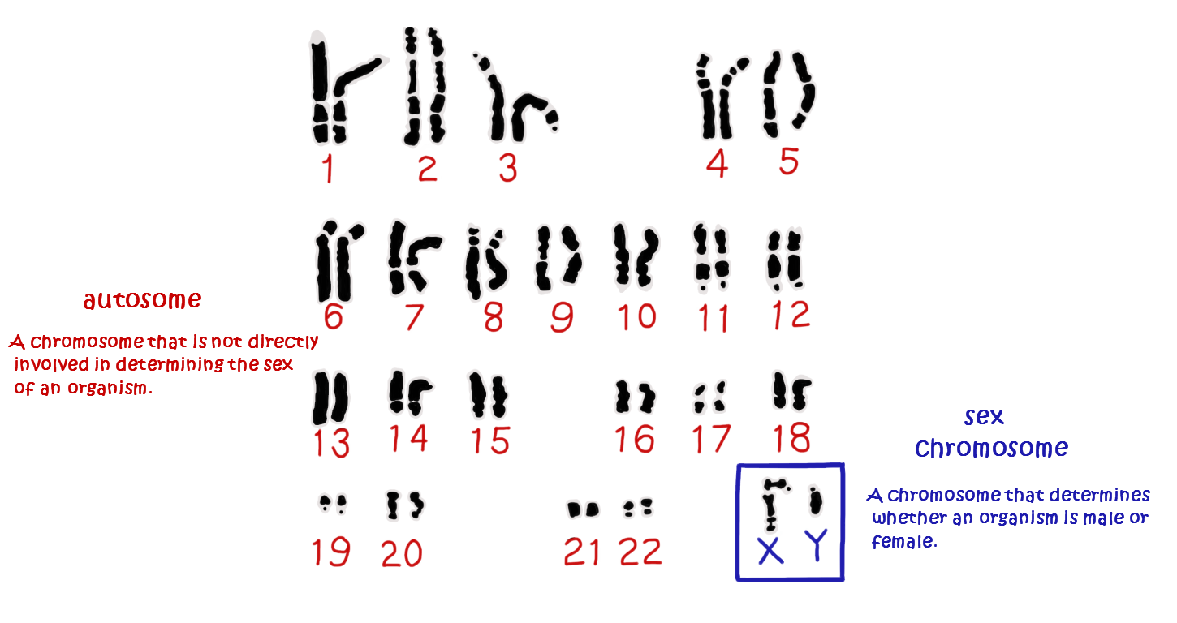
Sex chromosomes and autosomes
Sex chromosomes = the 23RD pair of chromosomes (XX OR XY). Determine the sex of an individual (male or female)
Autosomes (autosomal chromosomes) = The chromosomes that make up the first 22 pairs of chromosomes.

Slide 9
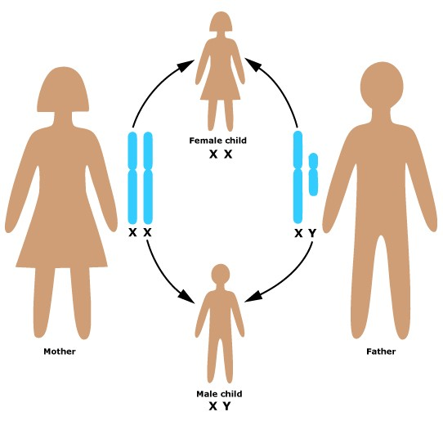
Thanks Dad!!
Males are responsible for determining the sex of their offspring….
Sperm can contain either an X or Y chromosome
Eggs can only contain an X chromosome

Slide 10
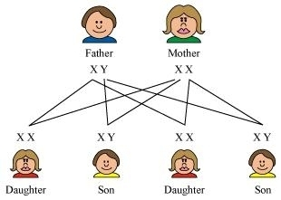

Slide 11
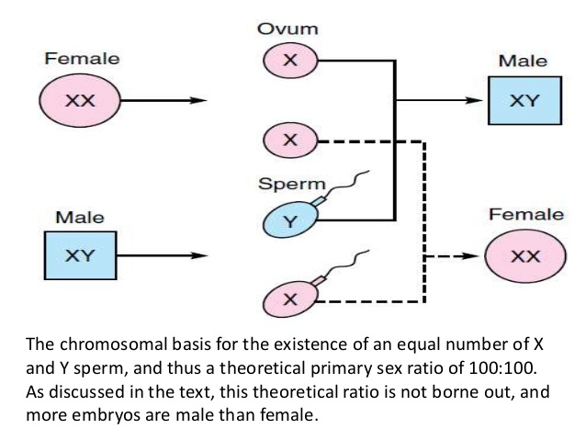

Slide 12
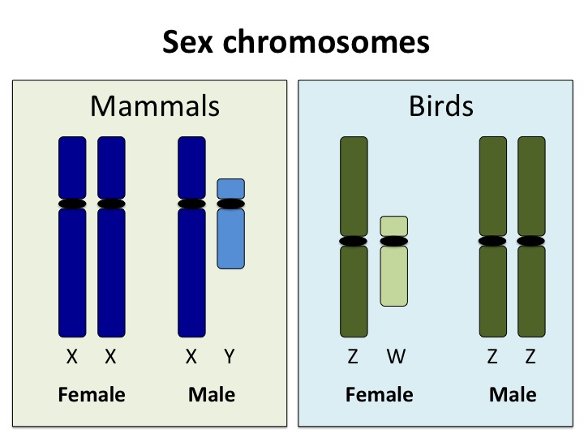
Sex determination – mammals v birds

Slide 13
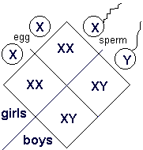
probability
The probability of a child being male or female is 50:50
Each time fertilization occurs there is a 50% chance the child will be male or female

Slide 14
Modes of inheritance

Slide 15
Gregor Mendel
Prior to 1865 patterns of inheritance were identified but not clearly explained.
Gregor Mendel was the first scientist to provide a clear explanation of patterns of inheritance after studying traits in pea plants.
He proposed two principles:
Various hereditary characteristics are controlled by factors (genes) and these occur in pairs (alleles).
For example people with brown eyes may have the genotype BB or Bb
During the formation of gametes the pairs of factors (genes) separate. When gametes unite at fertilization the pairs of genes come back together. (The Principle of Segregation)
For example sperm and eggs with either carry a single ‘B’ or a ‘b’ allele for eye colour.

Slide 16
Watch
https://www.youtube.com/watch?v=Mehz7tCxjSE

Slide 17
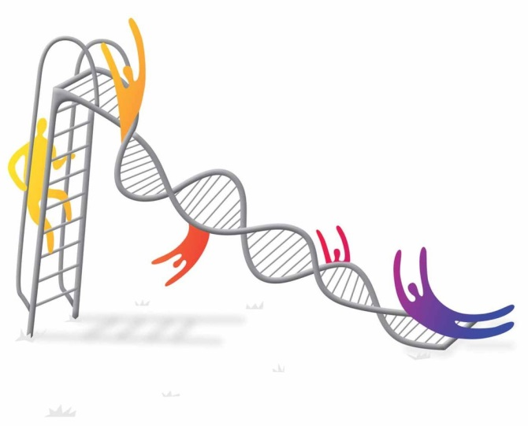
Key terms
Some key terms when looking at Mendel’s genetics include:
Pure-breeding
Organisms that produce the same characteristic in each succeeding generation when bread amongst themselves (homozygous)
Hybrid
An offspring that results from mating two individuals with different genetic constitutions (heterozygous)
Dominant trait
The characteristic of shown by a hybrid
Recessive trait
The characteristic masked by the dominant trait

Slide 18
Monohybrid crosses

Slide 19
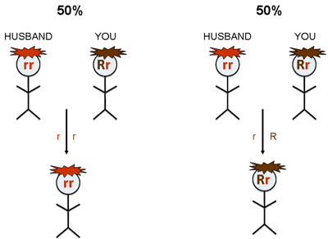
Monohybrid crosses
Cross = the mating of two organisms
Monohybrid cross = one pair of contrasting characteristics is studied at a given time.
For example: We may study patterns of inheritance for eye colour or hair colour (note: we do not study these together)

Slide 20
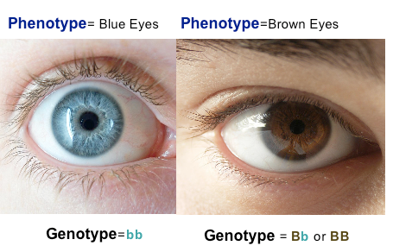
Genotype and phenotype
A persons genotype is the set of genes (represented by letters - alleles) that a person possesses.
A persons phenotype is the physical characteristic expressed by the person based on their genotype.

Slide 21
Dominant recessive inheritance

Slide 22
Genotype and alleles
Alleles = the alternate form of a gene
A person will receive one allele from their mother and another allele from their father for a particular gene. This makes up their genotype.
Alleles are represented by UPPERCASE and lowercase letters:
UPPERCASE LETTERS = DOMINANT ALLELE
lowercase letters = recessive allele
Inheritance that follows this patter is know as dominant recessive inheritance

Slide 23
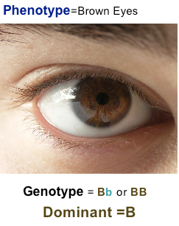
HOMOZYGOUS AND HETEROZYGOUS
Homozygous= A person has the same alleles for a particular characteristic (Pure-bred).
For example: A homozygous person with brown eyes has the genotype BB
Heterozygous = A person has different alleles for a particular characteristic. The characteristic expressed is the dominant allele (hybrid).
For example: A heterozygous person with brown eyes has the genotype Bb

Slide 24
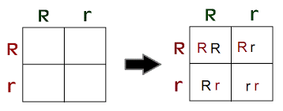
Punnett squares
Punnett squares can be used to determine patterns of inheritance:

Slide 25
Important rules when using punnett squares
When using punnett square for dominant/recessive inheritance you must:
Use the same letter. E.g. B or b
Use UPPERCASE and lowercase letters
Indicate what each letter represents. Eg. B = Brown eyes and b = blue eyes. This can be done next to the punnet square
When predicting phenotypes, indicate whether homozygous or heterozygous
Remember that punnet squares only indicate the likelihood (ratio) of inheritance

Slide 26
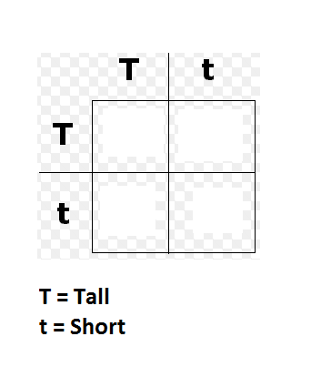
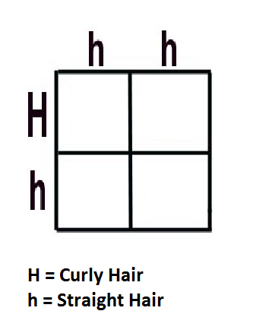
Your Turn…
For the following punnett squares:
Predict the possible genotype and phenotype of offspring
Predict the genotype and phenotype ratios/percentages for the offspring

Slide 27
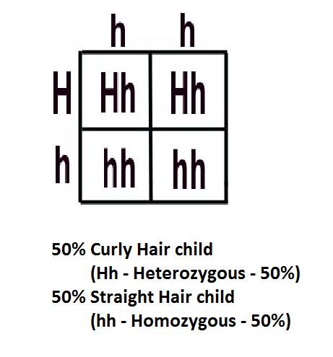
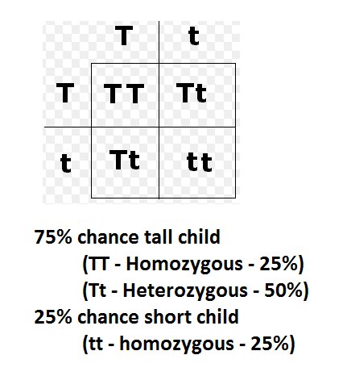
Check your answers…

Slide 28
Inherited traits
In your text book (human perspectives) on page 303 is a list of dominant recessive inherited traits.
Copy this into your notes - you will need to be able to identify some of these!

Slide 29
Sex linked inheritance

Slide 30
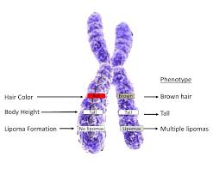
Sex linked characteristics
As the Y chromosome is smaller, it does not carry the same number of genes as the X chromosome
In females, normal pairing of alleles exists
In males, most genes on the X chromosome will lack a matching allele on the Y chromosome
The patters of inheritance for characteristics carried on the X chromosome are different in males and females

Slide 31
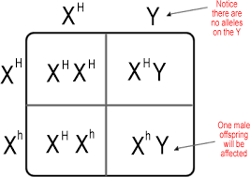
X linked punnett Squares
To determine the likelihood of offspring with an X linked disorder we use a punnett square
We use X’s and Y’s to represent gender (like a sex determination punnett)
Alleles are shown on the X’s
UPPER CASE and lowercase letters are used to show dominant and recessive alleles

Slide 32
Genotypes
Females:
- Homozygous Dominant X^{T} X^{T}
- Homozygous Recessive X^{t} X^{t}
- Heterozygous X^{T} X^{t}
Males:
- Hemizygous X^{T} Y or X^{t} Y

Slide 33
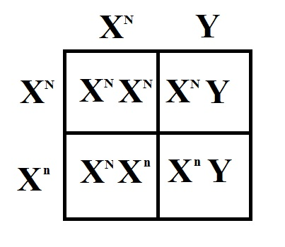

Slide 34
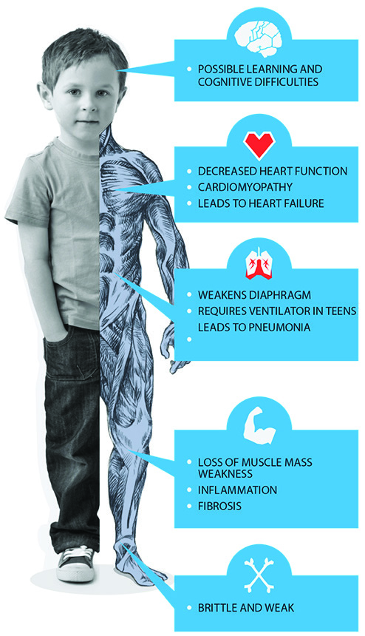
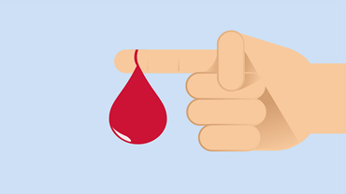
Common x linked disorders
Some common X linked disorders include:
Haemophilia
Red-Green colour blindness
Diabetes insipidus
Duchenne muscular dystrophy

Slide 35
Haemophilia
Relatively rare disease in which blood clots slowly or not at all
Defective allele to controlling normal blood clotting is recessive & carried on the X chromosome

Slide 36
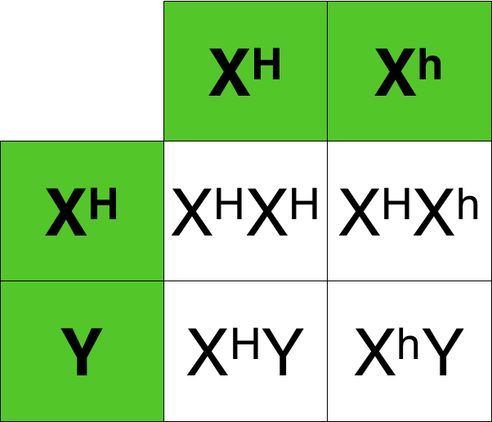
Haemophilia
Males: normal or haemophiliac, as they only have one ‘X’ chromosome
Females: Homozygous normal, heterozygous (carrier), or haemophiliac (homozygous)- this is very rare
Haemophiliac fathers pass this recessive gene to their daughters
Carrier mothers can pass defective gene to their sons (haemophiliac) or to daughters (carriers)
Example: Royal Family: Queen Victoria

Slide 37
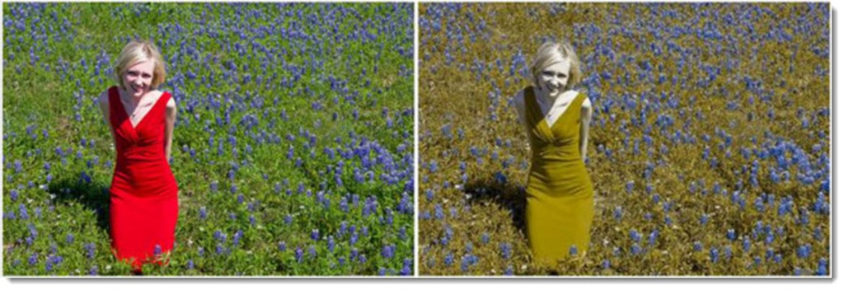
Red-green colour blindness
Ability to discriminate between red & green is controlled by a gene located in the X-chromosome
Individuals unable to distinguish between these colours possess the recessive allele of this gene
Gene is located on ‘X’ chromosome, therefore more frequently found in males than in females

Slide 38
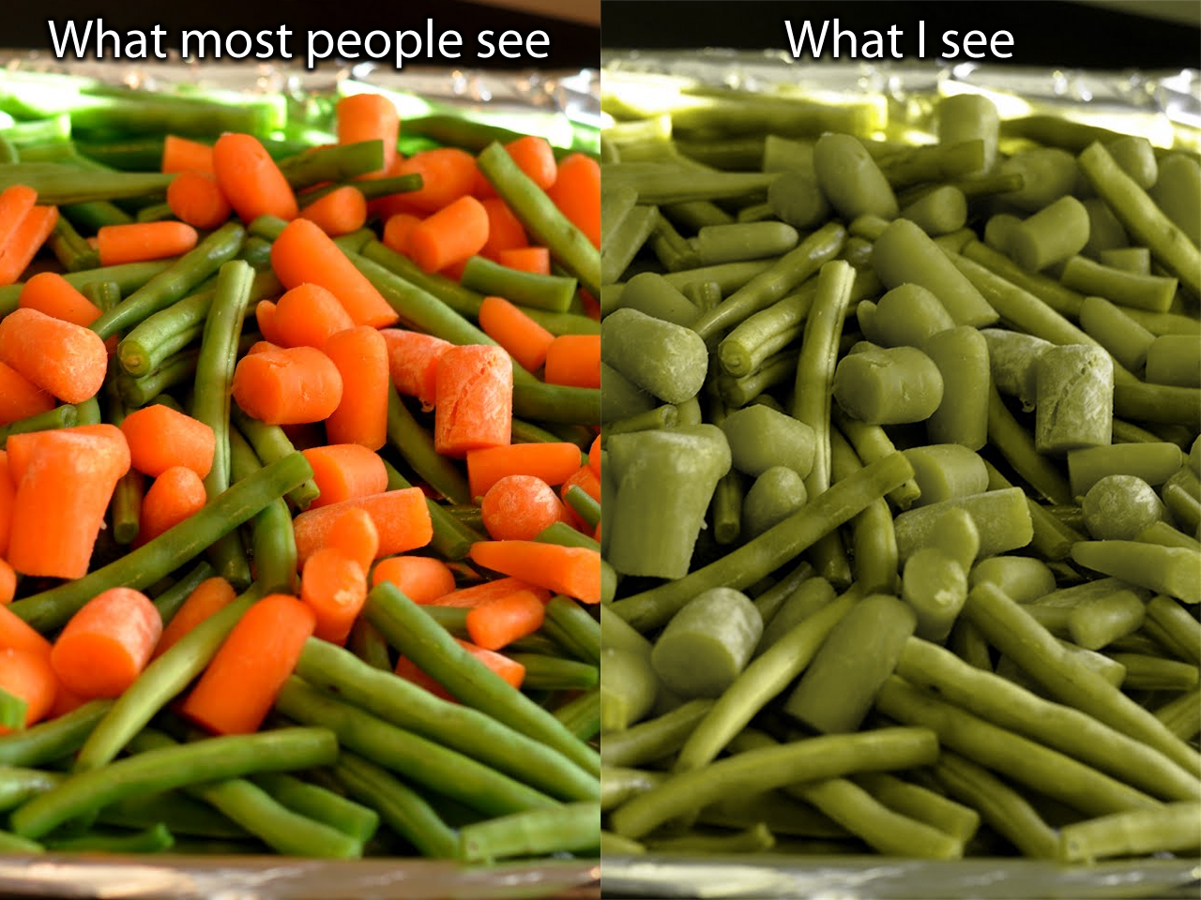

Slide 39
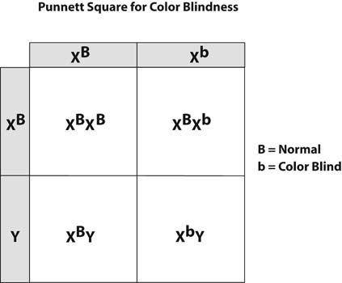

Slide 40
Duchenne muscular dystrophy
Wasting disease of leg muscles & later arms, shoulders & chest
At times may be due to a mutation- either in woman, making her a carrier, or in a boy, giving him the disease
Becomes apparent at around 3-5 years of age, when muscle weakness becomes evident
Muscle replaced by fatty substance as years pass
12-14 years: child confined to wheelchair & later bedridden
Have little chance of living beyond 20-25 years as respiratory failure eventually occurs

Slide 41
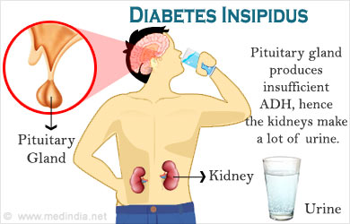
Diabetes insipidus
Individual passes very large quantities of urine, gradually becomes dehydrated
Death may result, unless water is available to replace that lost

Slide 42
Incomplete dominance

Slide 43
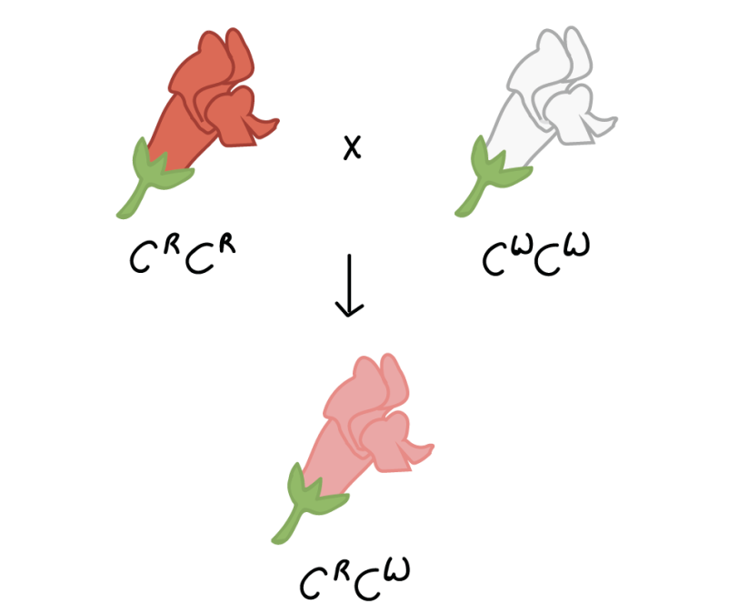
Incomplete dominance
There are some cases where the alleles of a particular gene are neither dominant or recessive….
This occurs when offspring show intermediate characteristics to those of their parents.
Can also be referred to as ‘blending’
When representing genotypes of incomplete dominant inheritance all UPPERCASE letters are used (as no allele is recessive)

Slide 44
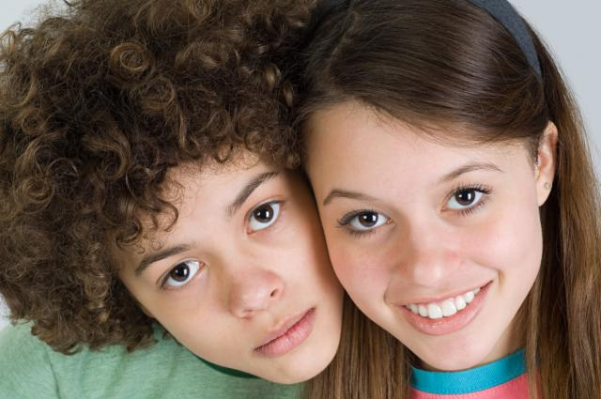
INCOMPLETE DOMINANCE
Hair type is an example of incomplete dominance:
Straight Hair = H^{S}H^{S}
Curly Hair = H^{C}H^{C}
Wavy Hair = H^{C}H^{S}

Slide 45
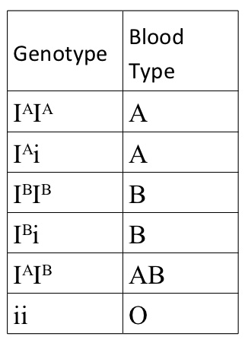
MULTIPLE ALLELES
When there are more than two alleles for a particular characteristic.
Follow a co-dominant pattern of inheritance
Blood groups
Possible alleles for blood groups include:
Antigen A = I^{A}
Antigen B = I^{B}
No Antigen = i

Slide 46
Co-dominance

Slide 47
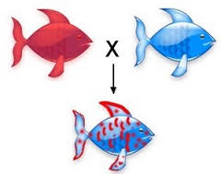
Co-dominance
Another example where the alleles of a particular gene are neither dominant or recessive….
Homozygous parents produce offspring that show characteristics of both parents

Slide 48
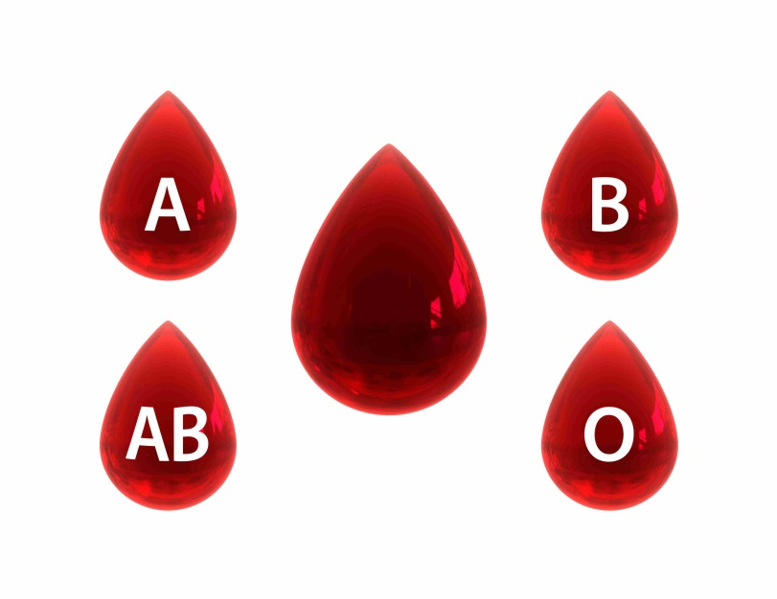
Co-dominance
When representing genotypes of co-dominant inheritance all UPPERCASE letters are used (as no allele is recessive)
For example: Blood groups are an example of co-dominance in humans as neither blood group is dominant over the other

Slide 50
Pedigree charts

Slide 51
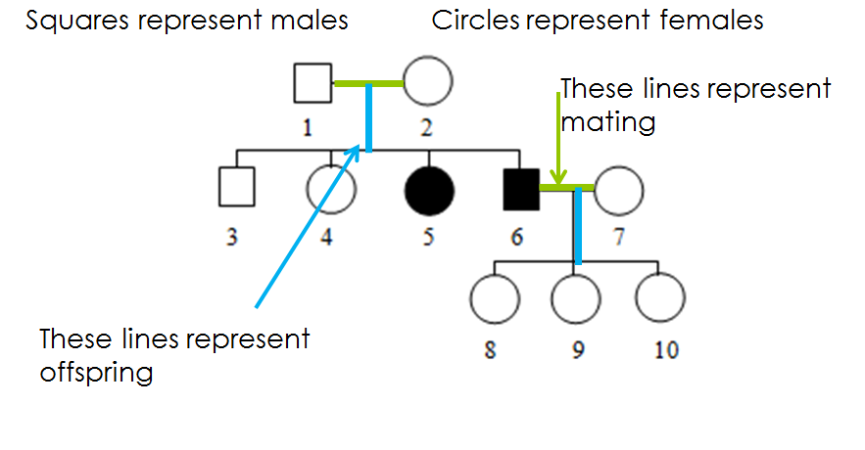
What do the symbols mean?

Slide 52
Watch!
http://www.youtube.com/watch?v=Wuk0W10EveU

Slide 53
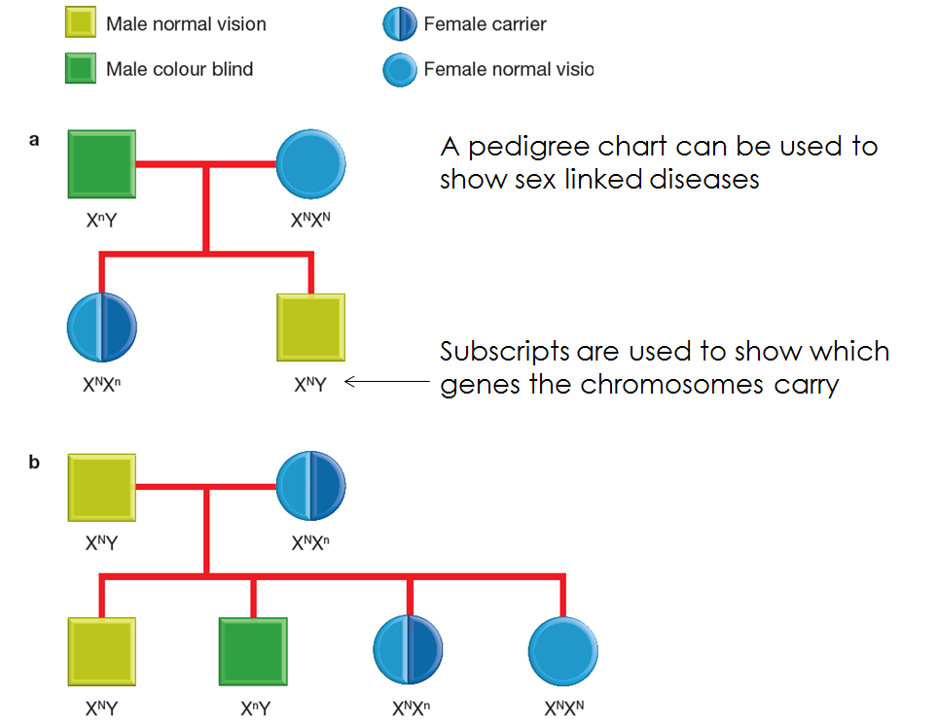
Note! Carrier females may not always be represented by a half shaded circles!

Slide 54
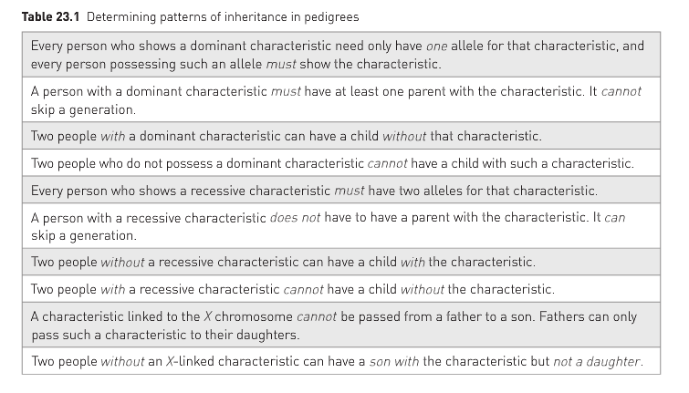
Rules for reading pedigrees..
Found on page 325 of text

