Slide 1
Australian Federation

Slide 2
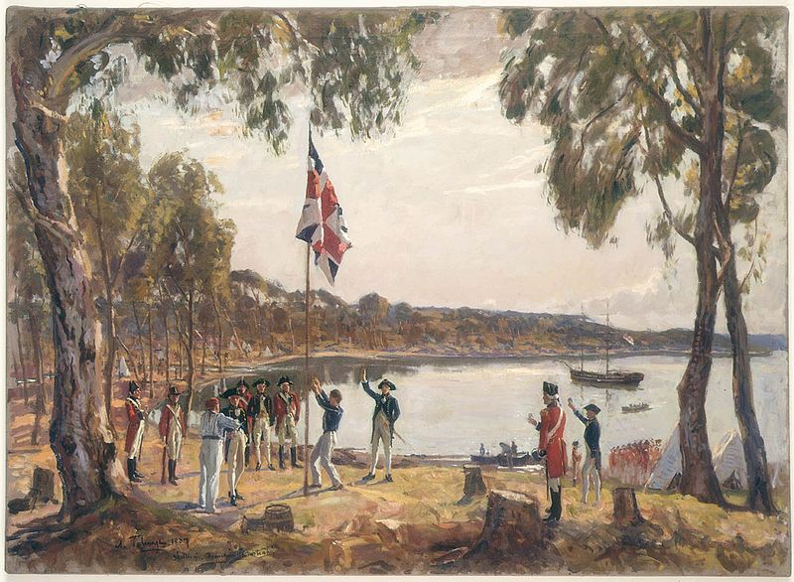

Slide 3
Colonial Government: Pre-1901
The colonies (1788 -1850) were ruled by autocratic governors with legislative, executive and judicial power.
As the free settler population increased, so to did the demand for a more representative government.
Early members of the Legislative Councils were appointed by the monarch.

Slide 4
Colonial Government: Pre-1901
The Australian Courts Act (1828) was passed by the British Parliament
It stated that English Law would apply to the two existing colonies of NSW and Van Dieman’s land (now called Tasmania).
The Australian Constitutions Act No 2, (1850) granted the colonies the right to establish their own constitutions and hence enjoy a limited degree of self-government.

Slide 5
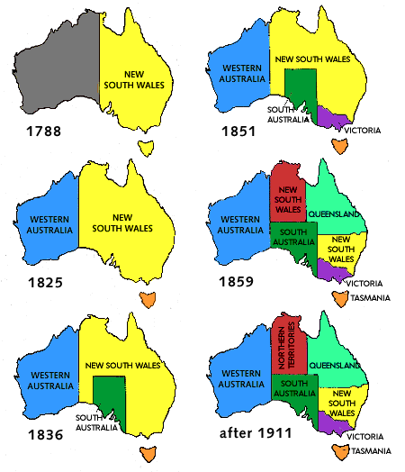

Slide 6
What is Federation
Federation is the bringing together of the colonies into a national union.
In Australia’s case this was the colonies of: New South Wales, Victoria, Queensland, South Australia, Tasmania and Western Australian
Intended to form a nation with a federal (national) government.

Slide 7
What is Federation
The colonies (which would later be known as states) would retain the Parliaments and legal systems that were already well established and continue to govern themselves on most of the issues they were doing already.
Certain matters of national significance would be taken over by the national government.

Slide 8
What is Federation
For Federation to occur an Australian Constitution had to be written and agreed to by the colonies, and then Parliament in Britain would need to pass it.
This happened on July 9 1900. On January 1, 1901, the first day of the twentieth century, the Commonwealth of Australia was proclaimed.
The states retained their systems of government and the Commonwealth Government (also known as the Australian or Federal Government) came into being.

Slide 9
Reasons for Federation - Defence
The inadequate level of defence.
Each colony had its own, small, military
It was reasoned that a large single defence unit was superior to a number of small, under funded colonial defence units.

Slide 10
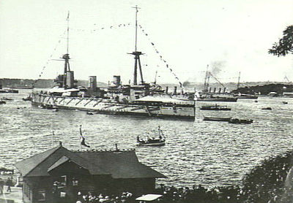

Slide 11
Reasons for Federation - Immigration
Many supported federation because they wanted to see immigration policies against non-Europeans strengthen.

Slide 12
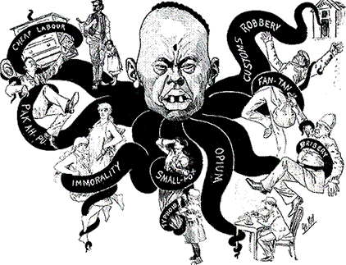

Slide 13
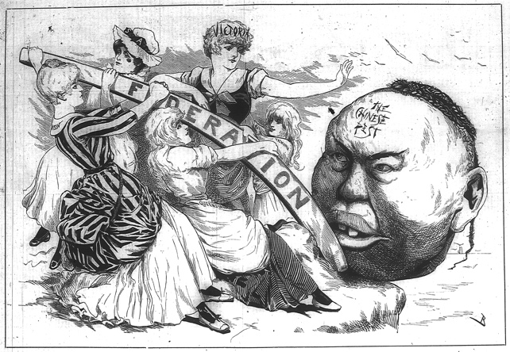

Slide 14
Reasons for Federation - Railways
Some were in favour of Federation so that a uniform railway gauge could be built thus aiding trade and defence links between the colonies.

Slide 15
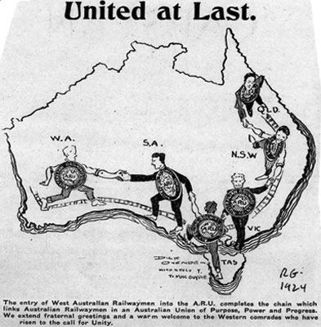

Slide 16
Reasons for Federation – Free Trade
Many people believed that an over-arching national or central government could establish free trade between the colonies.
Prior to federation a merchant wishing to trade between colonies had to pay taxes, making it less profitable.
This was bad for Australian economic growth.

Slide 17
Reasons for Federation – National Pride
Even before the colonies were united, the public felt a growing sense of national pride which caused them to want to establish a single united country.

Slide 18
Reasons against Federation
The level of opposition to Federation was significant.
The first Constitutional Convention was held in 1891,
It took another 10 years for Federation to be proclaimed.

Slide 19
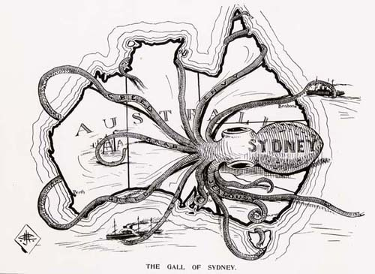

Slide 20
Reasons against Federation
The differences in economic policies between New South Wales (which tended to favour free trade) and Victoria (which, after 1860 was protectionist – had large taxes in imports)
The fears of the smaller colonies at being dominated by the larger ones
The large distances between the colonies
‘Social differences’ between the colonies
General public apathy (lack of interest) towards political issues

Slide 21
