Slide 1
Study Techniques
Human Biology
A.Williams

Slide 2
Find the study technique/s that work for you!
It’s all about memorising and learning how to answer questions well

Slide 3
Step one: Writing notes
Clear and brief
Link diagrams to structure to function
Labelled diagrams- annotate
Blue bolded words in text- know definitions
Don’t rewrite the whole book!
Use powerpoints to help summarise and add to notes from textbook.
Worksheets
Goal Setting
Colour

Slide 4
Step two: memorise
Find ways of memorising now that you understand content
Mnemonics
Songs
Videos- Step Up, Crash Course, Khan Academy
Posters/notes/palm cards/graphic organisers etc

Slide 5
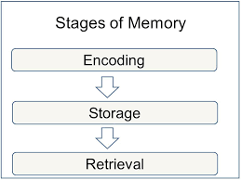
Step three: Answering Questions
Review Questions
Apply your knowledge questions
Worksheets
Study Guide
Practice Extended Responses
Highlight questions and understand what the question is asking
Look at marks allocated
Online Quizzes, Kahoot
Family members/friends to test you

Slide 6
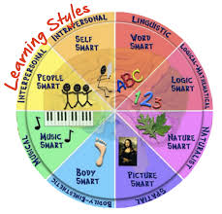
Useful Information
Look at your learning style:
http://www.educationplanner.org/students/self-assessments/learning-styles-quiz.shtml
Everyone learns differently and it’s important to know what works for you!

